Slide 1
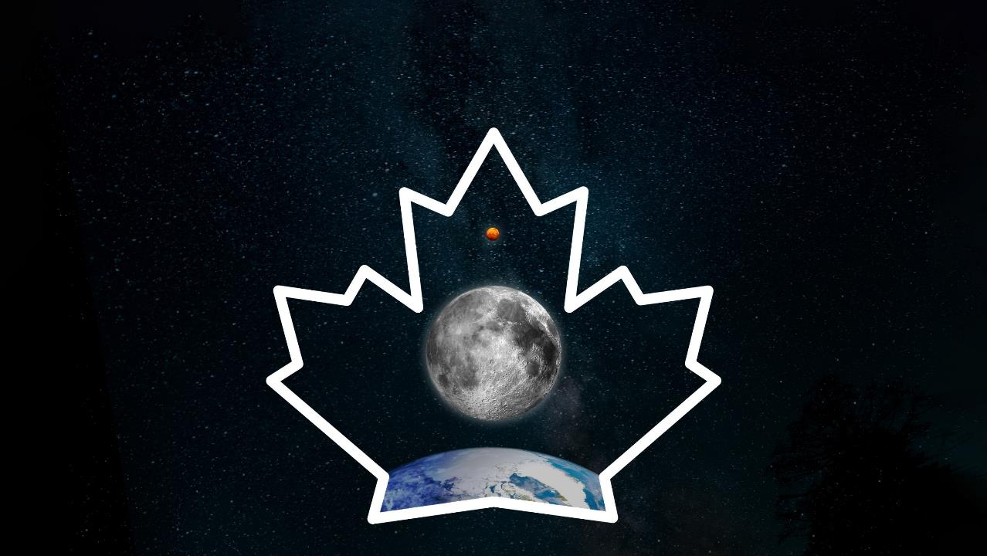



CANADA’S ROLE IN
MOON EXPLORATION
Notes:
Humanity’s return to the Moon
Thank you for having me here today. I am thrilled to talk to you about Canada’s role in lunar exploration.
Over 50 years ago, human beings first stepped on the Moon – our planet’s only natural satellite.
After maintaining continuous human presence aboard the International Space Station for over 20 years, only 400 kilometres above our planet, humanity is now getting ready to return to the Moon, a destination 1,000 times farther than the Space Station. And this time, the goal of this major international collaboration in human space exploration is to send humans deeper into space than we have ever been.
Canada’s role
Canada will be part of this great endeavour!
A Canadian astronaut will fly to the Moon on the historic Artemis II mission!
Canada is contributing to NASA’s Artemis campaign, a multi-mission campaign that will push human space exploration to the Moon and on to Mars. The campaign includes major initiatives like the Artemis missions and Gateway.
The Canadian Space Agency’s Lunar Exploration Accelerator Program (LEAP) funds a wide range of opportunities for Canadian science and technology activities in lunar orbit and on the Moon’s surface.
Text version: Canada’s role in Moon exploration (Credit: CSA)

Slide 2
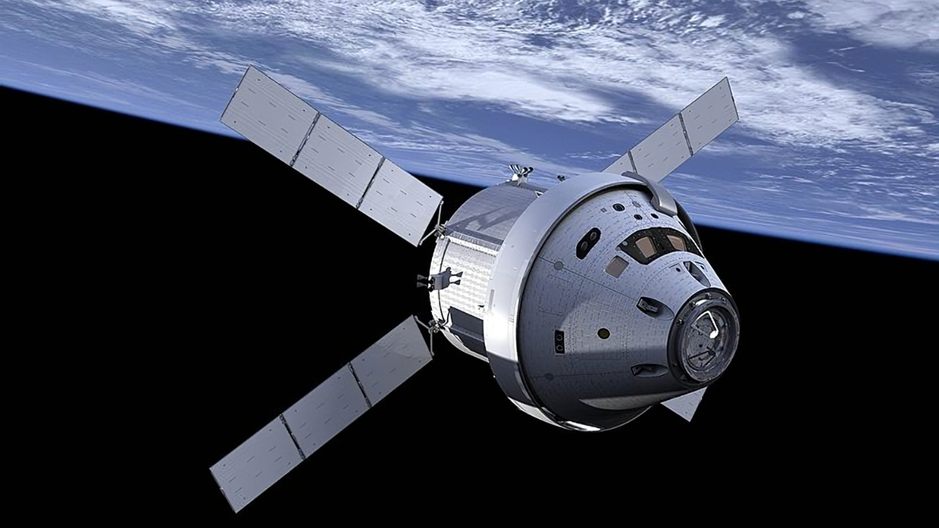
Artemis Missions
I
ARTEMIS I an uncrewed test flight
ARTEMIS II a crewed test flight
ARTEMIS III astronauts land on the Moon
II
III
IV
V
Notes:
The NASA-led Artemis campaign
Artemis is a new chapter of lunar exploration designed to send humans farther into space than ever before.
These increasingly complex missions lay the foundation for sustainable human and robotic exploration of the Moon, and onward to Mars.
Like the Apollo program over 50 years ago, Artemis begins with missions around the Moon before a mission that lands on the lunar surface.
After Artemis I, the successful uncrewed test flight that took place in 2022, comes Artemis II, currently planned for launch no earlier than September 2025.
Through the Artemis missions, NASA will land the first woman and the first person of colour on the lunar surface.
Text version: Artemis Missions. Artemis I: an uncrewed test flight; Artemis II: a crewed test flight; Artemis III: astronauts fly to the Moon. (Credit: NASA)

Slide 3
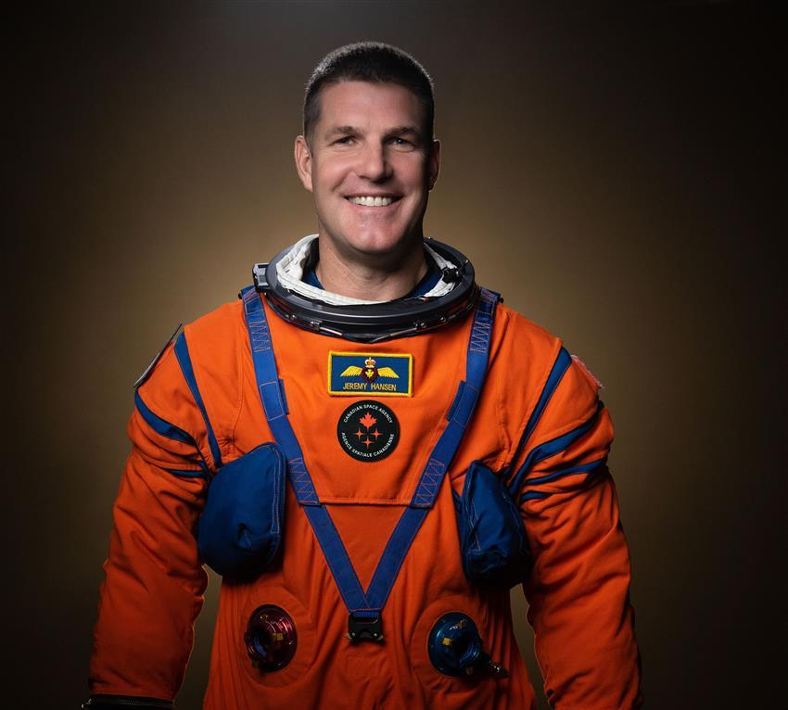
CSA astronaut Jeremy Hansen
Notes:
Canadian Space Agency astronaut Jeremy Hansen
And for the first time, a Canadian will make history by flying around the Moon.
Canadian Space Agency astronaut Jeremy Hansen will be part of a new generation of space explorers.
With Artemis II, Canada will become the second country to have an astronaut fly around the Moon.
Canada’s seat is assured by Canadian Space Agency astronaut Jenni Gibbons, who is assigned as the Canadian backup on the mission. She is taking all the same training and will be ready to step in if Jeremy is unable to take part.
Jeremy will bring Canadians along on his journey to the Moon by sharing about his training, preparation, and mission through video logs, or vlogs, and on social media. Be sure to follow for updates!
Text version: CSA astronaut Jeremy Hansen (Credit: NASA)

Slide 4
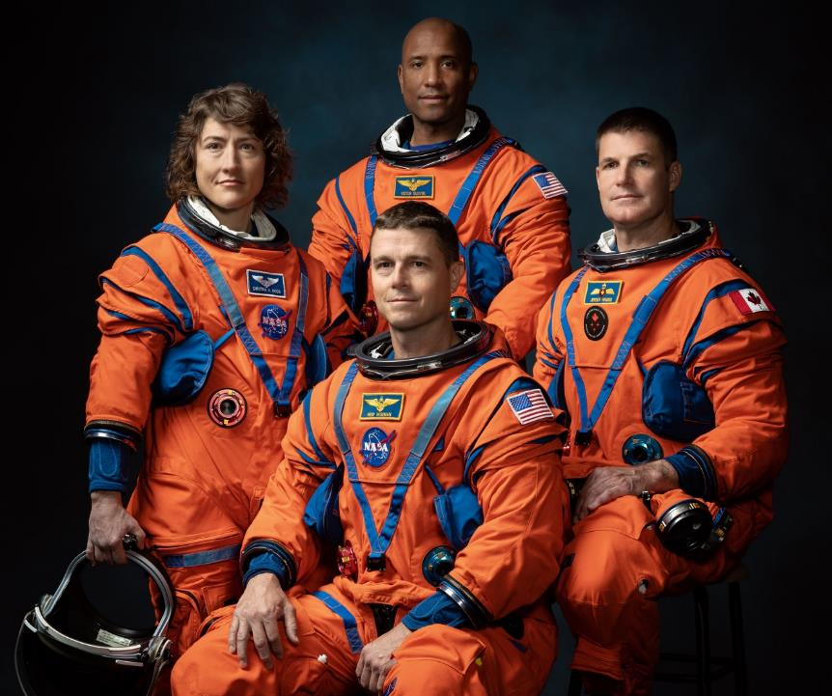
Artemis II crew
Reid Wiseman
Victor Glover
Christina H. Koch
Jeremy Hansen
Notes:
Artemis II crew
Jeremy will join three NASA astronauts: Commander Reid Wiseman (sitting, in the middle), pilot Victor Glover (standing in the back), and mission specialist Christina Koch (standing to the left) aboard the Orion spacecraft.
They will spend approximately 10 days away from Earth as they test Orion’s systems in Earth orbit and proceed onward to the far side of the Moon.
Text version: Artemis II crew: Reid Wiseman, Victor Glover, Christina H. Koch, Jeremy Hansen (Credit: NASA)

Slide 5
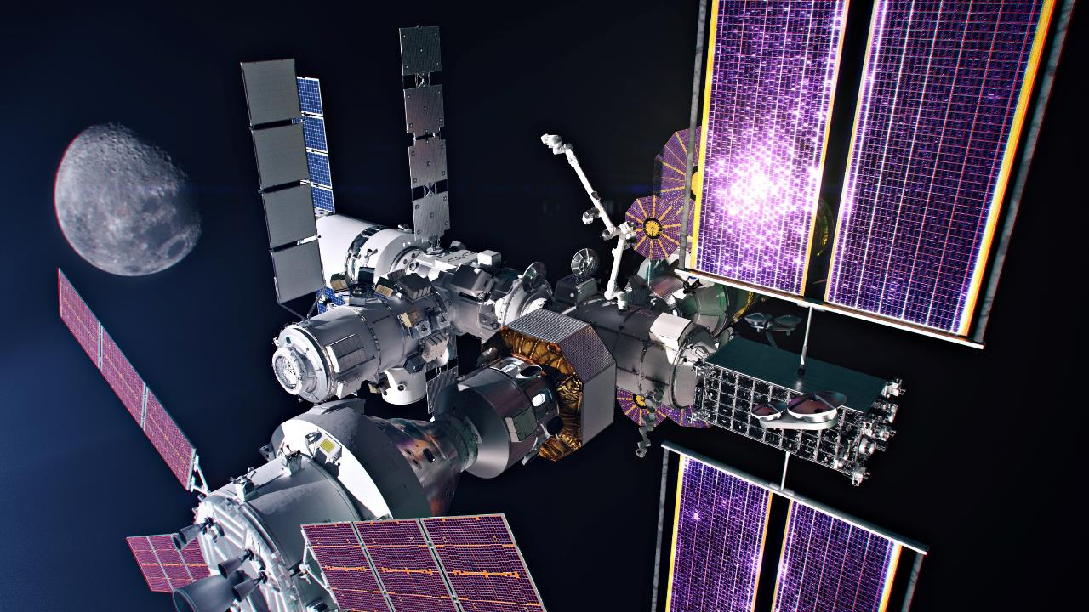
Notes:
Jeremy Hansen is part of the Artemis II flight thanks to Canada’s contribution to Gateway.
Gateway:
is a small space station that will orbit the Moon
is about one-sixth the size of the International Space Station
will include modules for science research and living quarters for crews of four astronauts
is an international partnership led by NASA
The first two elements of Gateway – the Power and Propulsion Element (PPE) and the Habitation and Logistics Outpost (HALO) – will launch together no earlier than 2025. Other modules will be added afterwards.
Canada’s contribution, Canadarm3, is scheduled to launch no earlier than 2029.
Gateway is expected to support science and technology demonstrations by 2026. Canada will have the opportunity to conduct a variety of scientific experiments aboard Gateway.
Gateway will be:
a science laboratory
a test bed for new technologies
a rendez vous location for exploration of the surface of the Moon
a mission control centre for operations on the Moon
one day, a stepping stone for voyages to Mars
Text version: Gateway (Credit: NASA/Alberto Bertolin/Bradley Reynolds)

Slide 6
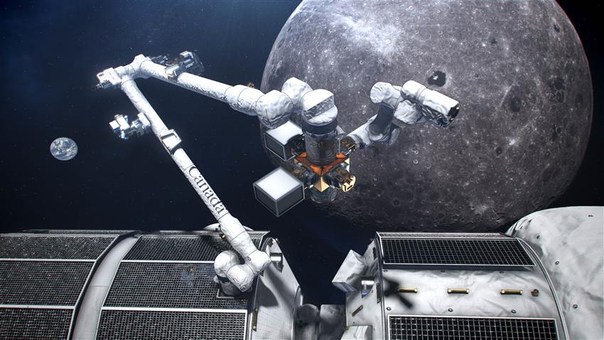
Canadarm3
Notes:
Canada’s contribution: Canadarm3
Canadian robotic system that will perform some tasks around the Moon without human intervention.
The system will also be operated by robotics flight controllers in Canada, or by Gateway crew.
could be used to
maintain, repair and inspect Gateway
relocate Gateway modules
help astronauts during spacewalks
enable science in lunar orbit
catch spacecraft visiting Gateway
Text version: Canadarm3 (Credit: NASA/CSA)

Slide 7
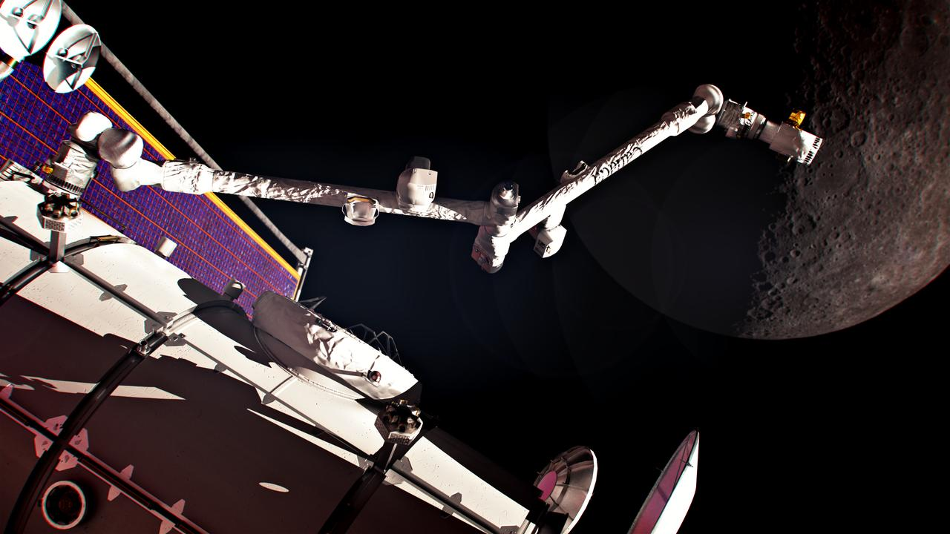
Notes:
Canadarm3
is composed of:
a large arm
a small, agile arm that:
will transfer mission-critical material between the interior and exterior of the space station
will repair the large arm if necessary
a set of detachable tools
will be able to travel the entire length of Gateway by moving end-over-end with anchoring “hands”
What Canada gets in return
opportunities for science on the Moon’s surface and in lunar orbit
technology demonstrations
commercial activities, as Canadian companies will be given a wide range of opportunities to test innovative technologies in lunar orbit and on the lunar surface
two astronaut flights: Jeremy Hansen’s historic participation in Artemis II and another flight to Gateway
(Credits: Alberto Bertolin, Bradley Reynolds)

Slide 8
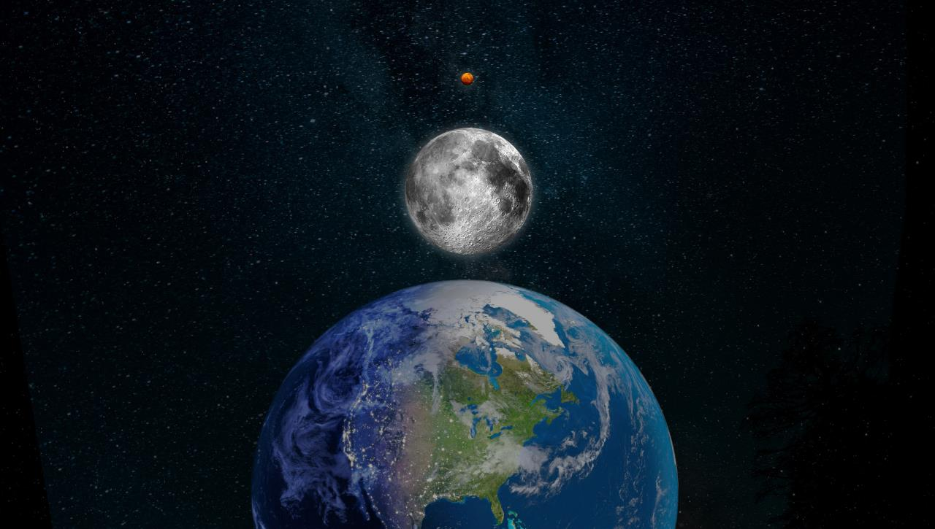
LEAP: Lunar Exploration Accelerator Program
Notes:
Opportunities for lunar science and technology
A lot of technology development and science are needed to support these exciting missions ahead.
The Lunar Exploration Accelerator Program (LEAP) opens doors to a wide range of opportunities for Canadian science and technology activities in lunar orbit or on the Moon’s surface.
Text version: LEAP: Lunar Exploration Accelerator Program (Credit: CSA)

Slide 9
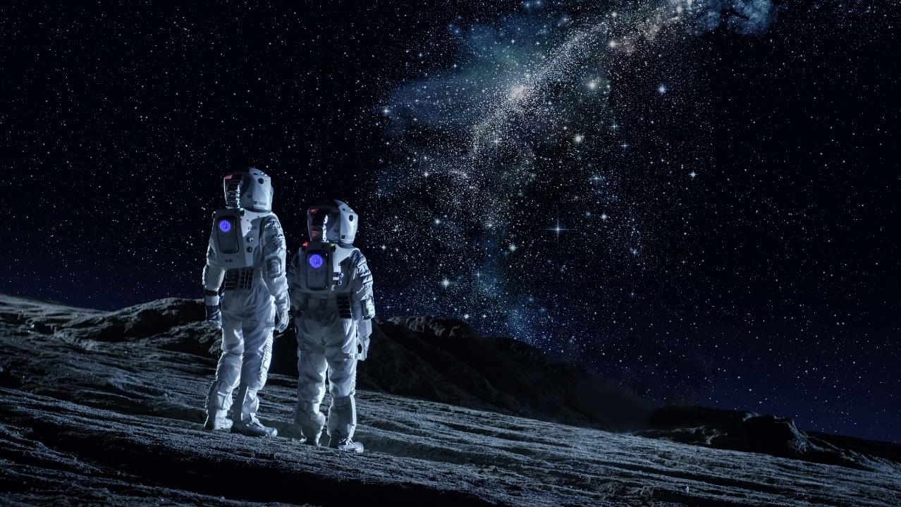
Remote healthcare
Notes:
Advances in remote healthcare
An important challenge of these long missions to the Moon and Mars is to keep astronauts safe and healthy.
Astronauts in space have limited access to healthcare providers and medical resources, as well as long travel times to healthcare facilities. These are in fact similar to challenges faced by people living in remote communities here on Earth.
Through LEAP’s health-based initiative, Health Beyond, the Canadian Space Agency is working closely with experts to find solutions in remote and autonomous healthcare that will benefit both astronauts in space and Canadians living in remote areas.
Text version: Remote healthcare (Credit: CSA)

Slide 10
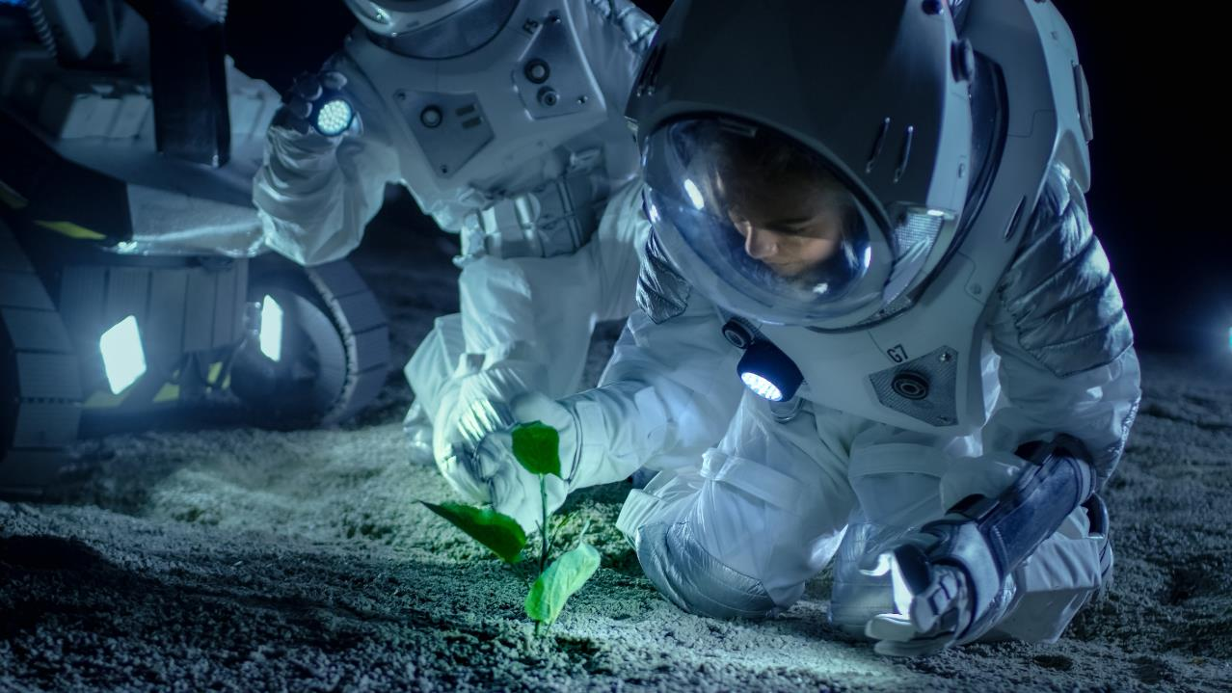
Food production
Notes:
Food production
Another aspect to consider when planning for future missions is food availability and production. Astronauts on the International Space Station not only bring food with them, but they can also get fresh food shipped from Earth on a regular basis. Astronauts taking part in longer missions in deeper space will need to be more self-sufficient.
The Canadian Space Agency is supporting the development of efficient techniques for growing food in harsh environments both in space and on Earth.
Technologies designed to produce tasty and nutritious food with minimal resources are not only for use on long-duration space missions, but also have the potential to benefit people living in remote and harsh environments like Canada’s North.
Text version: Food production (Credit: CSA)

Slide 11
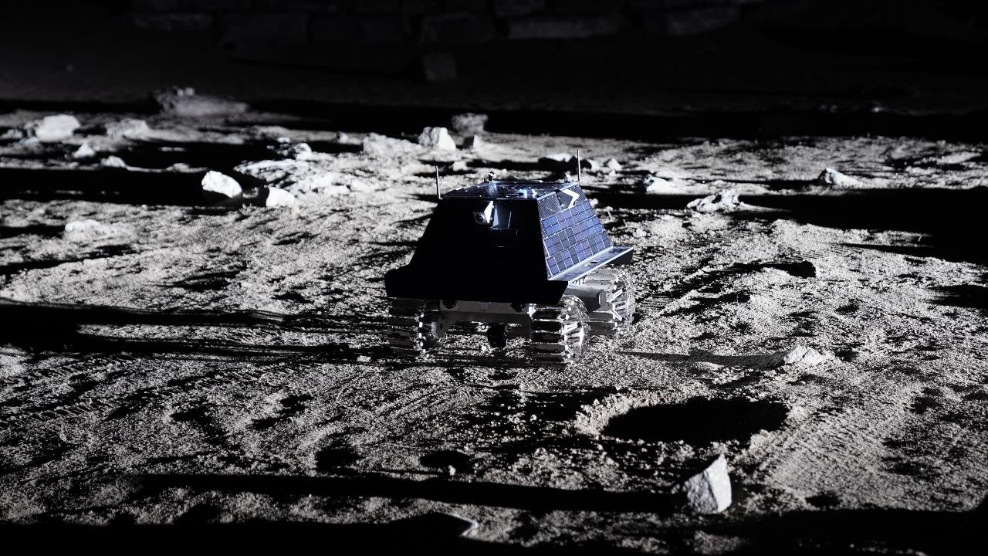
Canadian Lunar Rover
Notes:
Lunar exploration
Canadian lunar rover
Canada is sending a rover to the Moon!
The development, launch, and operation of a Canadian lunar rover is one of the exciting technology demonstrations under LEAP.
Canadensys is building the rover and developing its Canadian payloads.
The science rover will:
be designed to survive a lunar night – which lasts 14 Earth days and is extremely cold and dark
explore the Moon’s south pole to find water ice
be sent to the Moon no earlier than 2026
The rover will navigate the surface of the Moon to test and demonstrate key systems like surface mobility, telecommunications, dust mitigation, navigation, and remote semi-autonomous control. The hydrogen and oxygen from lunar water ice could be used as fuel for future missions to Mars!
Text version: Canadian lunar rover (Credit: CSA)

Slide 12
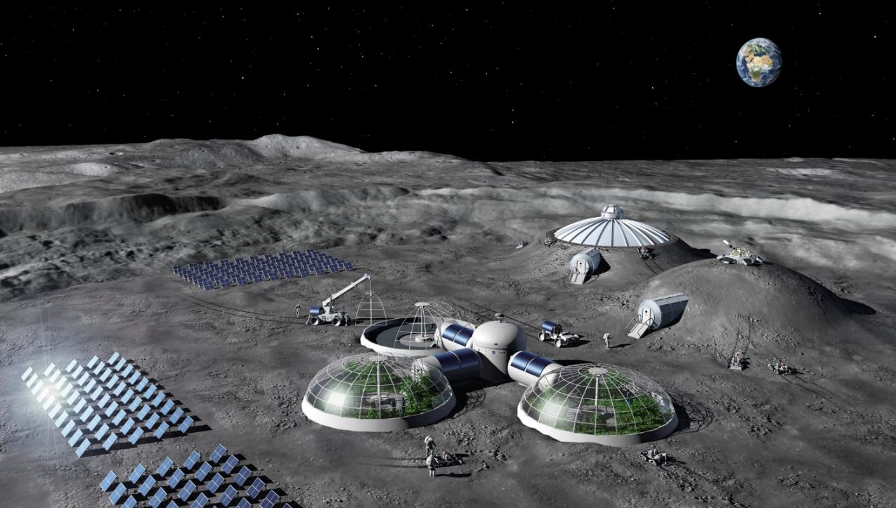
Lunar Utility Vehicle
Notes:
Lunar utility vehicle
Canada will also design, build and operate a lunar utility vehicle.
The Canadian lunar utility vehicle will be available to provide critical assistance to astronauts on the Moon and support operations.
Investments through the next phase of LEAP will enable the development of new technologies for the lunar utility vehicle.
Text version: Lunar utility vehicle (Credit: ESA – P. Carril)

Slide 13
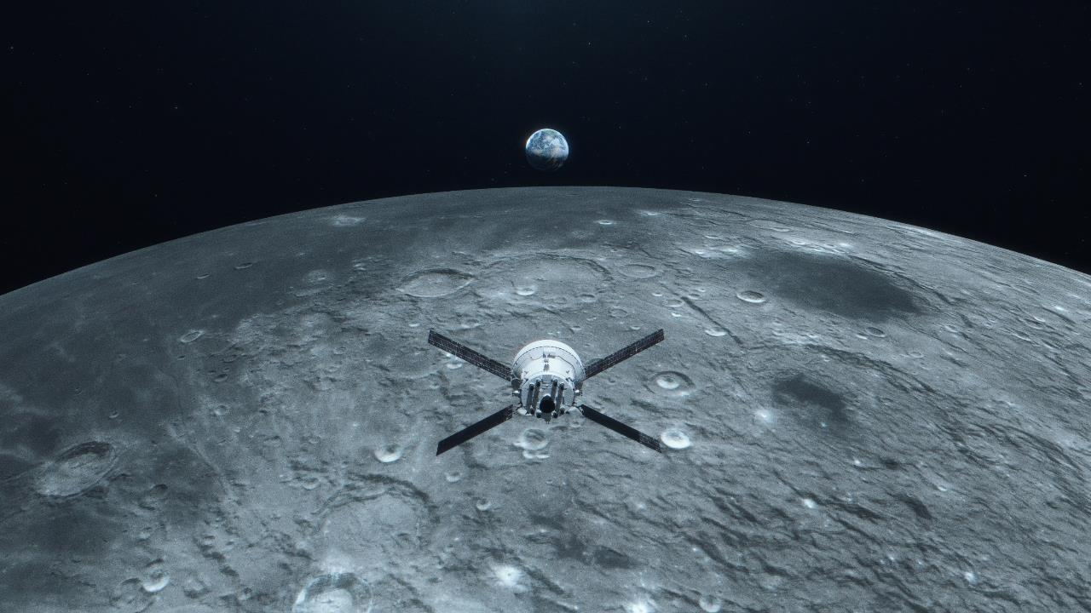
The future of space exploration
Notes:
Conclusion
These are exciting times for Canada!
This new era of lunar exploration provides opportunities for Canadian companies and researchers, who are ready to take advantage of this international effort by contributing smart innovations, cutting‑edge technologies, and world-leading science.
These upcoming missions to new destinations will inspire young Canadians to reach for the stars and become the next generation of scientists, engineers, and explorers.
(Credit: NASA/Liam Yanulis)

Slide 14

Notes:
End – CSA website and social media
To stay up to date on Canada’s role in going back to the Moon, visit the Canadian Space Agency’s website and follow us on social media.
Text version: Follow us on social media. Suivez-nous dans les médias sociaux. asc-csa.gc.ca (Credit: CSA, NASA)

