Slide 1
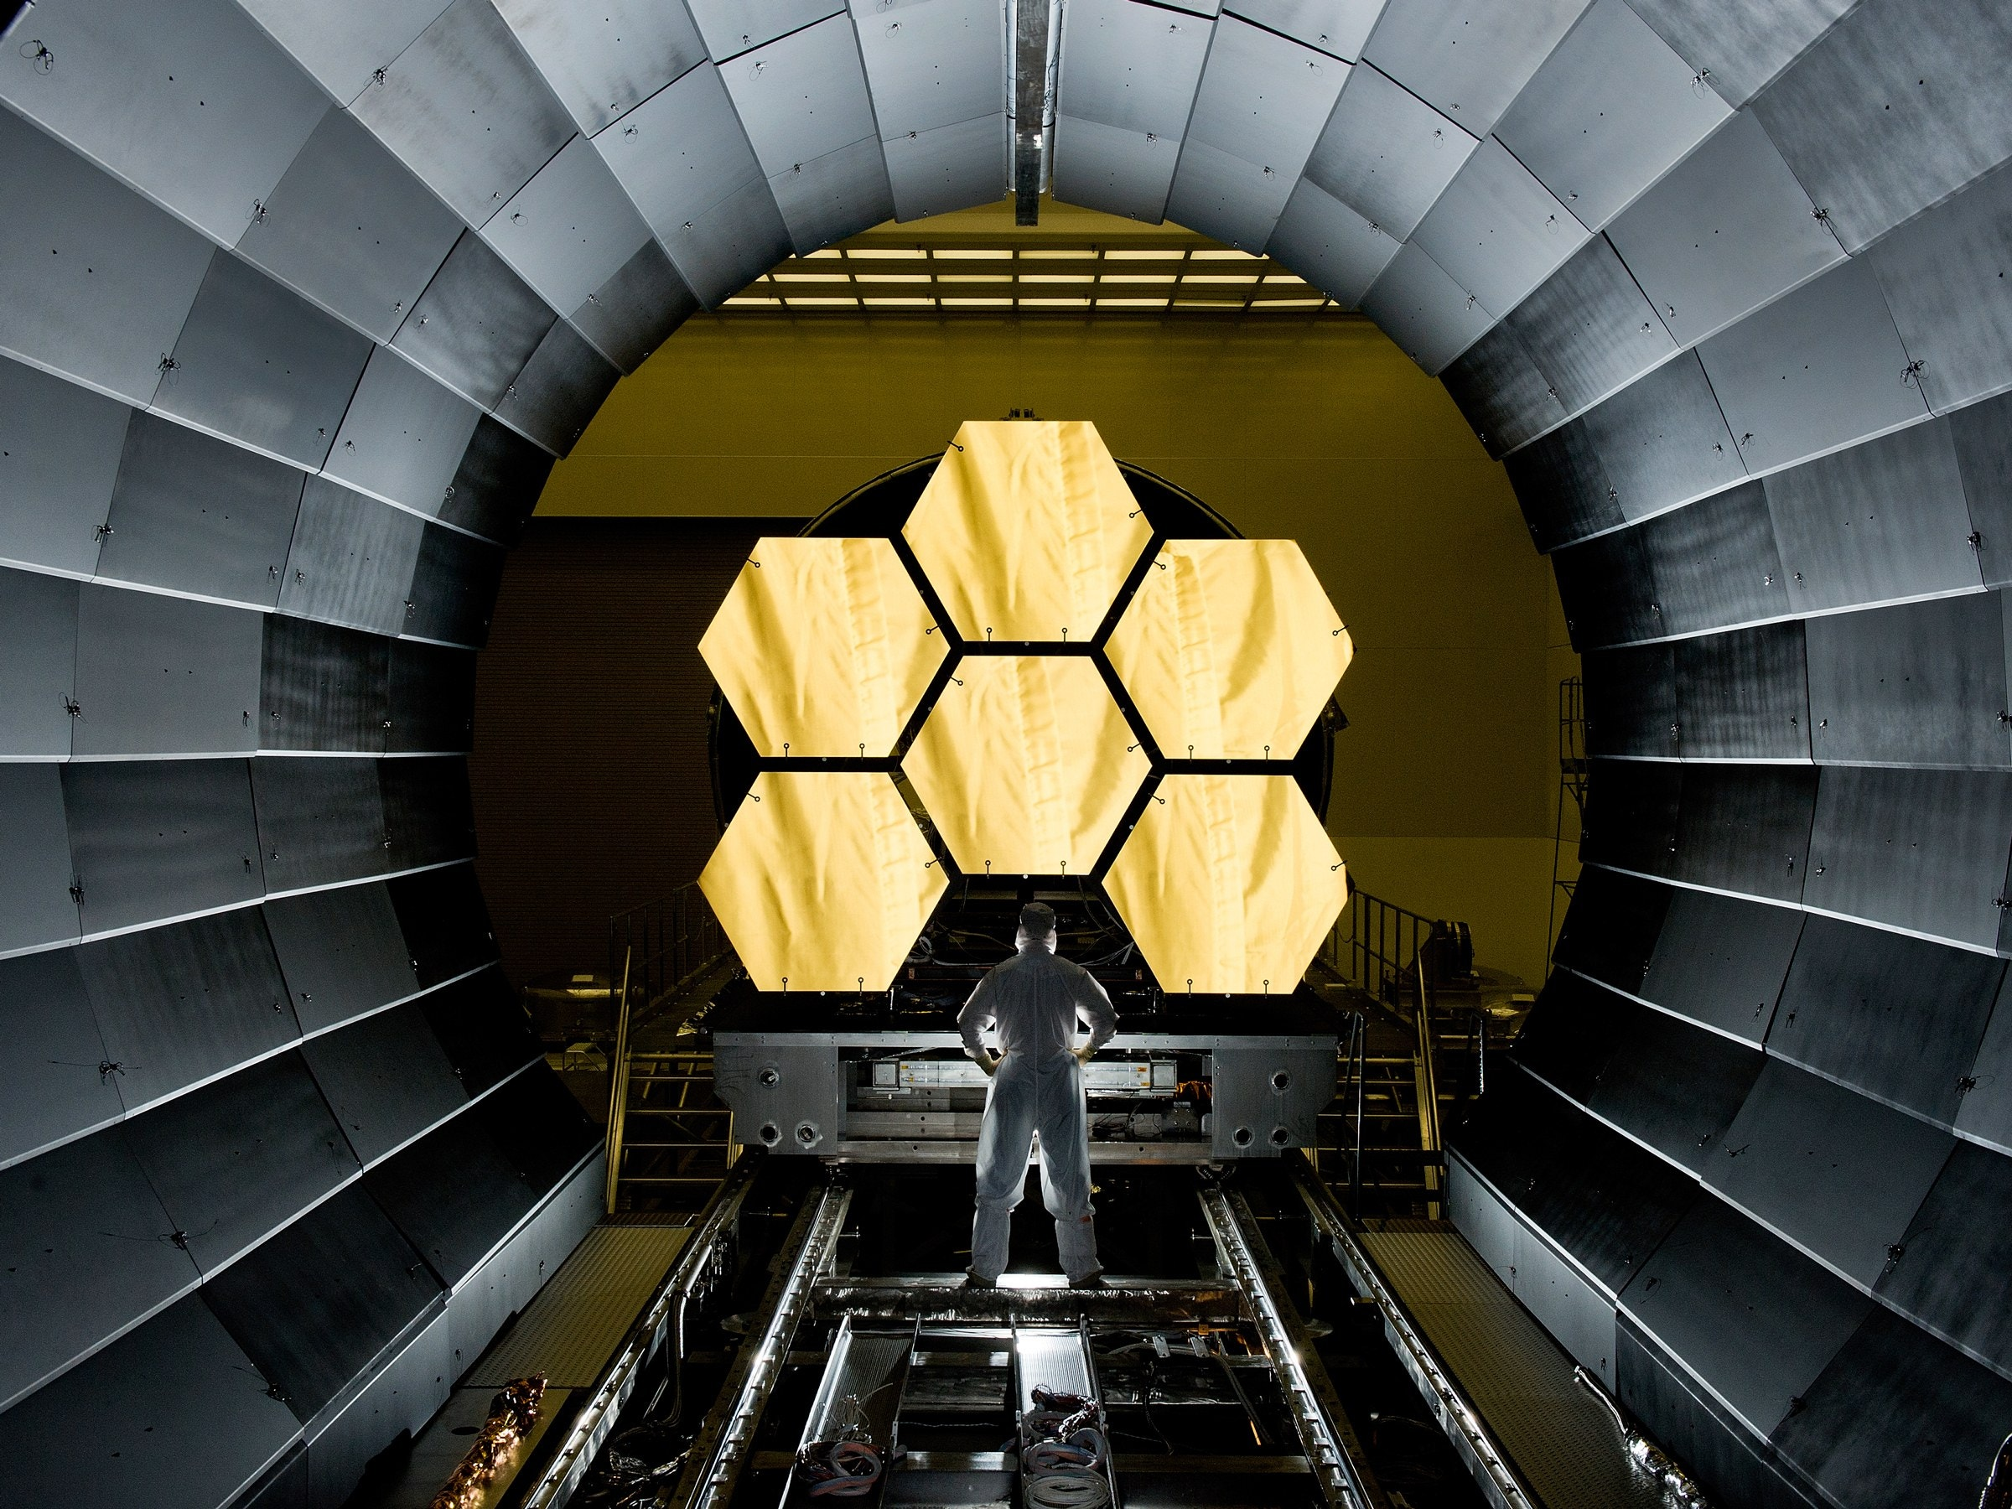
The James Webb Space Telescope
Canada’s role in the exploration of the universe
Notes:
Thank you for having me here today. I am really excited to talk to you about a mission that will take us on a journey back in time: the James Webb Space Telescope. Webb will help answer some of astronomy’s biggest questions.
Image credit: NASA/David Higginbotham

Slide 2
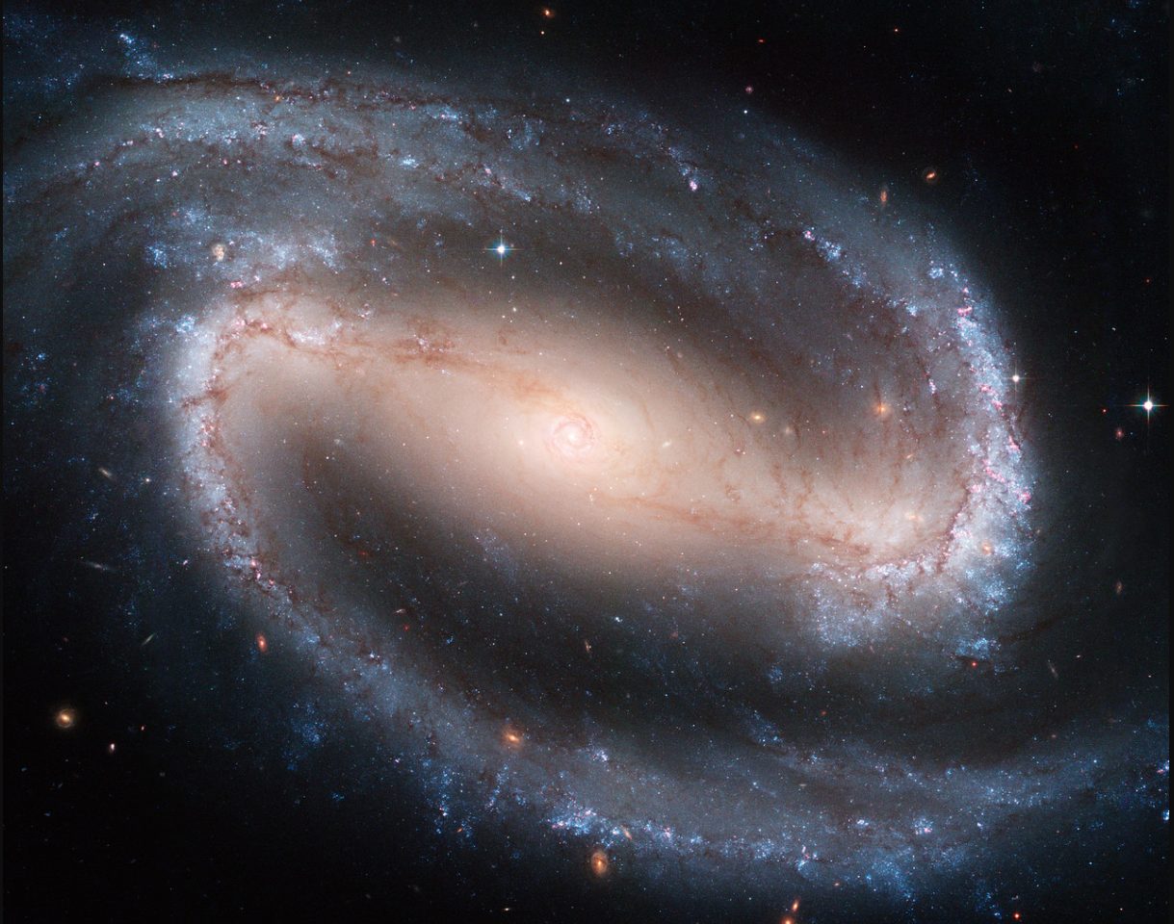
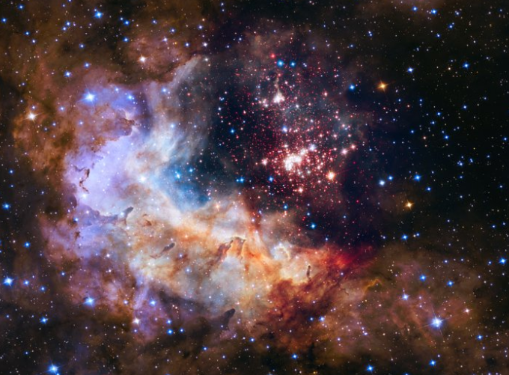
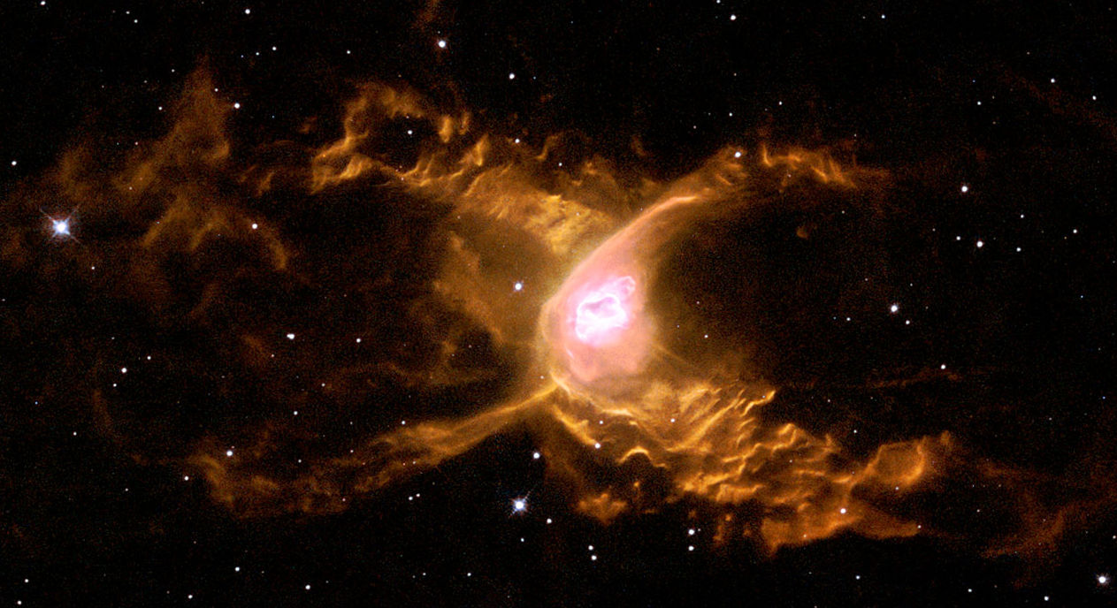
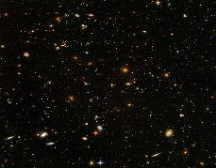
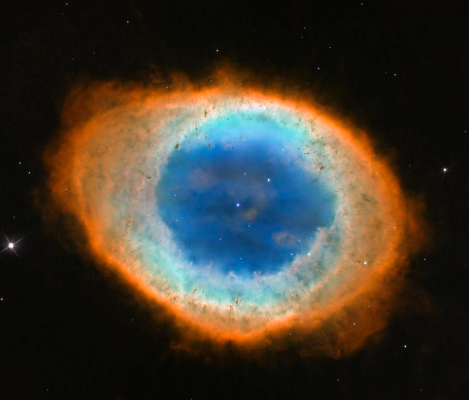
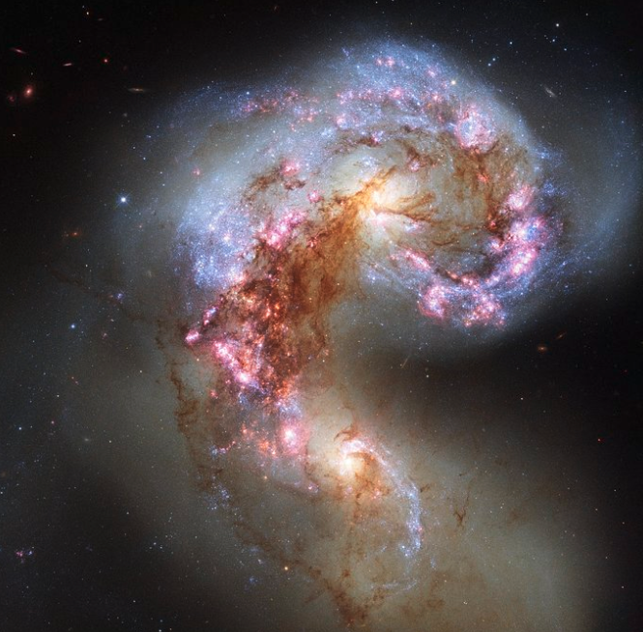
Notes:
Astronomy is one of the oldest sciences, practised around the world for millennia.
Over time, researchers have developed more and more sophisticated methods to collect information about the planets, stars, and galaxies that surround us. We have some ground-based telescopes around the world that collect data every night. Another way of learning more about the universe is sending telescopes to space.
Image credits: NASA/Hubble/ESA/STScI

Slide 3
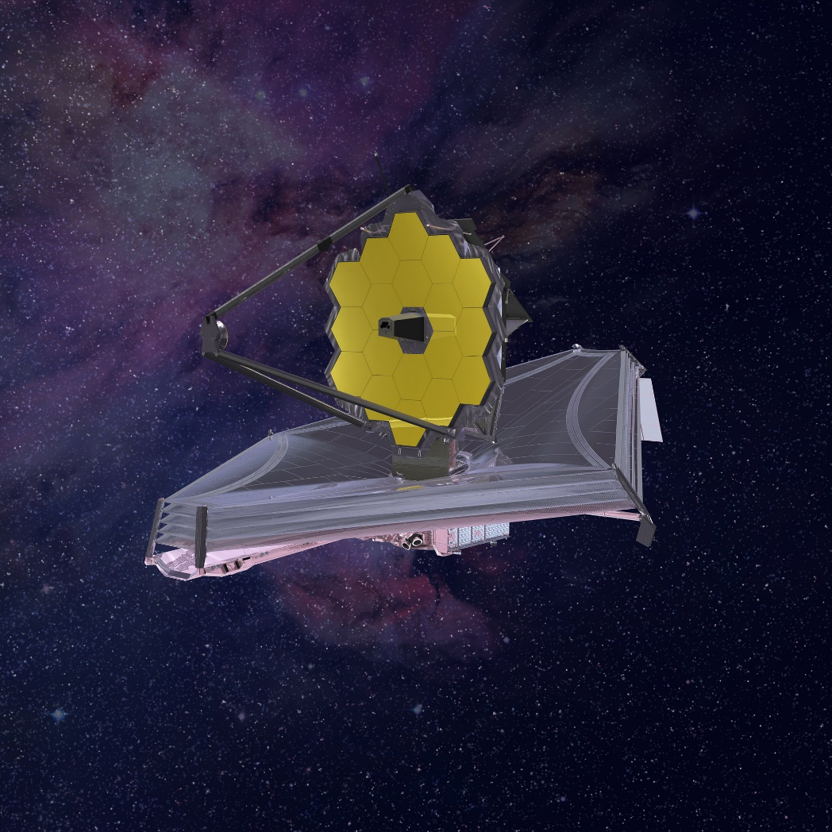


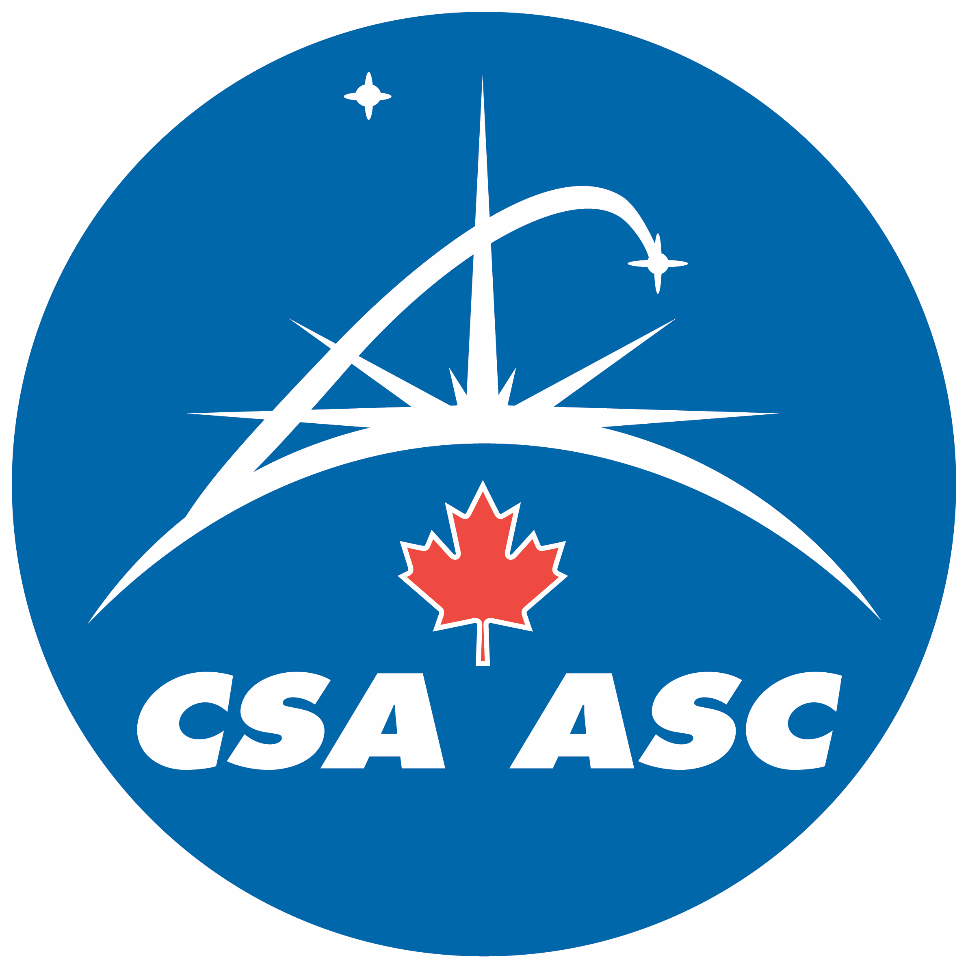
Notes:
Now, comes a space telescope that opens a whole new chapter in astronomy: the James Webb Space Telescope. Webb is an international collaboration between NASA, the European Space Agency, and the Canadian Space Agency.
1) Webb is the most complex and powerful space telescope ever built. With its massive golden mirror, and by studying the universe in the infrared light, Webb can peer farther back in time and detect light from the earliest stars and galaxies.
2) Canada has contributed the Fine Guidance Sensor, the “eyes of the telescope,” and NIRISS, one of the four scientific instruments onboard.
3) This contribution earns Canadian researchers a piece of Webb’s exciting mission, giving them observation time that promises to revolutionize our understanding of the universe.
Image credit: NASA

Slide 4
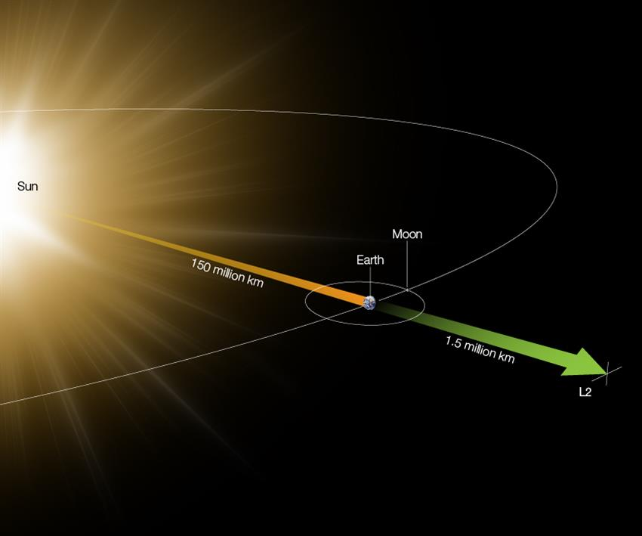
From its vantage point 1.5 million km away from Earth, Webb will use infrared light to study every phase in cosmic history.
Notes:
Webb’s destination is a point in space called Lagrange 2, or L2 – one and a half million kilometres away from Earth. Its considerable distance from Earth means that it cannot be serviced in space.
With Webb, astronomers will study every phase in cosmic history, from the light in the early universe from only a few hundred million years after the Big Bang and the formation of stellar systems to the search for clues of life on exoplanets and the evolution of our own solar system.
Image text: From its vantage point 1.5 million km away from Earth, Webb will use infrared light to study every phase in cosmic history.
The graphic illustrates the second Lagrange point, or L2, which is 1.5 million kilometres from Earth, opposite the Sun. The Sun and Earth are 150 million kilometres apart.
Image credit: ESA, CSA

Slide 5
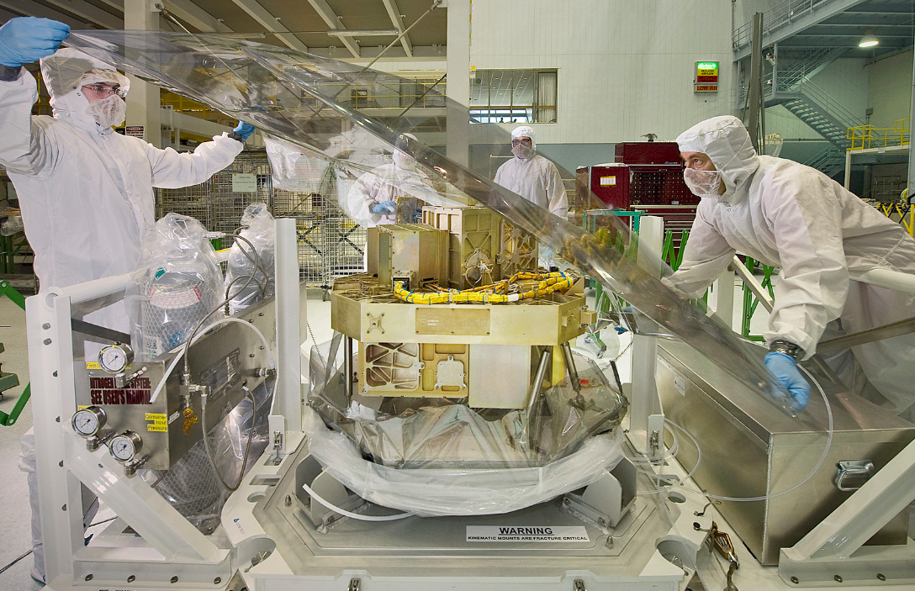
Canada has contributed the Fine Guidance Sensor (FGS) and the
Near-Infrared Imager and Slitless Spectrograph (NIRISS) instrument.
Notes:
Canada’s role
The Canadian Space Agency is contributing two highly important elements, built by Canadian company COM DEV, now a division of Honeywell.
Contributing the Fine Guidance Sensor and the NIRISS instrument to Webb means that Canadian astronomers have an allotted time for observations.
The Canadian-made FGS will allow Webb to:
+ determine its own position in space;
+ locate and track its celestial targets; and
+ remain steady with very high precision, on specific targets.
The FGS will play an important role in all scientific observations made by Webb and will help stabilize the telescope to ensure the collection of clear and detailed images.
Image credit: NASA
Image text: Canada has contributed the Fine Guidance Sensor (FGS) and the Near-Infrared Imager and Slitless Spectrograph (NIRISS) instrument.

Slide 6
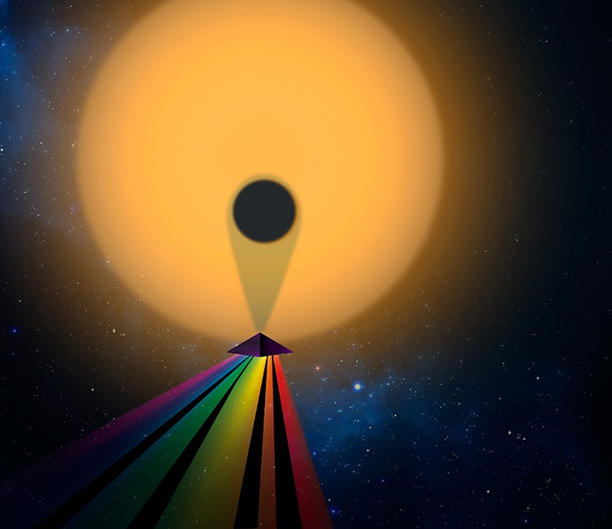
NIRISS measures the unique atmospheric fingerprint (spectrum)
of planets orbiting distant stars.
Using Webb, scientists could find habitable exoplanets if their spectra reveal the presence of important molecules like water, carbon dioxide, methane and oxygen in their atmospheres.
Notes:
The search for life in other worlds begins with the search for clues of life.
By measuring the unique properties of the light that filters through the atmosphere of an exoplanet as it passes in front of its host star, we can detect the presence of specific molecules in that atmosphere – similar to creating a fingerprint of each exoplanet. And seeing if it’s a match!
The Canadian NIRISS instrument will enable scientists to:
+ determine the composition of exoplanets’ atmospheres;
+ observe distant galaxies; and
+ examine faint light sources in the vicinity of bright objects.
Image credit: Christine Daniloff/MIT, Julien de Wit
Image text: NIRISS measures the unique atmospheric fingerprint (spectrum)
of planets orbiting distant stars. Using Webb, scientists could find habitable exoplanets if their spectra reveal the presence of important molecules like water, carbon dioxide, methane and oxygen in their atmospheres.

Slide 7
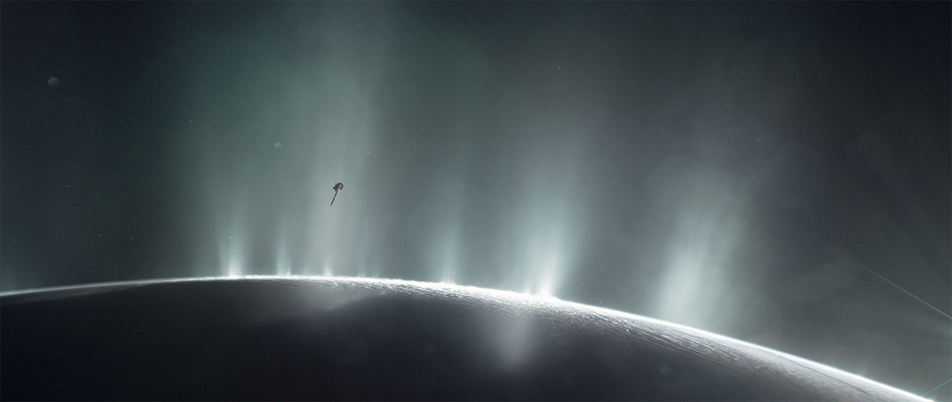
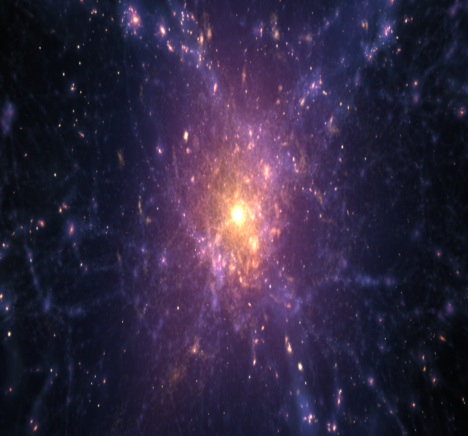
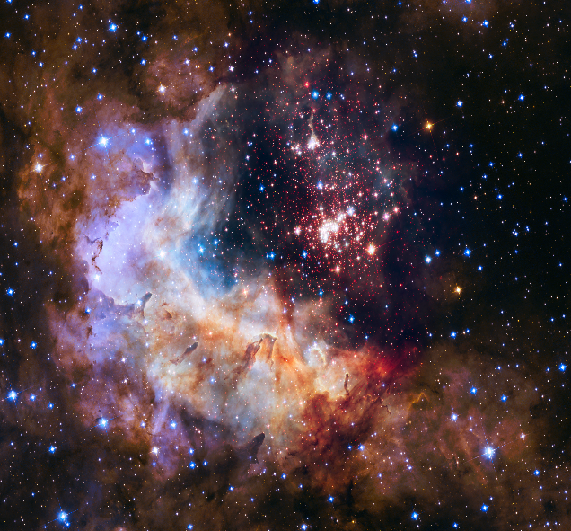
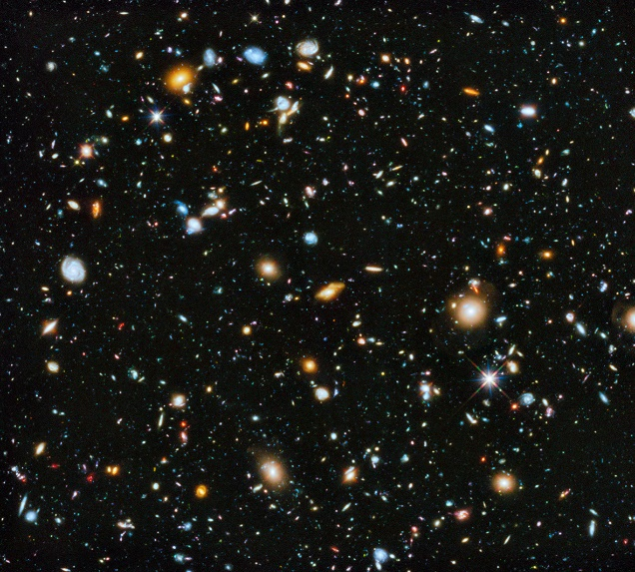
Webb: A new chapter in astronomy
Other worlds
Early universe
Star lifecycle
Galaxies over time
Notes:
From a science perspective, Webb represents the beginning of a new chapter in astronomy, and promises to really deepen our understanding of the cosmos.
Webb has four main science objectives:
OTHER WORLDS
Looking outwards from Earth, Webb will observe some of the planets of our own solar system, and some of their moons: for example, Saturn’s icy moon Enceladus. Farther from home, we know of over 4000 exoplanets with likely thousands more to discover.
LIFECYCLE OF STARS
Certain areas are known as star nurseries, star-forming regions like the red portion of this image.
Webb will give us new insight about how stars begin to form, evolve over their lifetime, and how they run out of fuel and eventually die.
EARLY UNIVERSE
Webb will look back in time to observe some of the oldest light of the early universe.
GALAXIES OVER TIME
Because Webb’s powerful gaze acts like a time machine, allowing us to see the universe as it used to be, the space telescope will allow us to observe galaxies over time.
Galaxies are subject to the powerful gravitational forces that sometimes bring them into contact with one another, where they often merge. This will happen to our Milky Way and our closest galactic neighbour, Andromeda Galaxy.
Image credits: NASA/ESA/STScI
Image text: Webb: A New Chapter in Astronomy. Other worlds, Star lifecycle, Early universe, Galaxies over time.

Slide 8
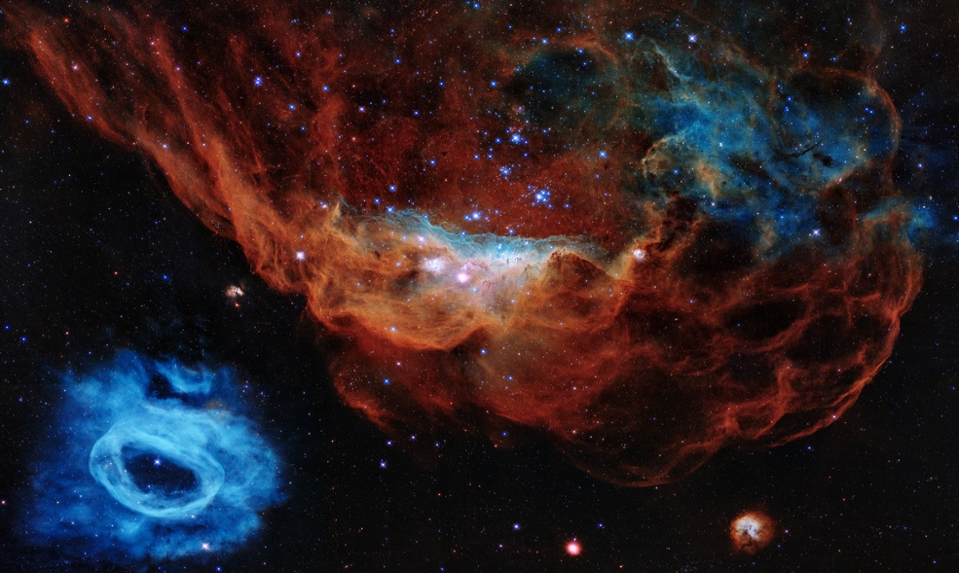
Notes:
NASA, ESA and the Canadian Space Agency have come together and built the world’s most complex and powerful space telescope.
Canada contributed the Fine Guidance Sensor and one of the four scientific instruments.. Thanks to this contribution, Canadian astronomers and scientists will take part in Webb’s exciting science mission that promises to revolutionize our understanding of the universe.
Image credits: NASA/Hubble/ESA/STScI

Slide 9
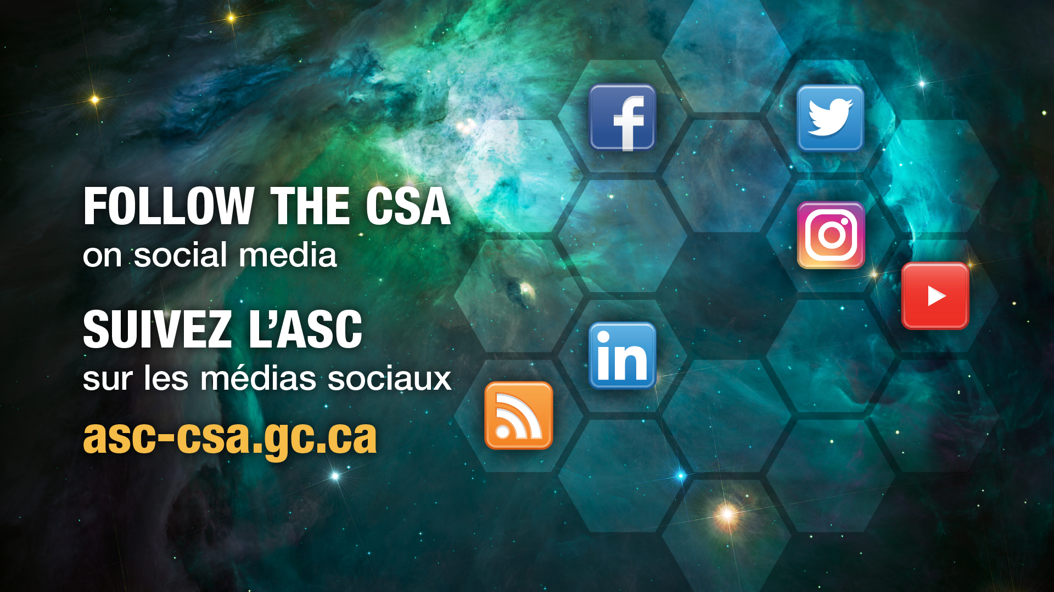
Notes:
To stay up to date on the Webb Telescope’s mission, visit the Canadian Space Agency’s website and follow us on social media.
Image: CSA
Image text: Follow the CSA on social media. Suivez l’ASC sur les médias sociaux. asc-csa.gc.ca.

Slide 10

People of Webb
Notes:
Projects like Webb rely on international collaboration with people of various backgrounds and expertise. Behind the scenes, there are talented people from academia, the private sector and government.
Here are some of the experts behind Canada’s participation in the James Webb Space Telescope. Among them are astrophysicists, physicists, scientists, researchers, engineers, and astronomers.
https://www.asc-csa.gc.ca/eng/humans/people-of-webb.asp
Image credit: CSA

Slide 11
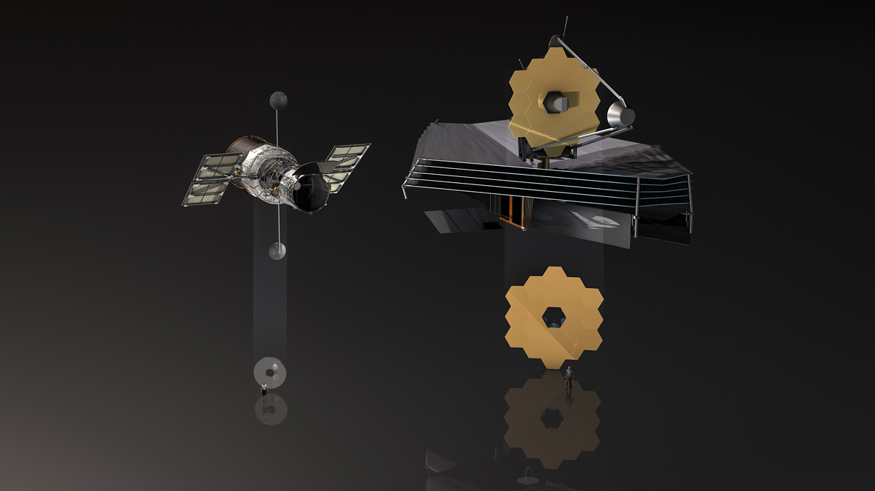
Notes:
There are three main differences when comparing Hubble with Webb:
Wavelength: Hubble’s main focus is on visible and ultraviolet light whereas Webb has been designed to focus on the infrared part of the spectrum. But why are infrared observations important to astronomy? Stars and planets that are just forming lie hidden behind dust that absorb visible light. Infrared light can penetrate this dusty shroud and reveal what is inside. Also, as the universe expands, the blue light of its oldest objects must travel great distances to reach us. This light is stretched and becomes redder as it moves through space. Webb is suited to gather this light. This will allow Webb to see farther back in time.
Size: Webb has an approximate 6.5-metre diameter primary mirror. Hubble’s mirror is a much smaller 2.4 metres in diameter, giving Webb around 6.25 times more collecting area!
Orbit: Hubble orbits Earth ~570 km above it. Webb will not orbit Earth: it will orbit the Earth–Sun L2 Lagrange point, 1.5 million km away.
Image credit: ESA/M. Kornmesser

Slide 12
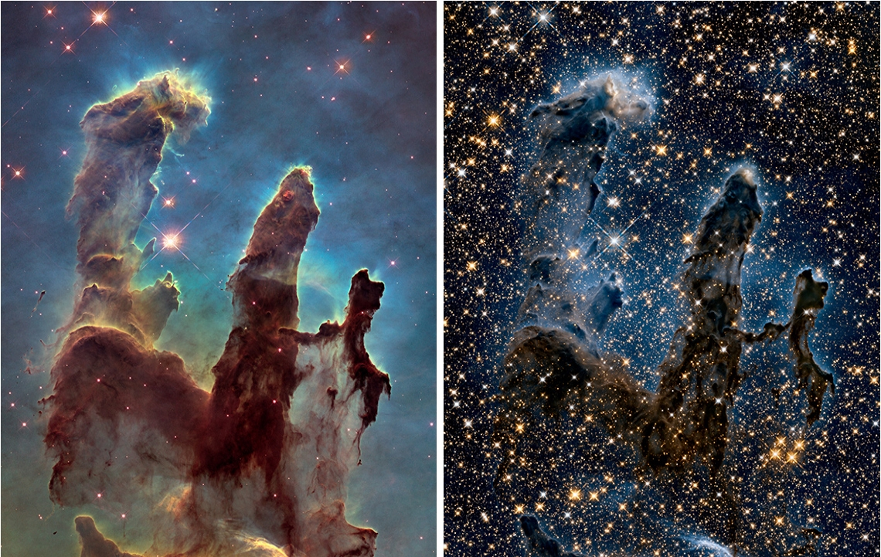
Notes:
Visible (left) vs. Infrared (right)
The Pillars of Creation in the Eagle Nebula can be seen in visible (left) and infrared (right) light as observed by the Hubble Space Telescope. Observing infrared light allows scientists to penetrate the dust and study otherwise unseen parts of our universe.
Image credit: NASA/ESA/Hubble Heritage Team (STScI/AURA)

