Slide 1
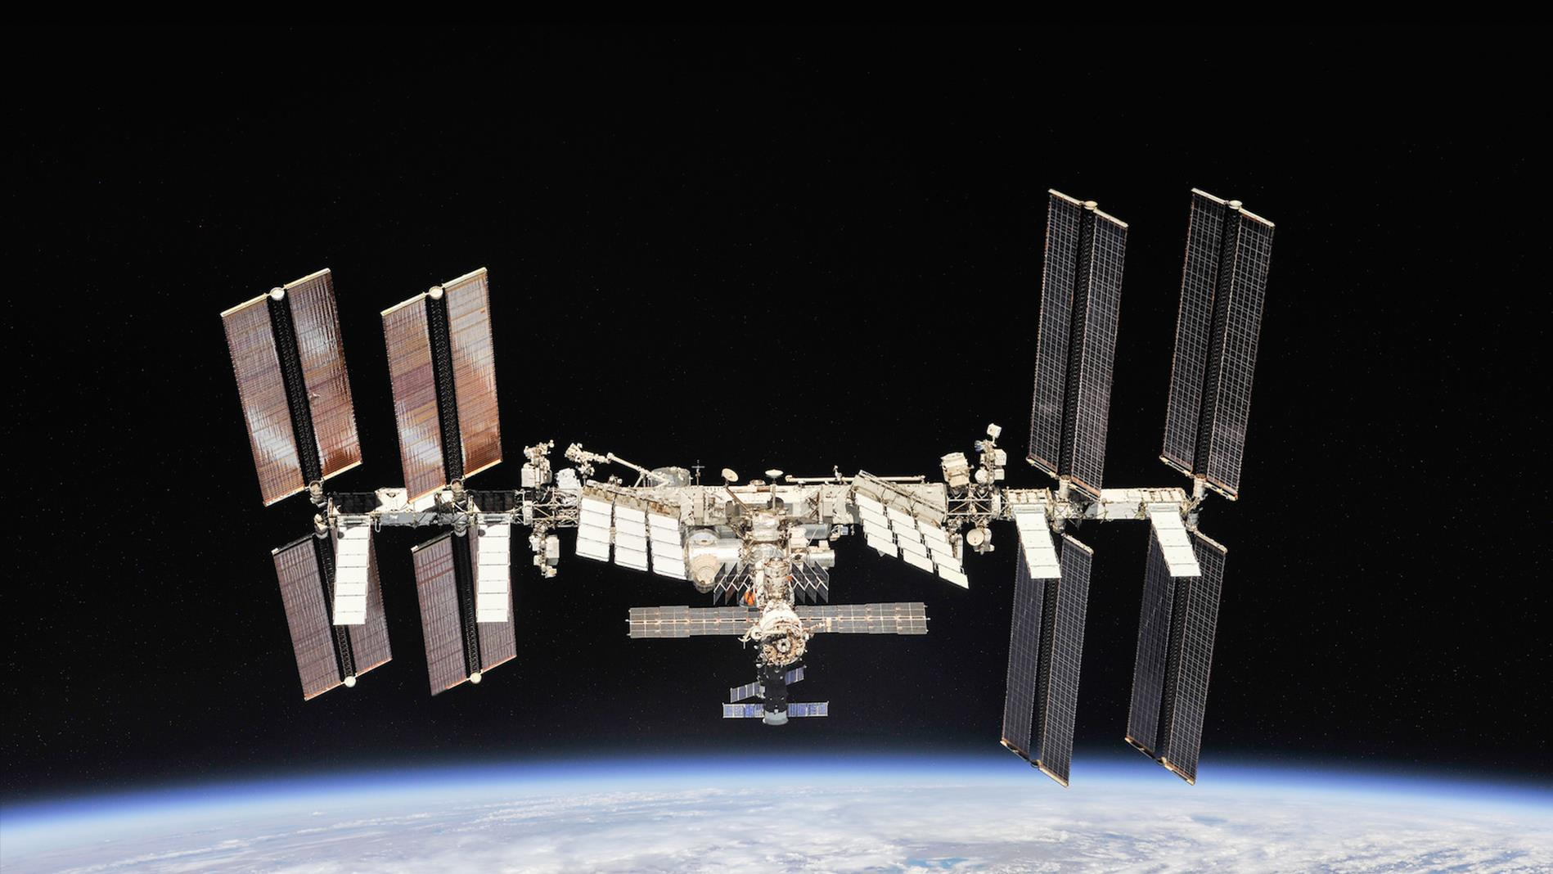


Notes:
The International Space Station
Thank you for having me here today. I am grateful for the opportunity to talk to you about the International Space Station.
(Credit: NASA)

Slide 2
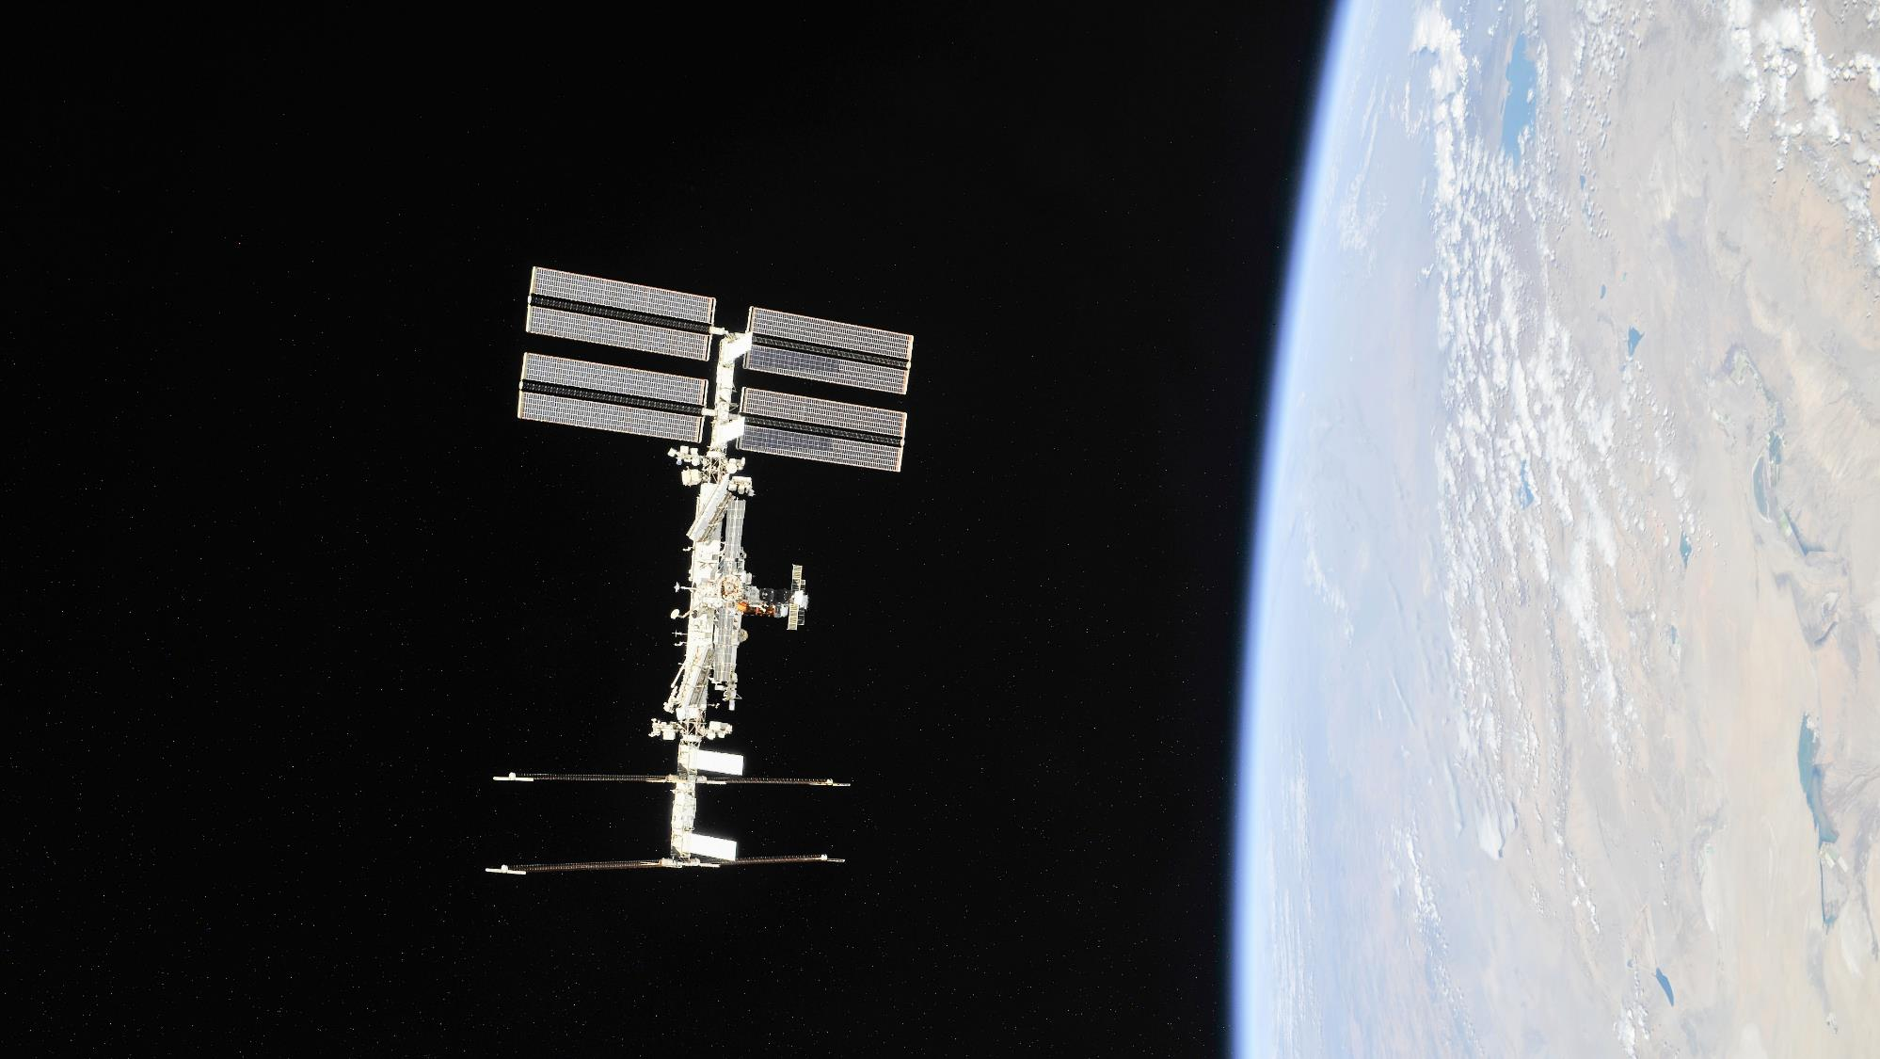
Notes:
What is the ISS?
The International Space Station (ISS) is a research laboratory in orbit above Earth. It has been continuously inhabited (crewed) since 2000. The Canadian Space Agency (Canada) is one of the Station's partners, along with NASA (the United States), Roscosmos (Russia), the European Space Agency (several countries in Europe), and the Japan Aerospace Exploration Agency (Japan).
The ISS’s first module was launched in 1998. Since then, over two decades of cutting-edge science experiments have been performed there. These experiments are designed to study the effects of space travel on astronauts' bodies before they undertake longer journeys further into our solar system – and the knowledge obtained is used to improve the lives of Canadians and all of humanity, here on Earth.
(Credit: NASA)

Slide 3
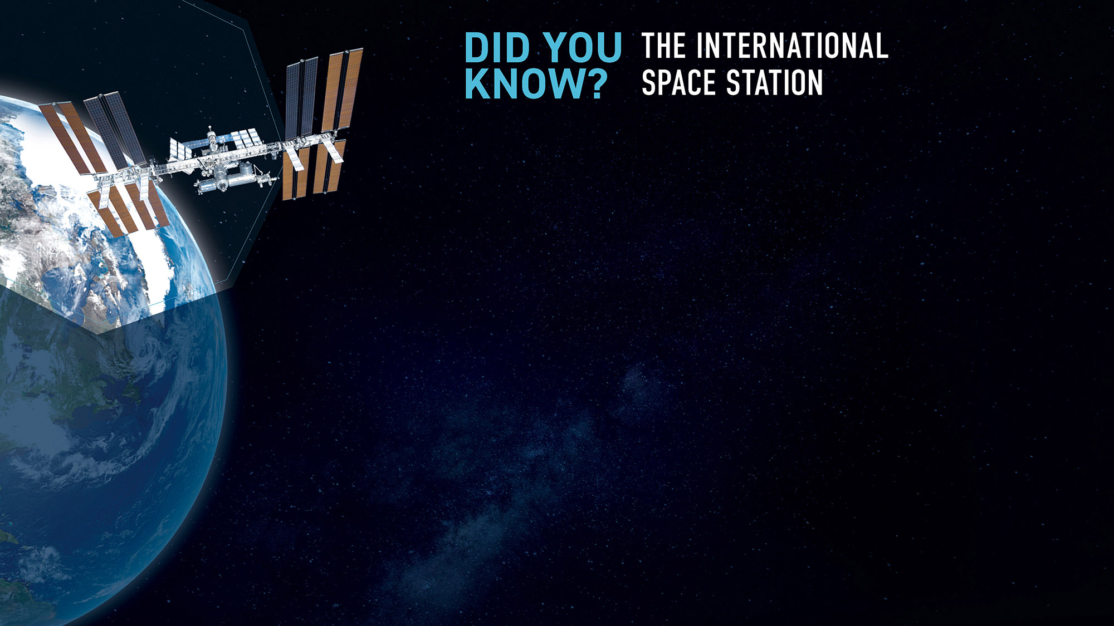
Notes:
Fast facts about the ISS

Slide 4
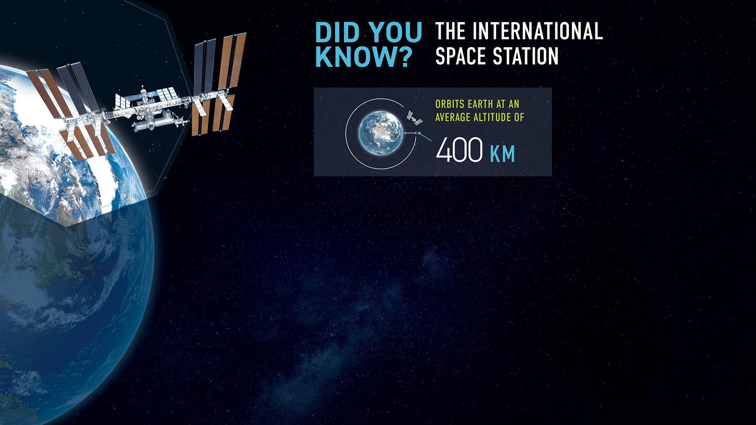
Notes:
Fast facts about the ISS
It orbits Earth at an average altitude of 400 km.

Slide 5
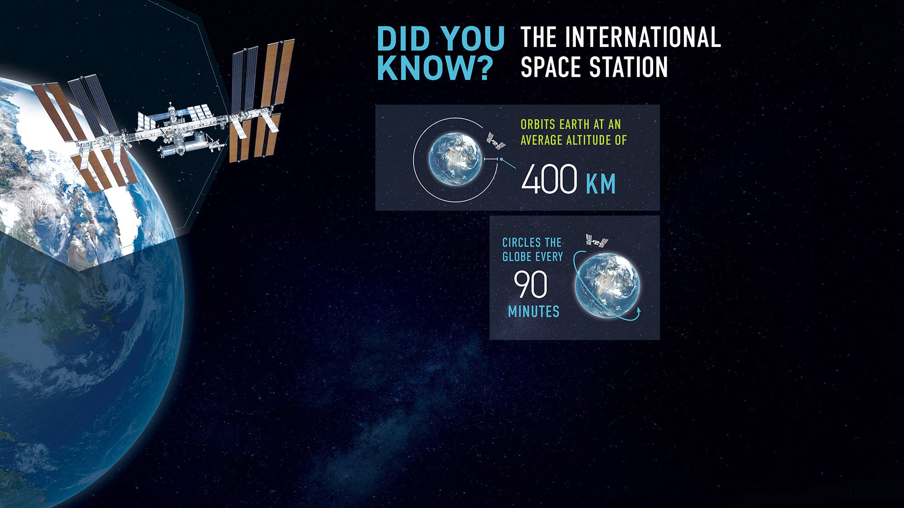
Notes:
Fast facts about the ISS
It orbits Earth at an average altitude of 400 km.
Every day, the ISS circles Earth every 90 minutes, or 16 times per period of 24 hours. That’s a distance roughly equal to a round trip to the Moon!

Slide 6
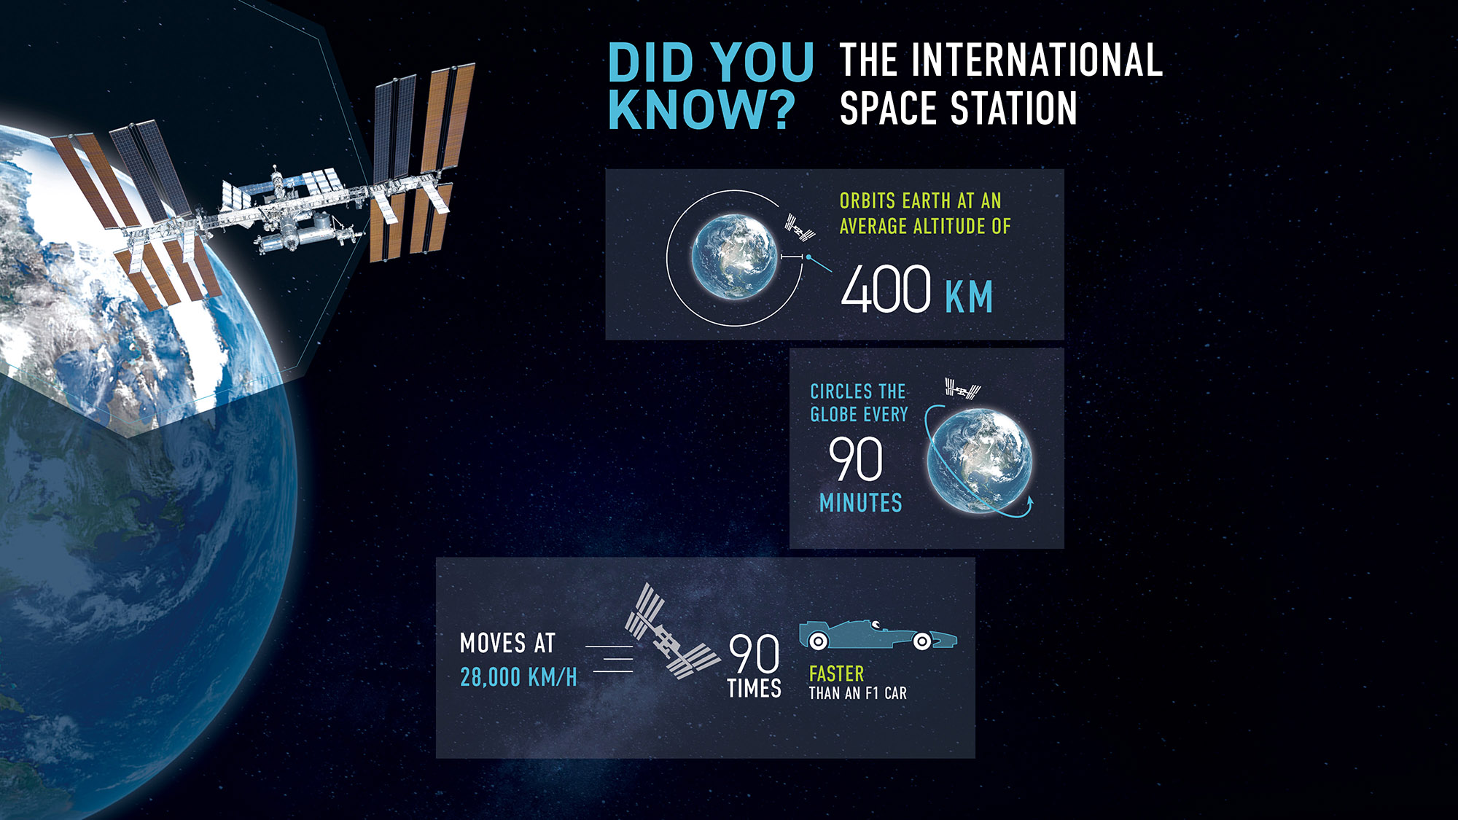
Notes:
Fast facts about the ISS
It orbits Earth at an average altitude of 400 km.
Every day, the ISS circles Earth every 90 minutes, or 16 times per period of 24 hours. That’s a distance roughly equal to a round trip to the Moon!
It moves 90 times faster than an F1 car.

Slide 7
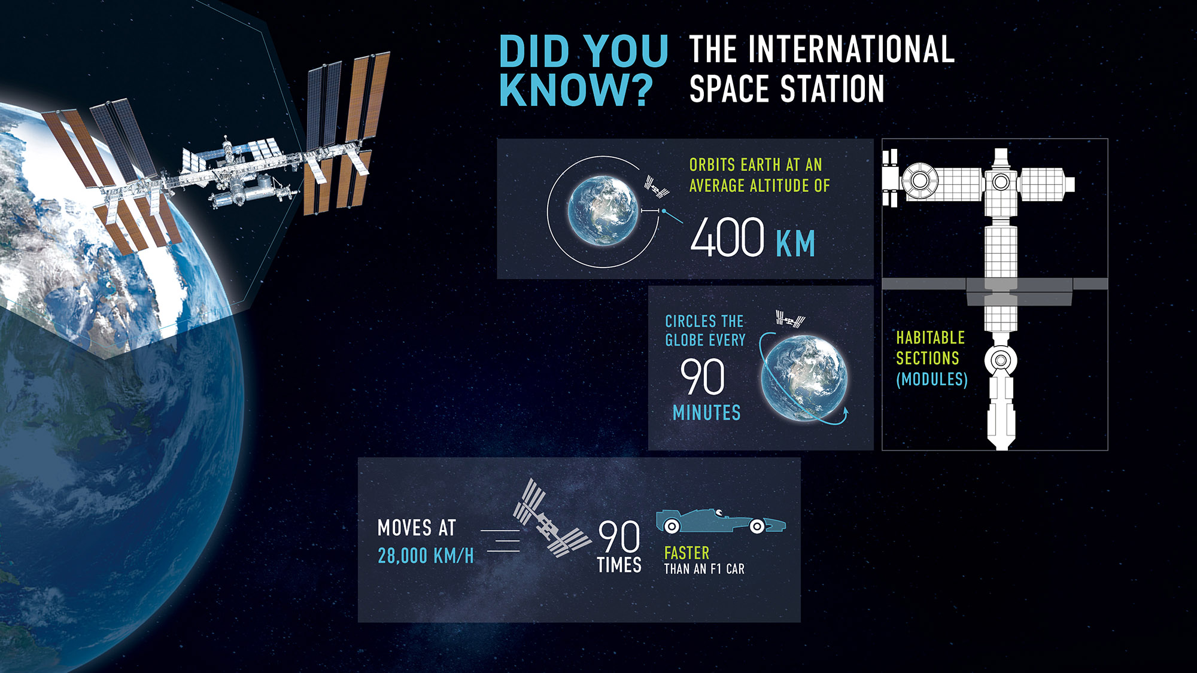
Notes:
Fast facts about the ISS
It orbits Earth at an average altitude of 400 km.
Every day, the ISS circles Earth every 90 minutes, or 16 times per period of 24 hours. That’s a distance roughly equal to a round trip to the Moon!
It moves 90 times faster than an F1 car.
The ISS is made up of habitable sections (called modules) filled with breathable air.

Slide 8
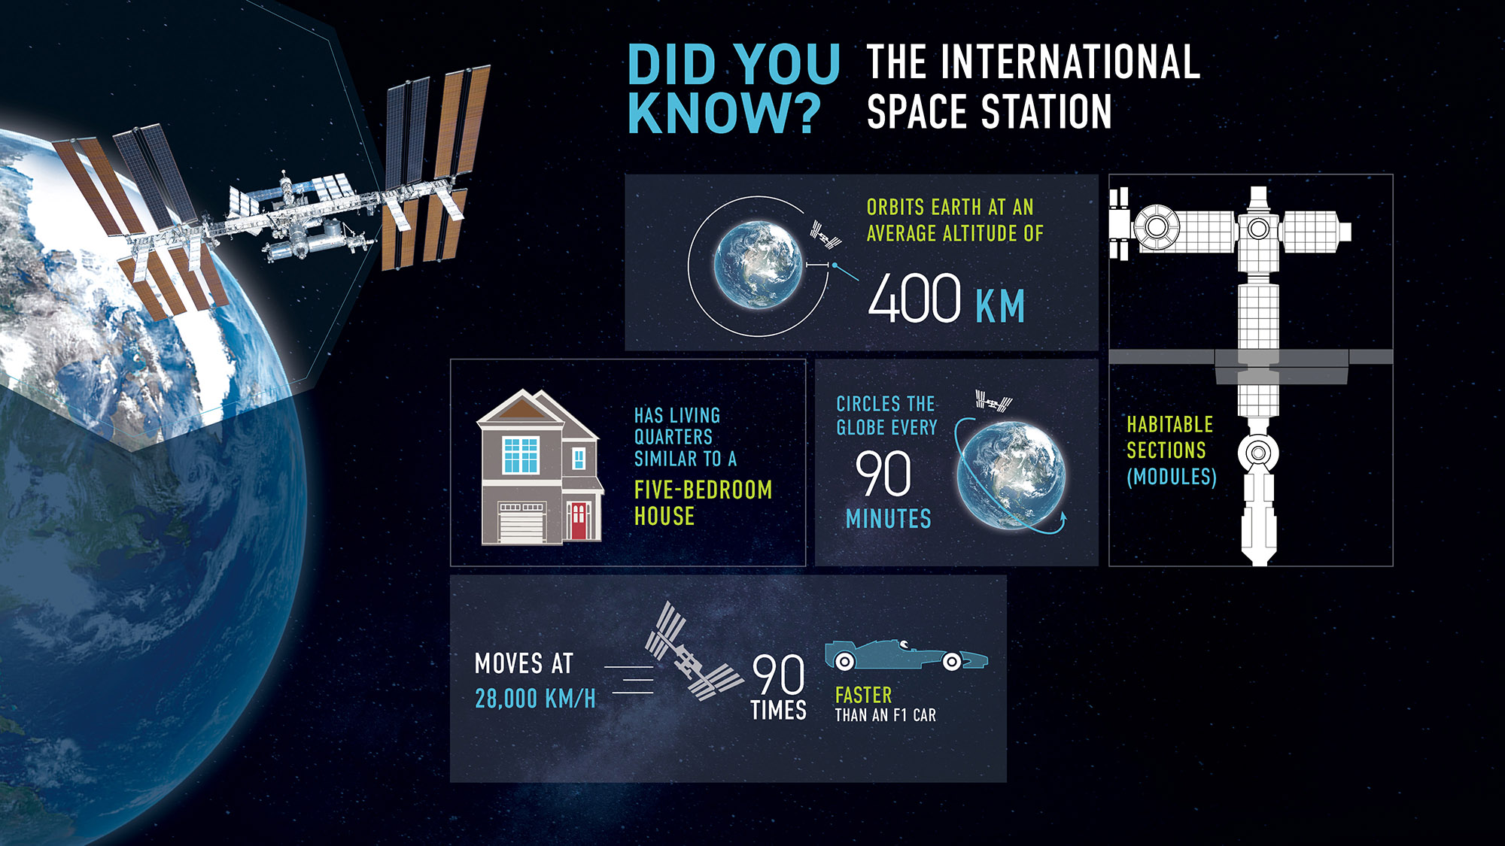
Notes:
Fast facts about the ISS
It orbits Earth at an average altitude of 400 km.
Every day, the ISS circles Earth every 90 minutes, or 16 times per period of 24 hours. That’s a distance roughly equal to a round trip to the Moon!
It moves 90 times faster than an F1 car.
The ISS is made up of habitable sections (called modules) filled with breathable air.
Its living space is about the size of a five-bedroom home. The ISS is about as wide as five hockey rinks.

Slide 9
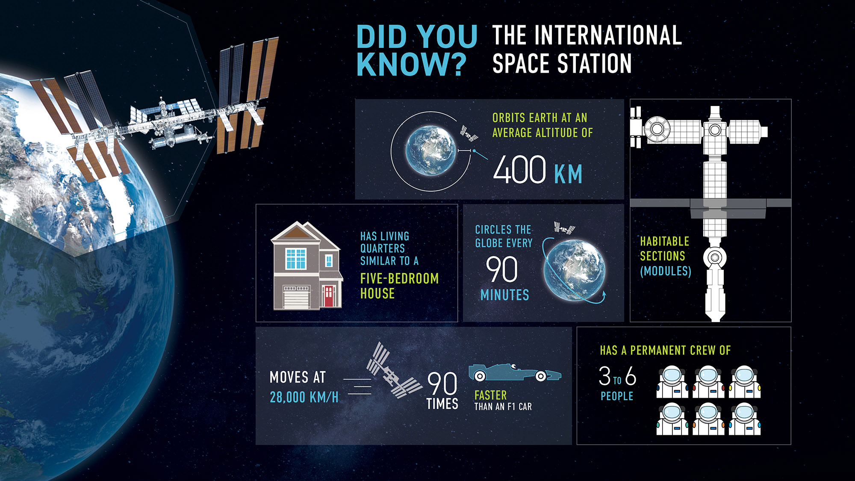
Notes:
Fast facts about the ISS
It orbits Earth at an average altitude of 400 km.
Every day, the ISS circles Earth every 90 minutes, or 16 times per period of 24 hours. That’s a distance roughly equal to a round trip to the Moon!
It moves 90 times faster than an F1 car.
The ISS is made up of habitable sections (called modules) filled with breathable air.
Its living space is about the size of a five-bedroom home. The ISS is about as wide as five hockey rinks.
It has a permanent crew of 3 to 6 people.

Slide 10
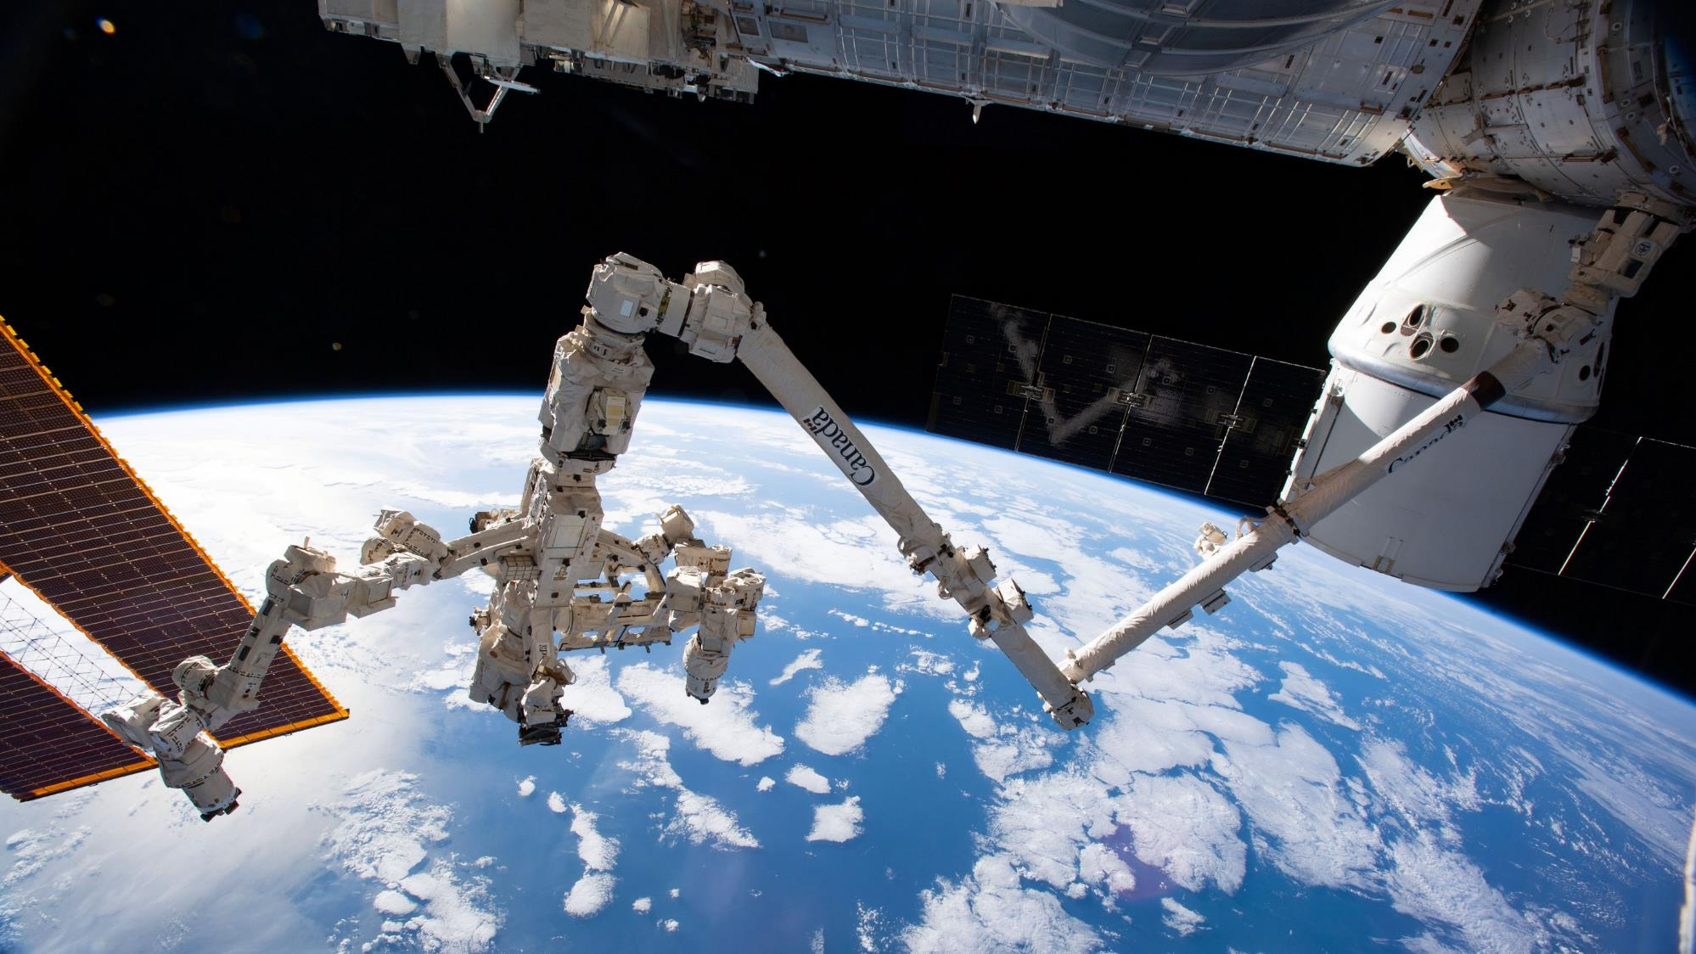
Notes:
Canada’s contribution
Canada's participation in the ISS is thanks to our contribution of space robotics:
Canadarm2, Canada’s iconic robotic arm
Dextre, the most sophisticated space robot ever built
the Mobile Base System, a transport and storage platform
All three elements are essential for many maintenance tasks and regular operations.
Providing these robots as part of the international collaboration has given Canada access to the ISS to:
send Canadian astronauts to the Station
test new technology
perform science experiments
(Credit: NASA)

Slide 11
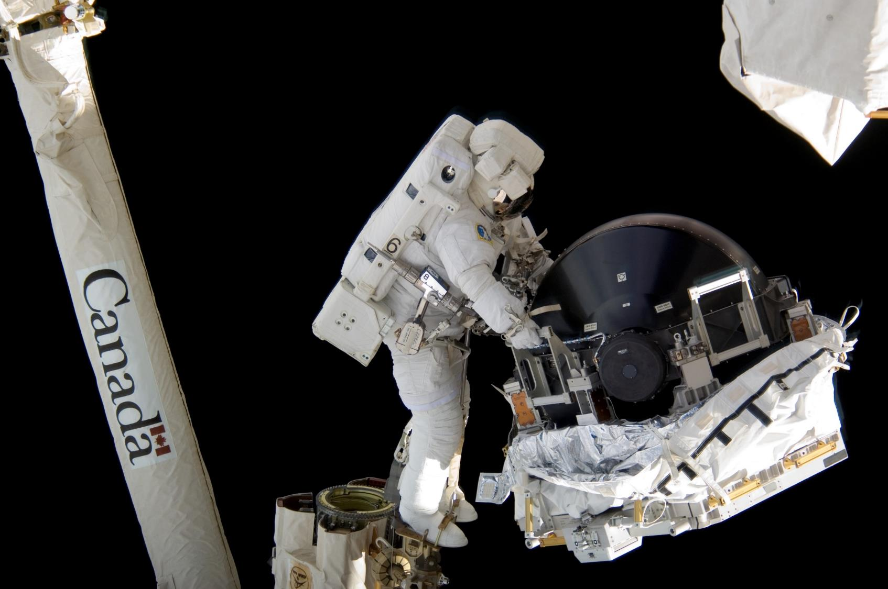
Notes:
Canadarm2 is a 17-metre-long robotic arm. It was installed on the Station in 2001 and was instrumental in the assembly of the orbiting lab.
It is still used on a near-daily basis to:
perform Station maintenance
move supplies, equipment, Dextre and even astronauts during spacewalks
perform "cosmic catches" by grappling visiting vehicles and berthing them to the ISS
Did you know?
Canadarm2 was not initially designed to catch cargo ships but rose to the challenge and began performing this tricky manoeuvre in 2009. This complex operation requires extensive training and highlights the importance and the adaptability of Canadian robotics. Today, astronauts from around the world travel to Canadian Space Agency headquarters to learn how to operate Canadarm2.
(Credit: NASA)

Slide 12
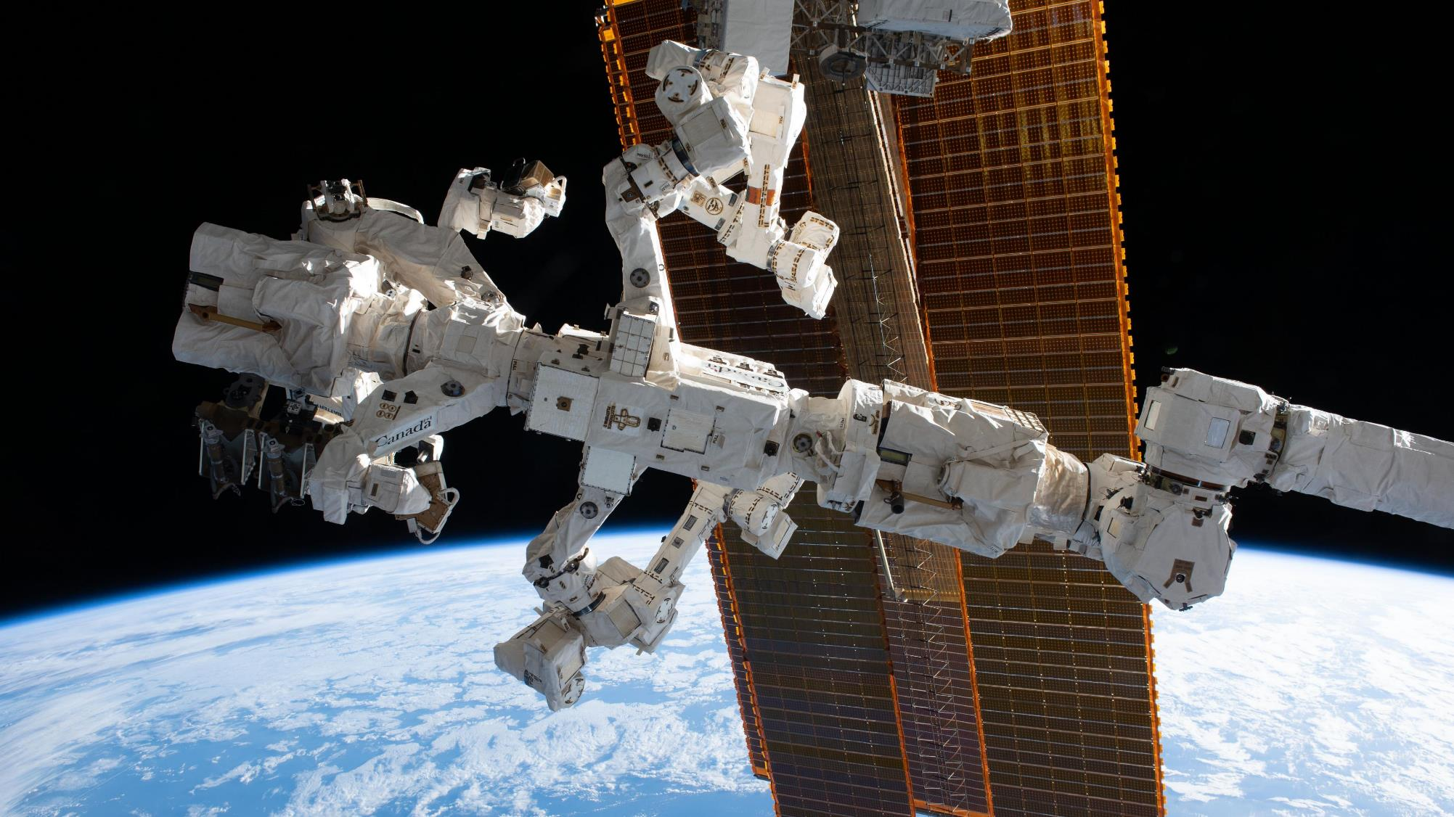
Notes:
Dextre is a robot that tackles the tough or routine jobs that need to be done in the harsh environment of space. It allows astronauts to spend more time doing scientific experiments instead of going on risky spacewalks.
Dextre:
installs and replaces small equipment
replaces defective components in the Station's electrical system
tests new tools and robotics techniques and can even repair itself!
Dextre can work on the whole surface of the ISS either attached to Canadarm2 or carried on the Mobile Base System.
Did you know?
The ground team at the Canadian Space Agency plans, monitors and controls more than half of all Canadarm2 and Dextre operations aboard the ISS from the Robotics Mission Control Centre located at Canadian Space Agency headquarters.
(Credit: NASA)

Slide 13
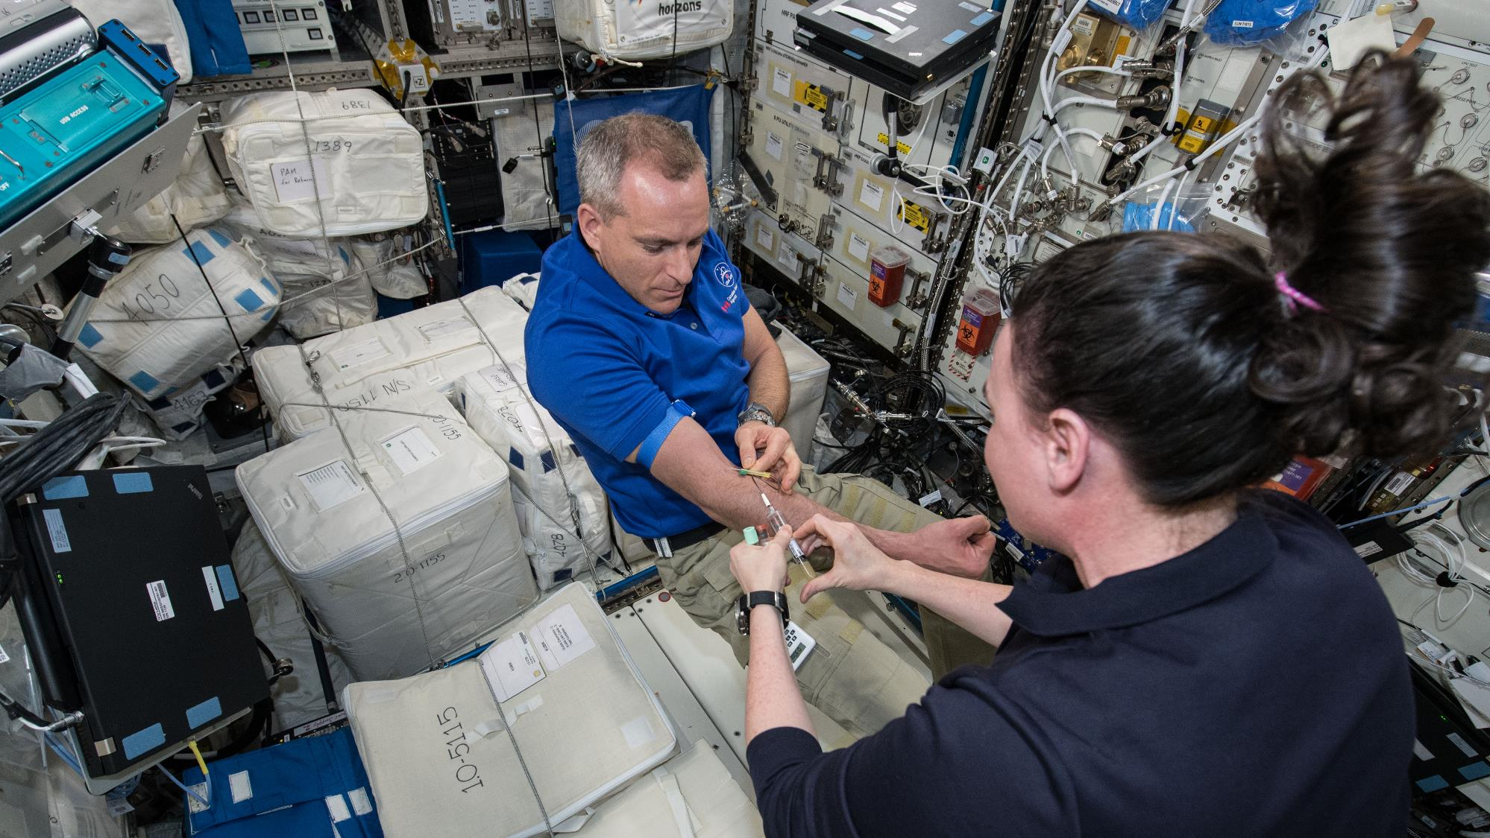
Notes:
A science laboratory in space, for the benefit of humanity
The unique microgravity environment of the International Space Station allows scientists and researchers from around the world to conduct science experiments that are not possible on Earth.
To date, over two dozen Canadian studies have been conducted aboard, some of which are still underway. Canadian ISS experiments are mostly focused on human and life science.
These experiments are designed to:
prepare for deep-space exploration
use the knowledge obtained to improve our quality of life on Earth
(Credit: NASA)

Slide 14
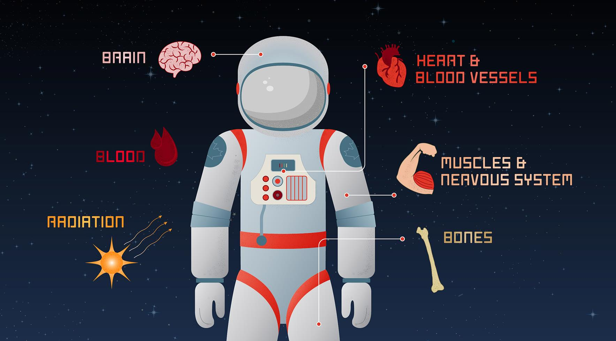
Notes:
Why do we conduct science in space?
Living in a near-weightless environment causes many changes to the human body. Spending time in space accelerates the aging process – which makes it a great place to study conditions associated with aging.
As humanity undertakes missions to more distant destinations in the solar system, we want to better understand the risks associated with human space flight – and help find countermeasures and treatments – to identify, characterize, and mitigate the effects on astronauts’ health to make space travel safer.
By studying how astronauts adapt to microgravity, scientists can advance our knowledge of a variety of health issues: cardiovascular problems, osteoporosis, Type 2 diabetes, and even the psychological effects of isolation and living in confinement. Studying the human body in space over a six-month mission gives us data that would take years to gather on Earth.

Slide 15
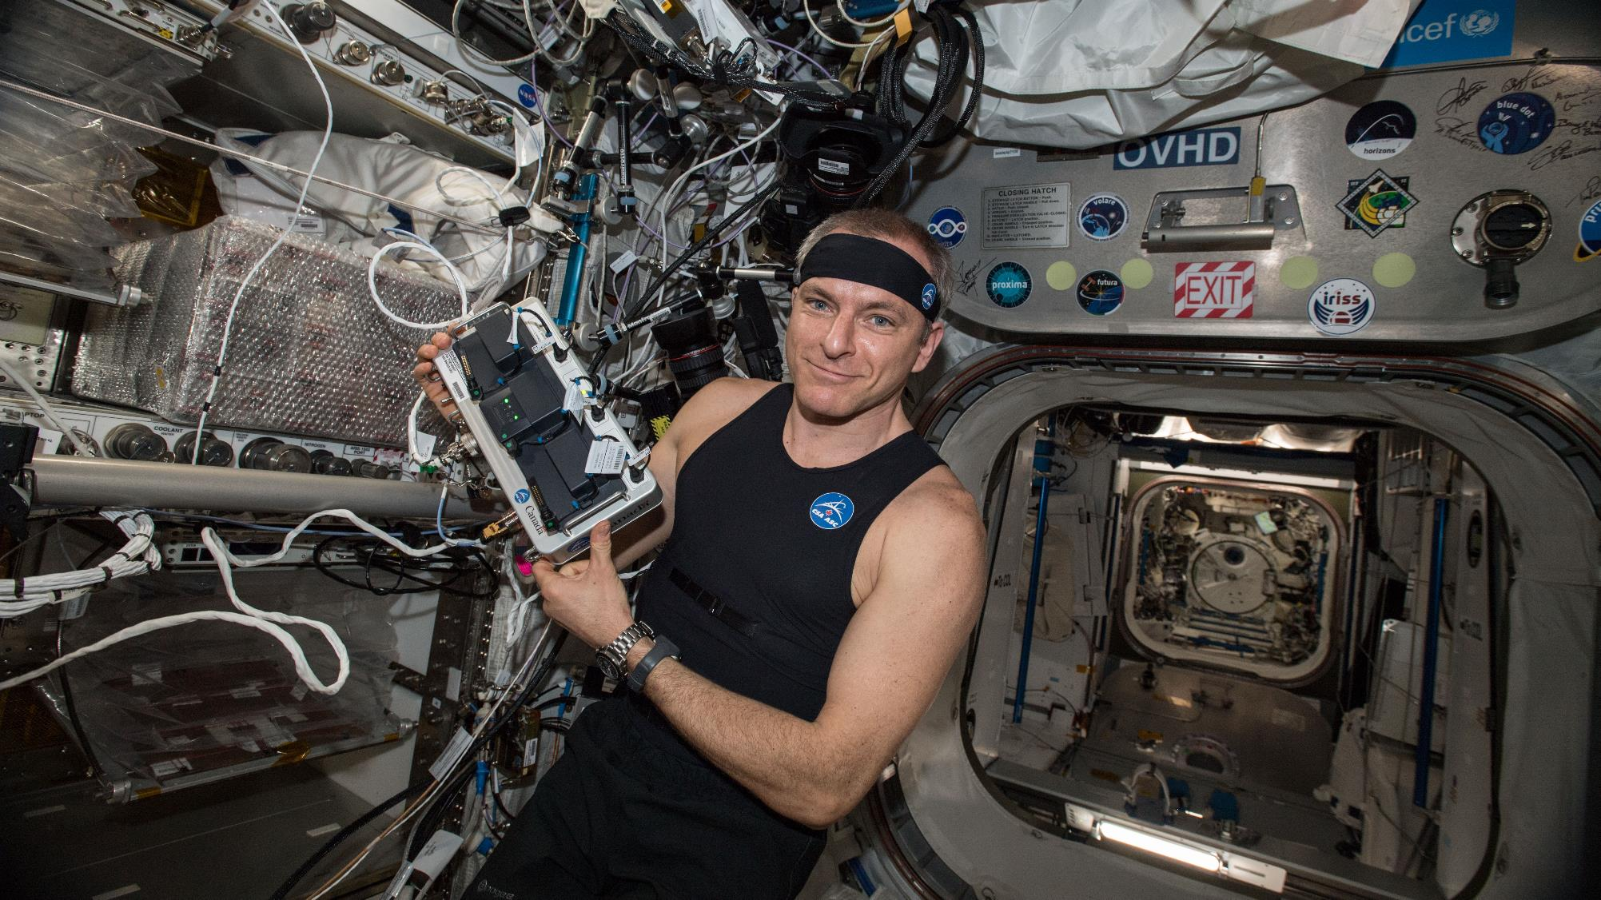
Notes:
Testing technologies
Canadian innovation aboard the ISS also extends to testing new technologies. One example is the Bio-Monitor smart shirt system.
Bio-Monitor is designed to measure and record astronauts' vital signs, all while fitting into their daily routine. It was developed by Montreal-based company Carré Technologies.
Since it was first tested on the ISS by Canadian Space Agency astronaut David Saint-Jacques, the Bio-Monitor is now used to collect scientific data for experiments.
This system also has the potential to help Canadians who are bedridden, housebound, or living in rural communities with limited access to medical support. The commercial version, Hexoskin, has been used to research everything from breathing disorders to epilepsy. There is even a smaller version used to study rare disorders in children.
(Credit: CSA/NASA)

Slide 16
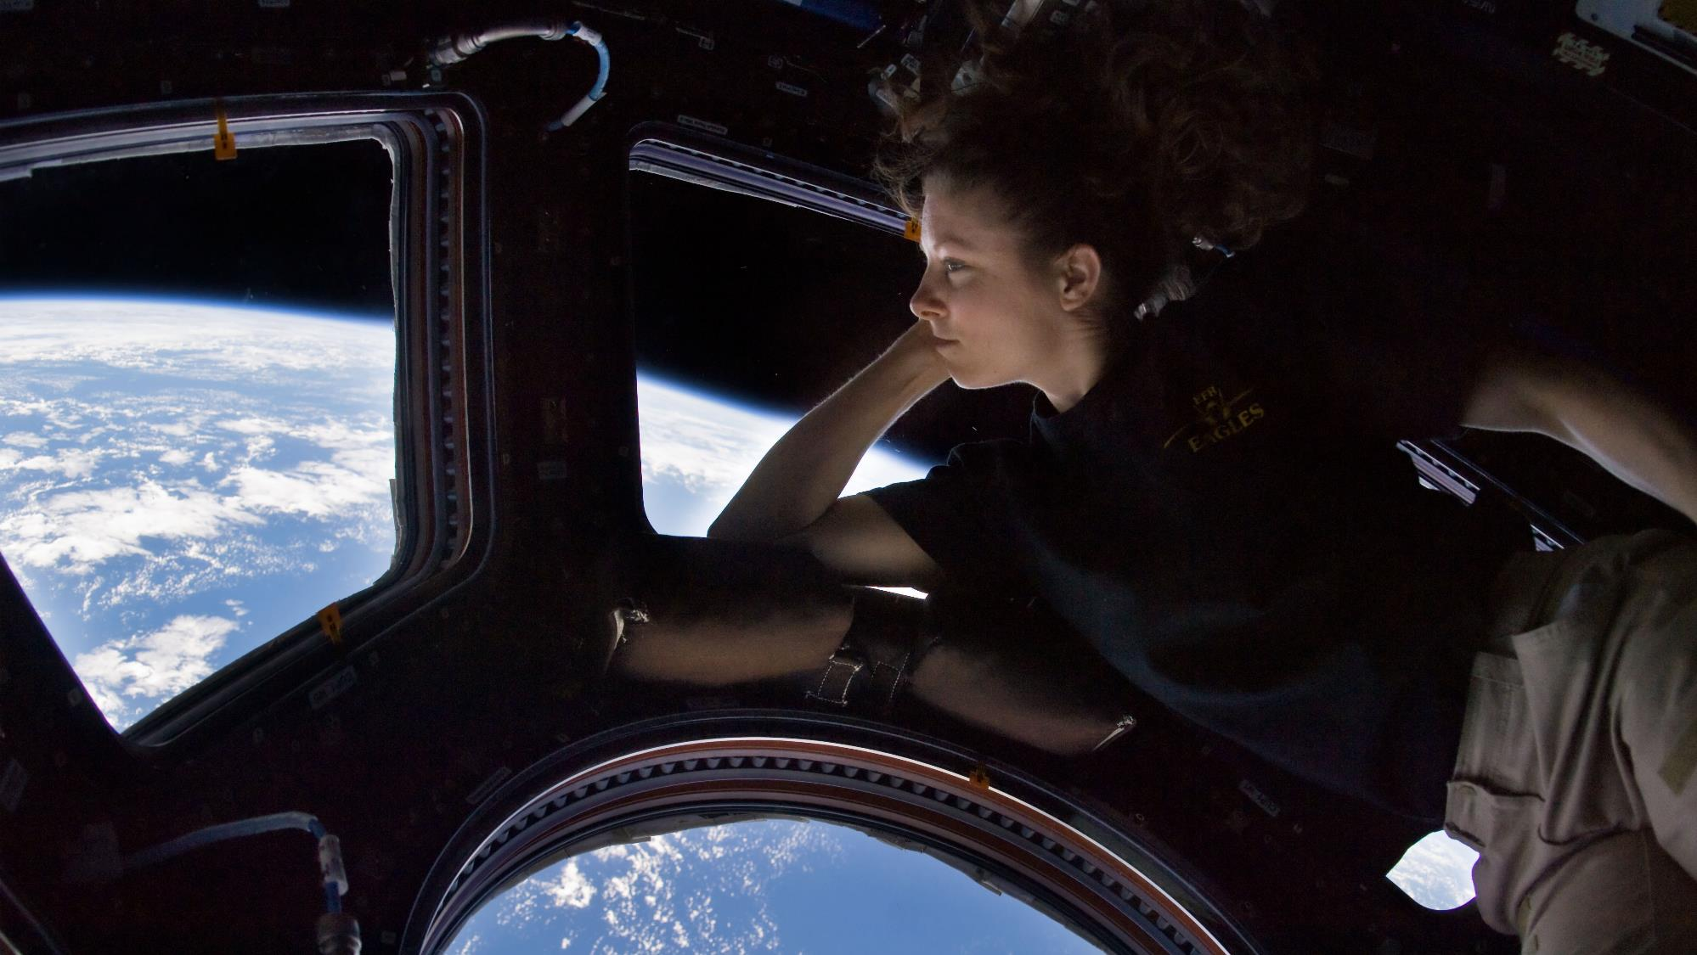
Notes:
Living and working on the ISS
Living in microgravity has its share of daily challenges. After all, the human body was designed to work with the pull of Earth’s gravity!
Fortunately, astronauts adapt quickly to life in orbit.
On a daily basis, astronauts maintain the ISS, perform science experiments, and conduct a wide variety of activities. They also enjoy free time during which they pursue hobbies or simply relax. Many astronauts say that their favourite activity is looking out the window and admiring Earth.
(Credit: NASA)

Slide 17
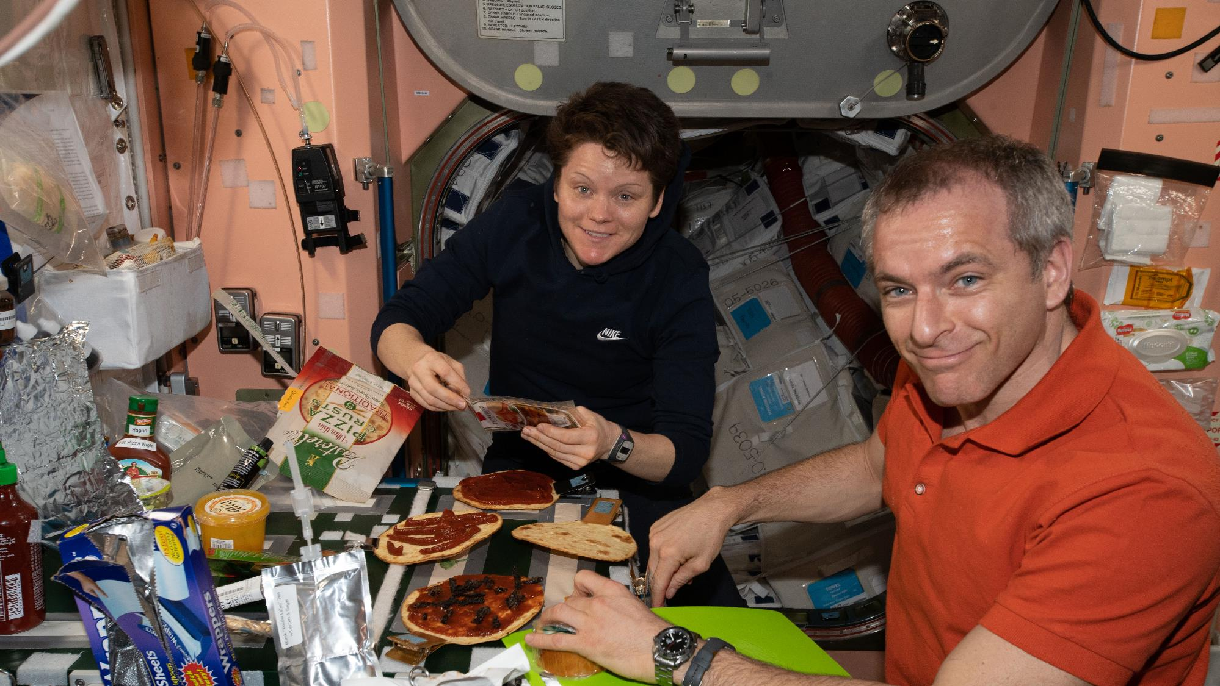
Notes:
Eating in space
On Earth, people like to get together to share a good meal. The same is true on board the ISS! For astronauts, this is an opportunity not only to refuel, but also to relax and spend quality time with colleagues.
Most meals on the ISS have been selected and packaged to ensure that they will last for the entire duration of a mission. Fresh food items like fruits and vegetables are sent to the ISS every few months on cargo resupply ships.
Astronauts have the chance to test certain foods several months prior to a space mission. To add variety to the standard ISS menu, crewmembers can also request some of their favourite foods or foods typical of their culture, as long as they are suitable for the Station’s environment. Astronauts’ families also sometimes send them special foods… more as a little taste of home than strictly for their nutritional value!
(Credit: NASA)

Slide 18
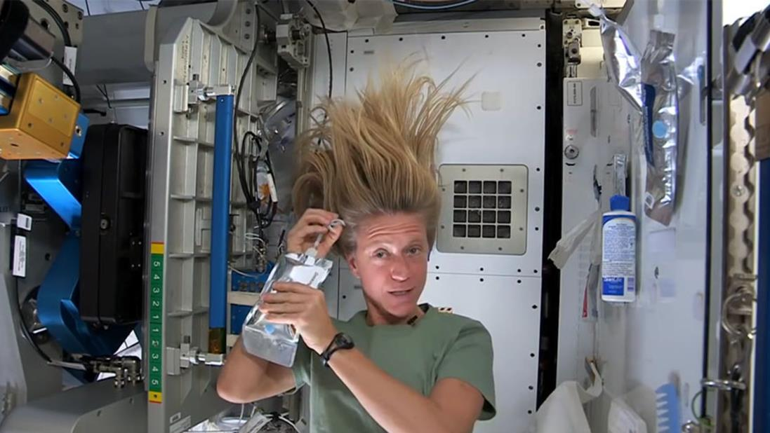
Notes:
Personal hygiene in space
The methods that astronauts use to maintain good hygiene in microgravity are a lot like those used on camping trips. The water supply on the Station is very limited. The ISS is a closed system that can reclaim about 93% of the water on board. Sweat, urine and moisture get purified back into drinking water.
Water does not "flow" in microgravity: it is therefore impossible to take a shower, wash your hands or go to the bathroom the same way you would on Earth. Performing these tasks requires resourcefulness and skill.
Check out the Canadian Space Agency website for videos of astronauts explaining various personal hygiene tasks such as “taking a shower,” brushing their teeth, shaving, clipping their nails, or getting a haircut.
(Credit: NASA)

Slide 19
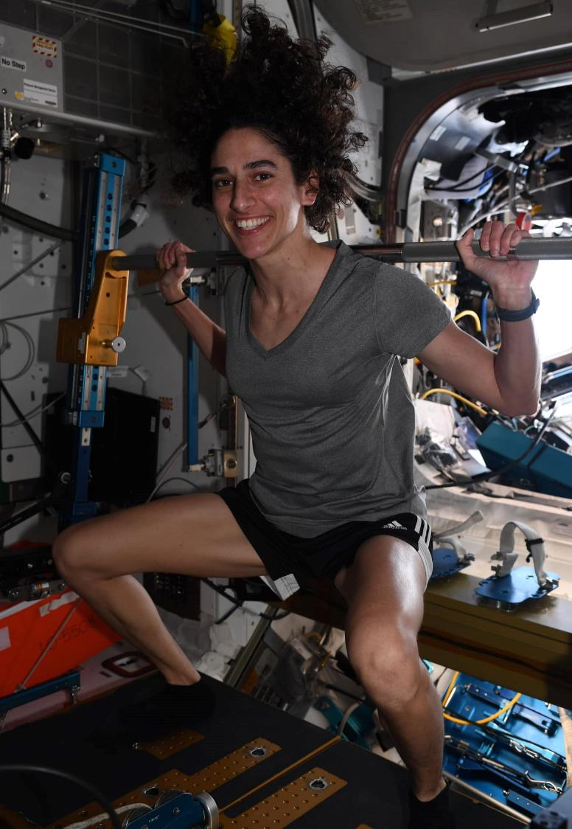
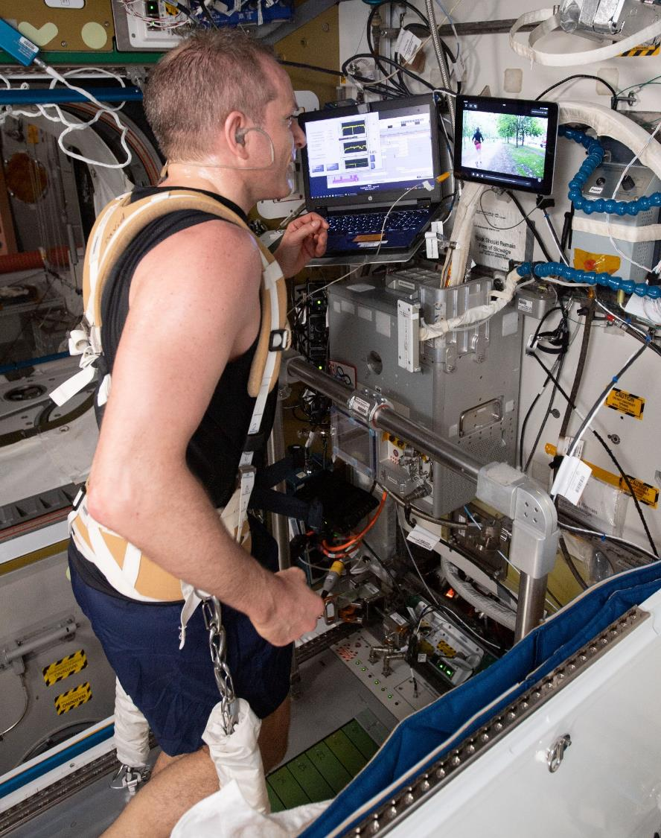
Notes:
Exercising in space
When you're in orbit, exercise is vital! Physical activity is the most effective way to counteract the adverse effects of weightlessness on the human body. Exercise is therefore a crucial part of the daily routine of astronauts, both on Earth and in space.
Without exercising in space, an astronaut’s body would experience major loss in:
muscle mass
bone density
cardiovascular health
The longer astronauts spend in space, the more significant the effects are on their body.
(Credit: NASA)

Slide 20
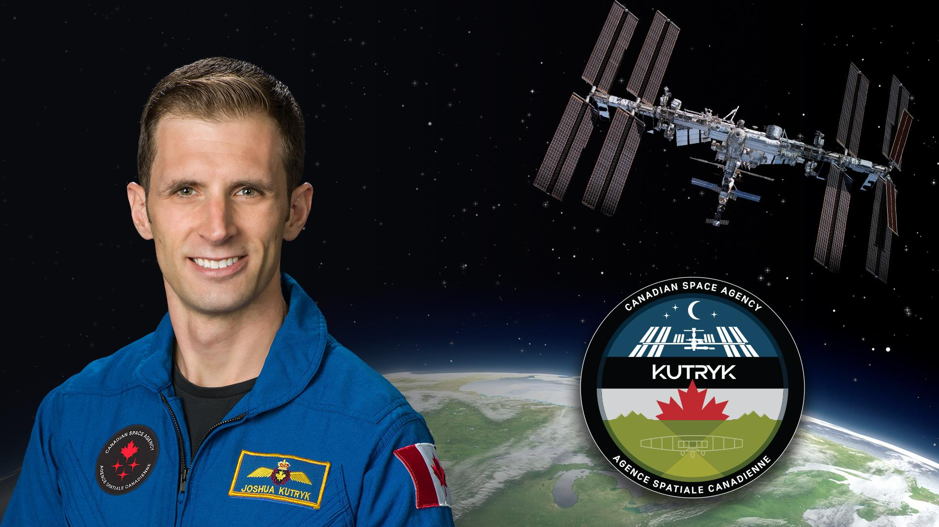
Notes:
The next Canadian to live and work on the ISS
Canadian Space Agency astronaut Joshua Kutryk will be the next Canadian to live and work on the International Space Station.
Hailing from Fort Saskatchewan, Alberta, Joshua Kutryk was fascinated with the sky and outer space from a young age. As a teenager he learned to fly in the Air Cadet program.
He joined the Royal Canadian Air Force and was a fighter pilot and experimental pilot totalling over 4000 hours on over 40 types of aircraft.
Joshua was selected by the Canadian Space Agency in 2017, and completed basic training at NASA in early 2020, earning the title of astronaut.
He is now training for a six-month mission to the ISS, which will be Canada’s fourth long-duration mission on the orbiting laboratory.

Slide 21
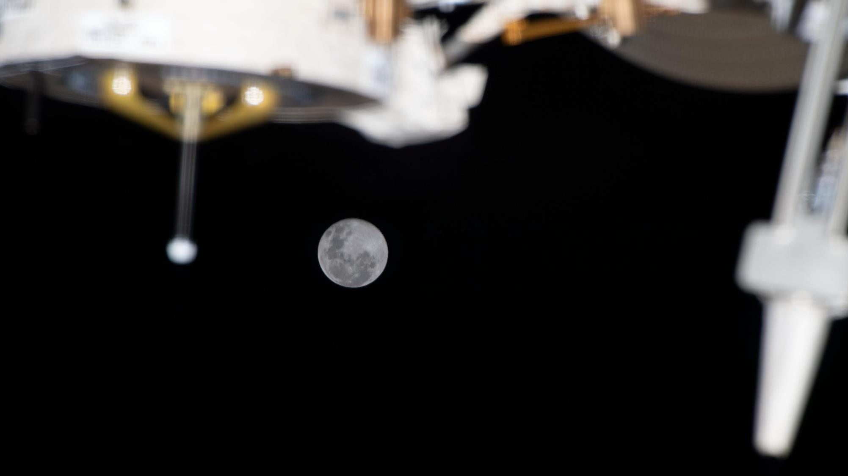
Notes:
What’s next for the ISS
Canada has committed to the ISS program until 2030.
The Canadian Space Agency is working with NASA and international partners on plans to safely deorbit the ISS, marking the end of an unparalleled chapter in human space exploration – but not the end of the story.
Low Earth orbit is likely to remain a destination for science, discovery, and commercial development.
And missions to deep-space destinations, like the Moon and Mars, will undoubtedly benefit from decades of research and know-how acquired aboard the International Space Station.
(Credit: NASA)

Slide 22

Notes:
To stay up to date on Canada’s role in the ISS and missions set to bring humanity back to the Moon, visit the Canadian Space Agency’s website and follow us on social media.
Text version: Follow the Canadian Space Agency on social media. Suivez l’ASC sur les médias sociaux. asc-csa.gc.ca
(Credit: CSA/NASA)

