Slide 1




SPACE BRAIN HACK
Notes:
Introducing the concept of Space Brain Hack to students
We’re heading back to the Moon… and taking humans farther than we’ve ever been before!
The Canadian Space Agency (CSA) and its partners around the world are facing many new challenges as they aim to send humans farther than they have ever gone in space.
Imagine you are a future lunar astronaut on a one-year mission on the Moon. Design a food system that creates fresh food for four lunar astronauts, that is flavourful and nourishing, with the least possible waste. Keep in mind the constraints presented to you in this presentation and generate enough fresh food to supplement the packaged food for the crew.
We are invited to “hack” the CSA’s brain because we all have foods that we like to eat and provide our body with the nourishment it needs… and imaginations to come up with new ideas and solutions. Are you ready?

Slide 2
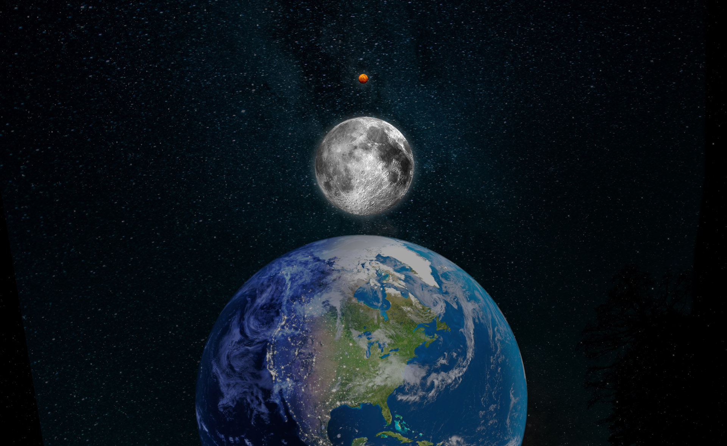
2
Notes:
Your challenge is to propose a solution for astronauts to have access to fresh food while they are in space.
You will learn more about space food, what is a food production system, how food production works on Earth and on the ISS currently and, after that, we'll begin thinking about solutions.
Let’s start by talking about lunar missions and food production.
Humans are working towards the exploration of space beyond the International Space Station (ISS). We are taking small steps by first returning to the Moon, with the goal of visiting Mars someday.
Currently, astronauts live and work aboard the ISS, which orbits 400 km above Earth. There have been humans living in space for longer than you have been alive – over 20 years! (See footnote.)
When you think about it, 400 km is not very far. And that means the ISS can be resupplied with food and other necessary items from time to time, there is a rotation of the crews every six months on average, and astronauts can technically get back to Earth if they are really in trouble.
However, this will not be the case the further we go from Earth in the exploration journey.
Footnote: The construction of the ISS started in 1998, with the launch of the first module. The first crew started living aboard the orbiting laboratory in November 2000.

Slide 3
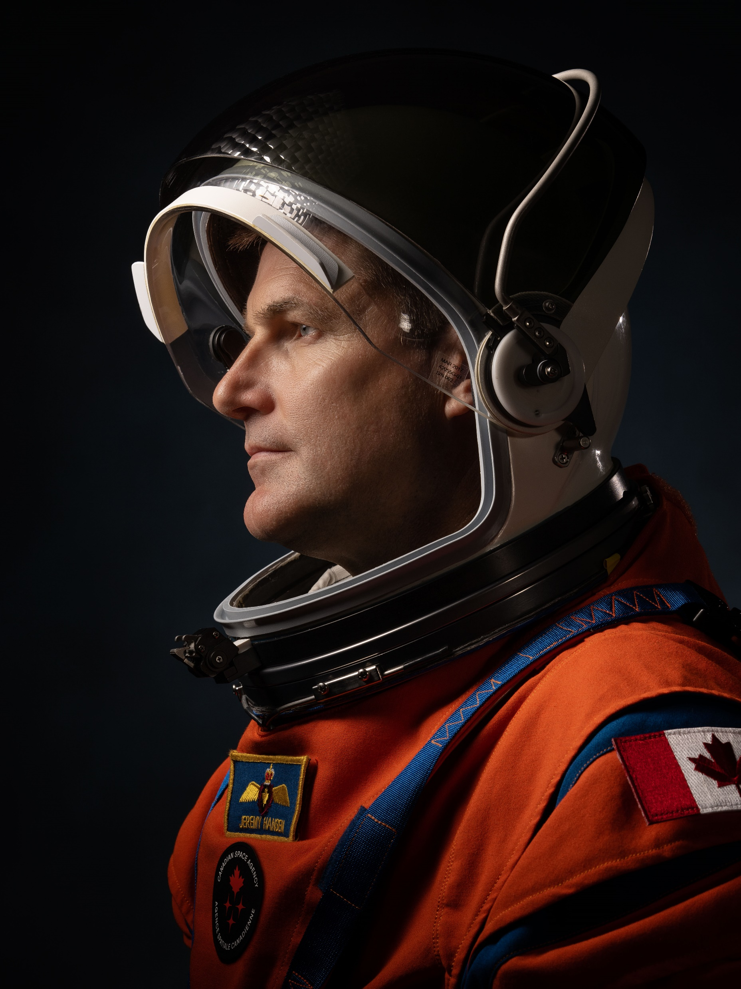
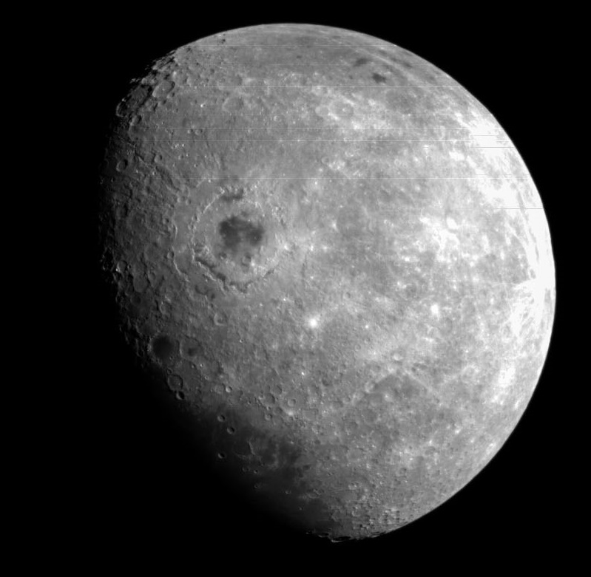
The Artemis program
Notes:
A bit about lunar missions
NASA, the CSA and other international partners are preparing for missions to the Moon, called the Artemis program. They will use new technology to study the Moon in new and better ways. They will also prepare for human missions to Mars. In the next few years, the first woman and first person of colour will land on the Moon.
The first Artemis missions include:
Artemis I, an uncrewed test flight of the Orion spacecraft, which launched on the Space Launch System (SLS) rocket on November 16, 2022 (landing: December 11, 2022).
Artemis II, the first-ever crewed test flight of the Orion spacecraft around the Moon, targeted to launch on the SLS rocket no earlier than November 2024. A CSA astronaut, Jeremy Hansen, (right image) will be part of the crew.
Artemis III, currently targeted for no earlier than 2025, will fly astronauts to the Moon. The mission will land humans on the lunar surface.
Image: NASA

Slide 4
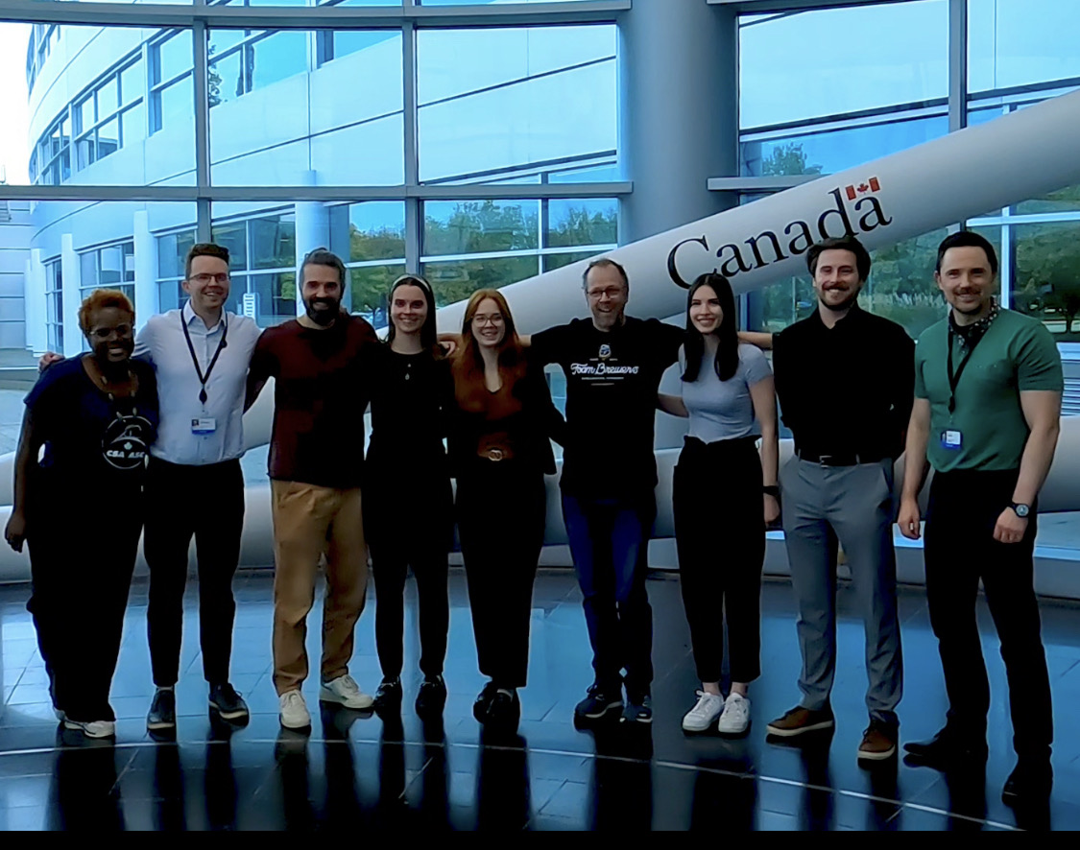
Food production experts at the CSA
Notes:
Astronauts are the tip of the iceberg of space travel. There is a large team of people supporting astronauts before, during and after their missions. Here are a few experts working with astronauts to ensure astronauts have proper nutrition and food full of flavour while on a mission. This team includes engineers, scientists, specialists in nutrition, in plants, agriculture and biology.

Slide 5
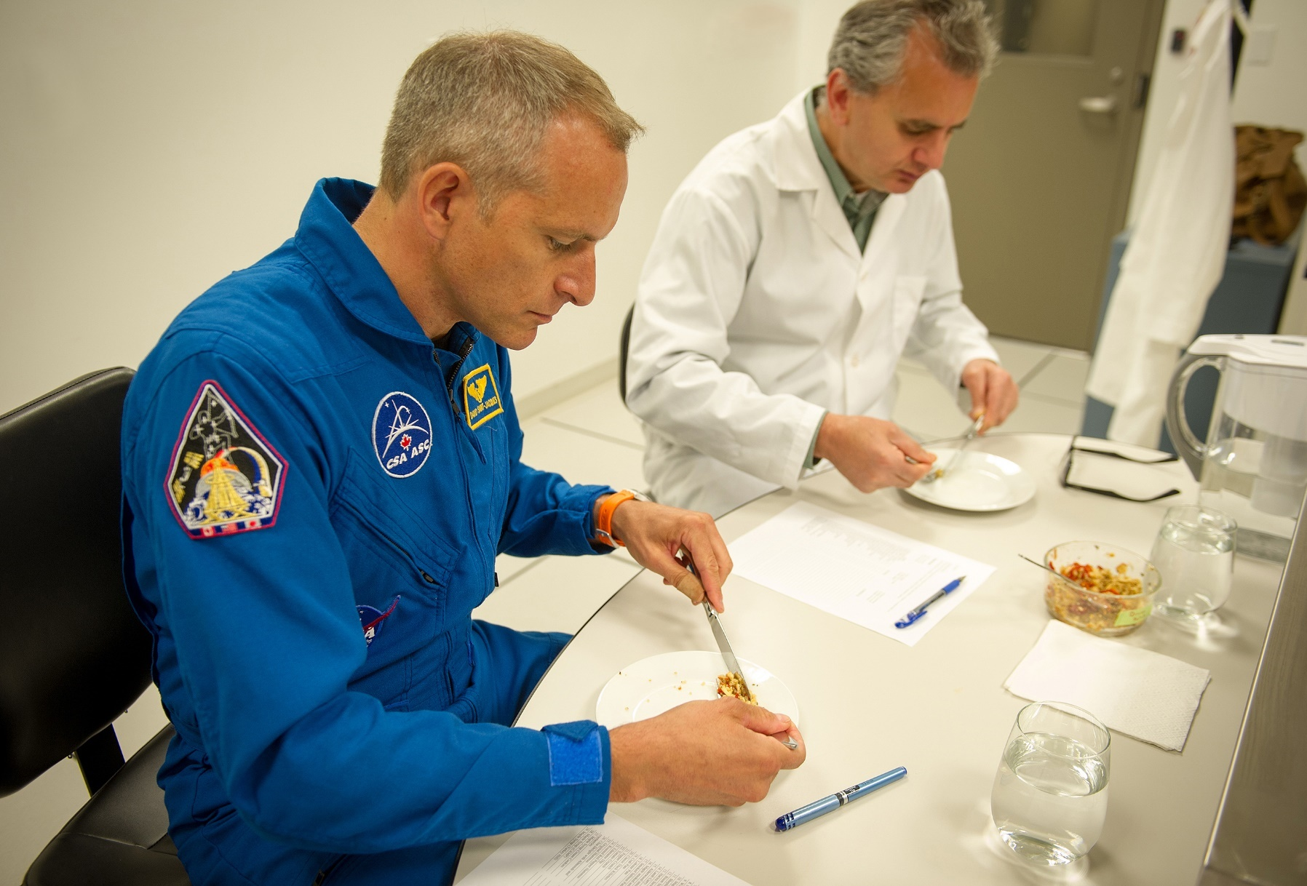


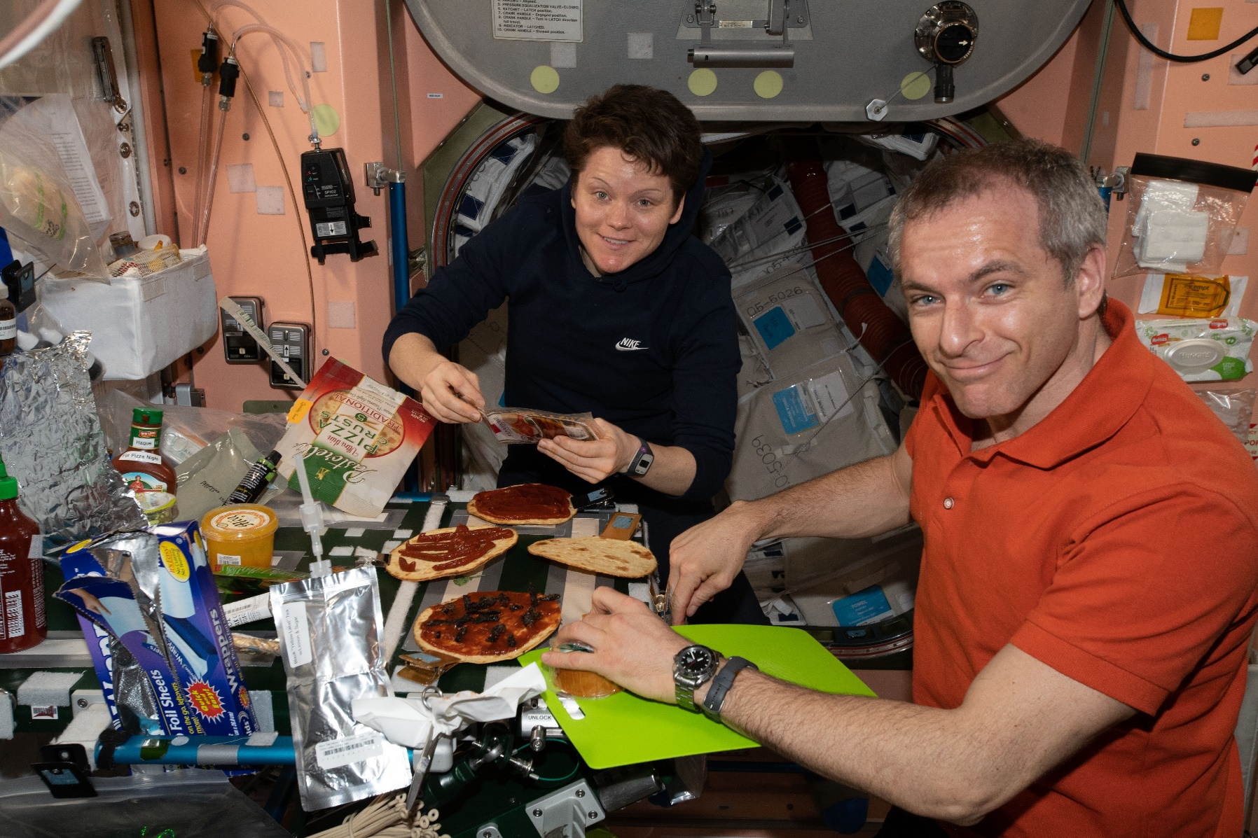
Food in space
Exercise
Food
Healthy astronauts
Notes:
Why it is important for astronauts to have balanced meals?
As we prepare for astronauts to live and explore the surface of the Moon, we are already using our knowledge from ISS expeditions to understand the impact of space on astronauts’ health. When astronauts live in space, especially for a long time, many changes happen to their bodies as they adapt to the microgravity environment. With exercise and nutritious diet, it is possible to lessen these changes – especially in the bones and muscles. Before astronauts go into space, dieticians and food scientists make sure that astronauts will have a variety of food options in space.
A balanced eating pattern in space is not that different from a balanced eating pattern on Earth. On the ISS there is a variety of food with a variety of textures and tastes. Having a variety of food encourages astronauts to meet their energy requirements and reduces the risk of body mass loss (including bone loss). The major difference between food on Earth and on the ISS is that astronauts rely on pre-cooked and packaged foods for their meals.
Like on Earth, astronauts often have celebratory meals. After successfully completing a major task or to celebrate culturally significant days or birthdays, crews usually gather to have a good meal together. They often share food from their own countries with their crewmates, and this gives them an opportunity to talk about their home and culture. In the bottom right image, CSA astronaut David Saint-Jacques and NASA astronaut Anne McClain prepare to enjoy personal-size pizzas.

Slide 6
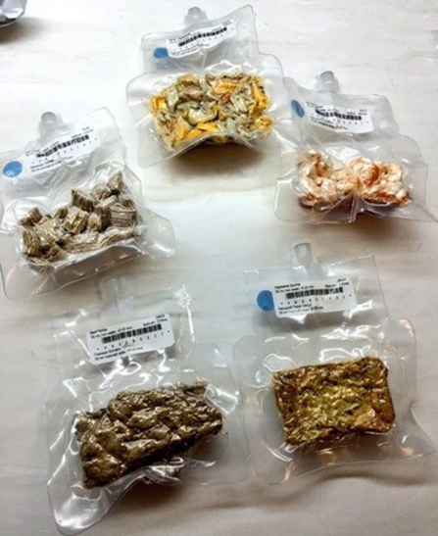
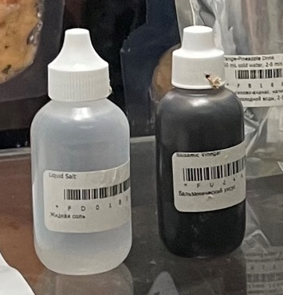
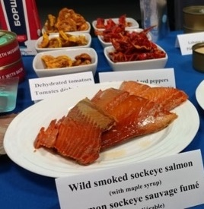
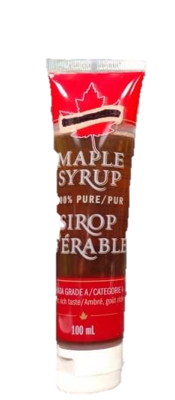
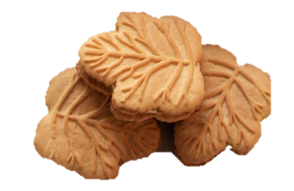
Space food
Notes:
This is what space food on the ISS looks like today: it is made to be as similar as possible to food on Earth so astronauts eat the food. For enough variety, there are about 50 drinks and 150 different foods on the standard ISS menu – everything from scrambled eggs to chocolate pudding is on the menu!
In the top left image, you see all the packaged dehydrated food with labels – the astronauts add water to rehydrate these meals. In the middle top photo you see liquid forms of salt and chili oil that are available to the astronauts to add to their food for extra flavour.
In the top right photo you see the wild maple-smoked sockeye salmon out of the “retort” package (retort package is like a can with a long shelf life but it is instead a flexible metallic pouch). As there are astronauts from different countries living on the ISS, there are foods from these countries. When a CSA astronaut goes to the ISS, we send them Canadian foods that they request such as tubes of maple syrup, salmon, bison chili and maple cookies for a treat.
(If your bandwidth allows, you could play the following video for your students: On the menu in orbit - Canadian Space Agency (asc-csa.gc.ca))

Slide 7
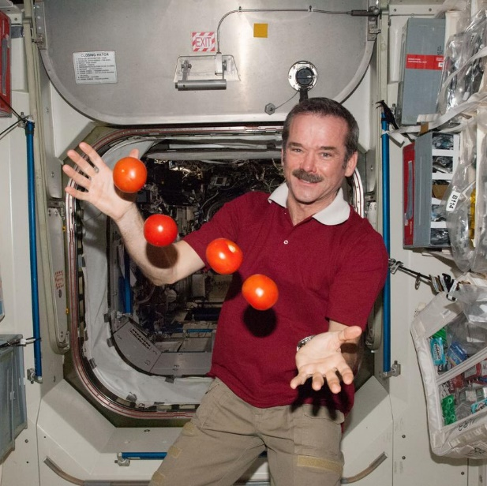
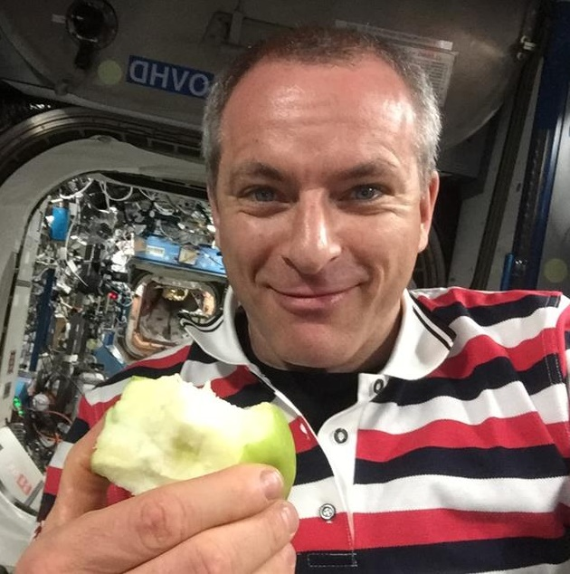
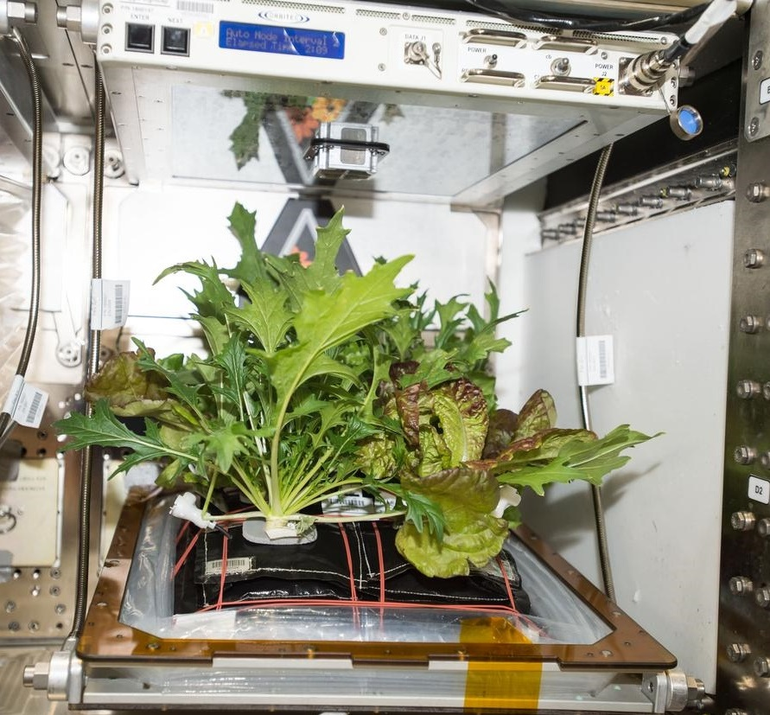
Fresh food and plants
Notes:
Some fresh fruits and vegetables are sent to the ISS about once every 1.5 months. The fresh food not only provides physical benefits but also provides psychological benefits to astronauts. However, for future missions to the Moon and beyond, this will likely not be possible, so having some fresh fruit or vegetables growing in a lunar habitat would be beneficial.
Here on Earth, most people are surrounded by vegetation. Plants play an important role on Earth and on the ISS too! Whether on Earth or on the ISS, plants purify our air and water, provide food, and support our well-being. On the ISS, plants provide psychological comfort with the familiar scents and colours of Earth. Similarly, having plants on the lunar base would help astronauts mentally during their stay. In the image on the right, there are three different variety of plants growing in the veggie growth chamber on the ISS.
(ASK STUDENTS) What do you think is needed to grow fresh food on Earth?
Make a list with the students! Let’s think of what we need here on Earth to grow fresh food: soil, sunlight, water, appropriate temperatures, nutrients, etc.
(ASK STUDENTS) What is the role of soil in plant growth on Earth?
Soil naturally has many nutrients that are required for plants to grow. If the soil is depleted in one or two nutrients, we can add fertilizers and nutrients to support plant growth.

Slide 8
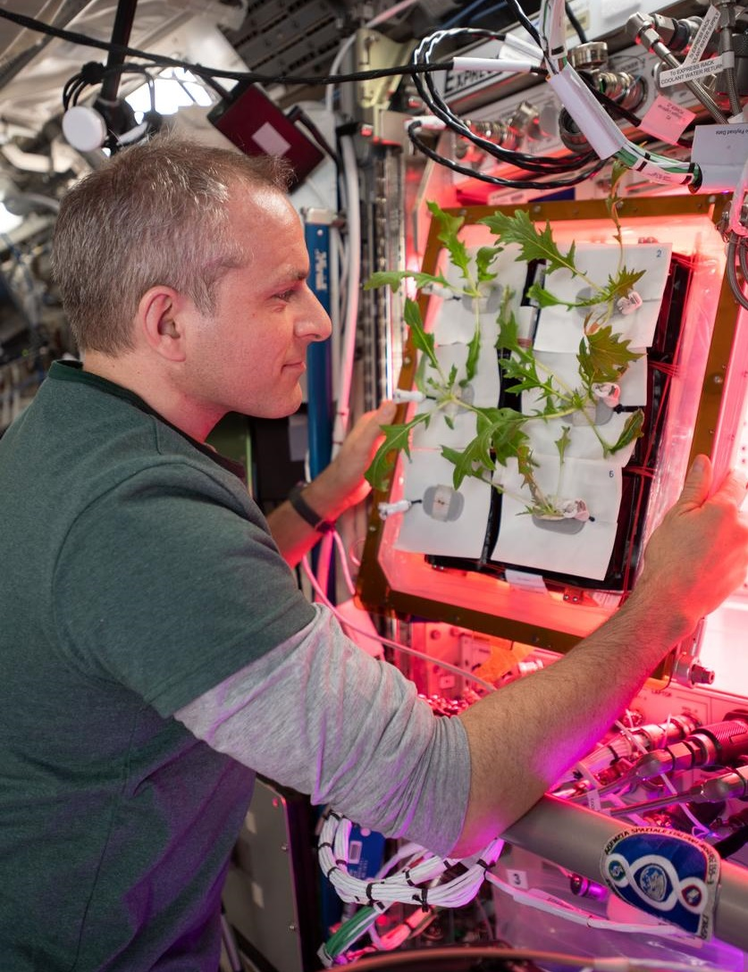
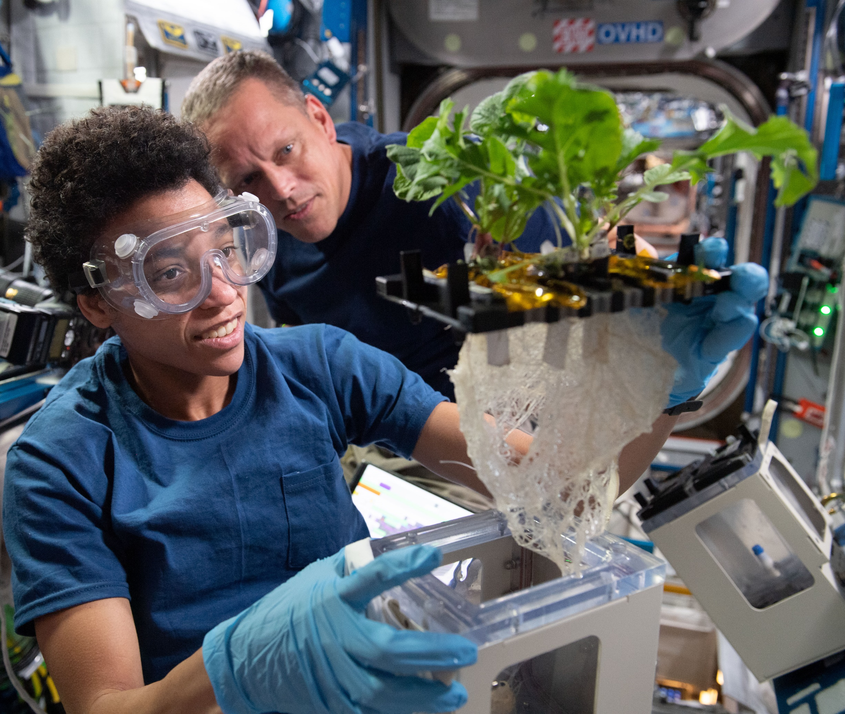
Growing food
Notes:
Before we talk about what is different on the Moon and how, let us first talk a bit about plant growth in general – what is needed for them to produce and grow. As we brainstormed in the last slide, plants need air (carbon dioxide), soil with nutrients, water, sunlight and appropriate temperatures for them to survive and thrive. In the soil, nutrients such as carbon, phosphorus, nitrogen, oxygen, sulfur, potassium, magnesium, and calcium are required depending on the type of plant.
The ability for people to grow plants has drastically changed over the past few decades. It is now possible to grow plants without sunlight, without soil, without pesticides and in a fully controlled environment to maximize how much we can grow.
How the nutrients are delivered is very important, and there are many types of nutrient delivery systems. For example, you can use the aeroponics method where the roots hanging in air or use a hydroponics system where a water-based nutrient solution is used rather than soil.
On the ISS, in the Veggie Plant Growth System, crop plants are grown using plant pillows. Each plant grows in a “pillow” filled with a clay-based growth media and fertilizer. The pillows are important to help distribute water, nutrients and air in a healthy balance around the roots. In the photo on the left, you see CSA astronaut David Saint-Jacques preparing to water the plants and looking for any leaves that have broken off.
You can utilize modern technologies (pumps, drip lines, mist nozzle, timers, etc.) to automate the process and ensure the plants are getting water and nutrients needed. In return, the plants provide clean water (in form of water vapour) and clean air (oxygen). These could be recycled and useful for astronauts. Currently, the water on the ISS is recycled.
Let’s think about the many options available for plant growth.
What about natural (Sun) light or LEDs?
For nutrients, how about soil, hydroponics, or aeroponics?
Are resources available at the location to use?
How about using robots to operate the system?
What does the habitat look like?
Where can it be in relation to the main crew habitat?
Can you recycle the plant waste?
What else is important?

Slide 9
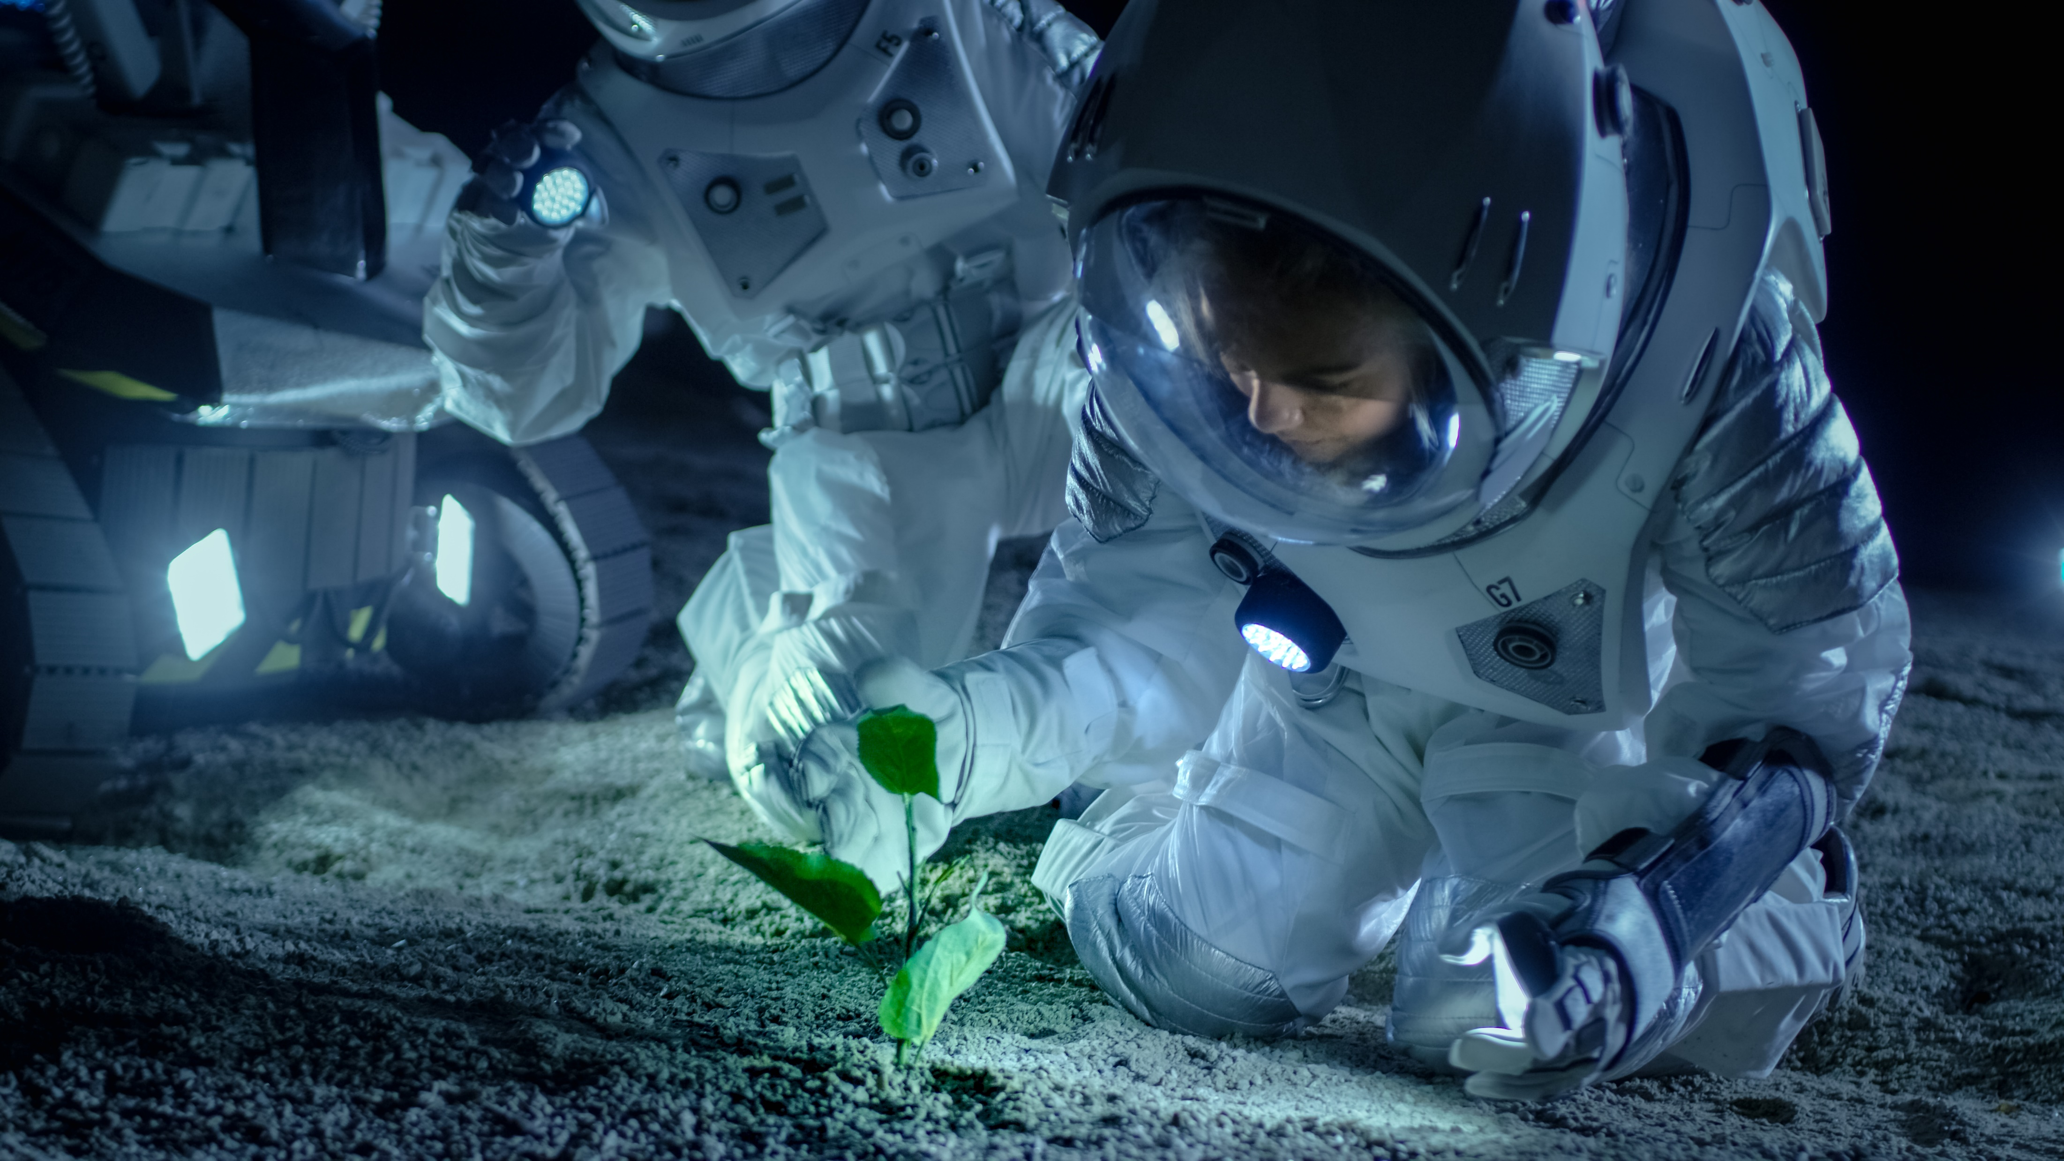
Notes:
The Deep Space Food Challenge is a competition that was launched by the CSA in partnership with NASA in January 2021.
The goal of the Challenge is to create novel food production technologies or systems that require minimal inputs and maximize safe, nutritious, and palatable food outputs for long-duration space missions, and which have potential to benefit people on Earth.
Innovators are required to design novel technologies and/or systems for food production that do not need to meet the full nutritional requirements of future crew but can contribute significantly to and be integrated into a comprehensive food system.
It is currently in the third and final phase. The winners of this competition will be announced in spring 2024.
You are working on the same challenge as folks in agencies across the globe!
(if the bandwidth allows, play this video - Using the challenges of space food production to help grow food on Earth - Canadian Space Agency (asc-csa.gc.ca))

Slide 10
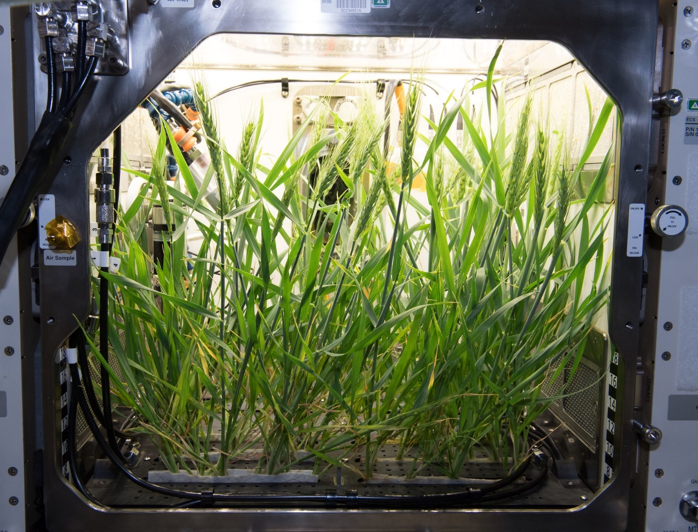
Your food production system
A standalone closed-loop system that has everything needed to produce food.
It might be a plant system for growing crops in space, or a cool new way to grow different kinds of foods.
Notes:
The food production system, or food-making machine you will be imagining for the Moon:
It could be a standalone system like a space greenhouse or indoor farm or a smaller system the size of a fridge that can fit inside a habitat module on the Moon.
This system has everything needed to make food, like lights, nutrients, water, temperature control, seeds/plants or other edible ingredients, and smart controls.
This system is closed-loop so it can recycle the air, water, has little to no waste, and can work by itself with almost no upkeep from an astronaut.
It might be a plant system for growing crops in space, or a cool new way to make different kinds of foods.
It could make enough food for snacks or a whole meal to supplement the packaged food.
This system is for space, but it could be useful here on Earth. For example, in remote and/or desert regions of the globe, and even at the scene of a natural disaster when the food supply chain is broken. The system could also be used in a densely populated areas where land is scarce.
On the ISS, there are only microwave oven-sized plant growth chambers. The image on the right is of the Advanced Plant Habitat. The Advanced Plant Habitat, a more recent addition to the ISS, is the largest growth chamber aboard the orbiting laboratory. It is designed to test which growth conditions plants prefer in space and conduct other plant and bioscience research.
Let’s think about how we can grow more in the small confines of space – in particular for a system that will provide fresh food for four astronauts to supplement the packaged food for a year on the lunar surface. We could use stacking to maximize space! We can use special lighting along with no soil but overall – it must keep the environment optimum to grow the plants at high intensity.

Slide 11
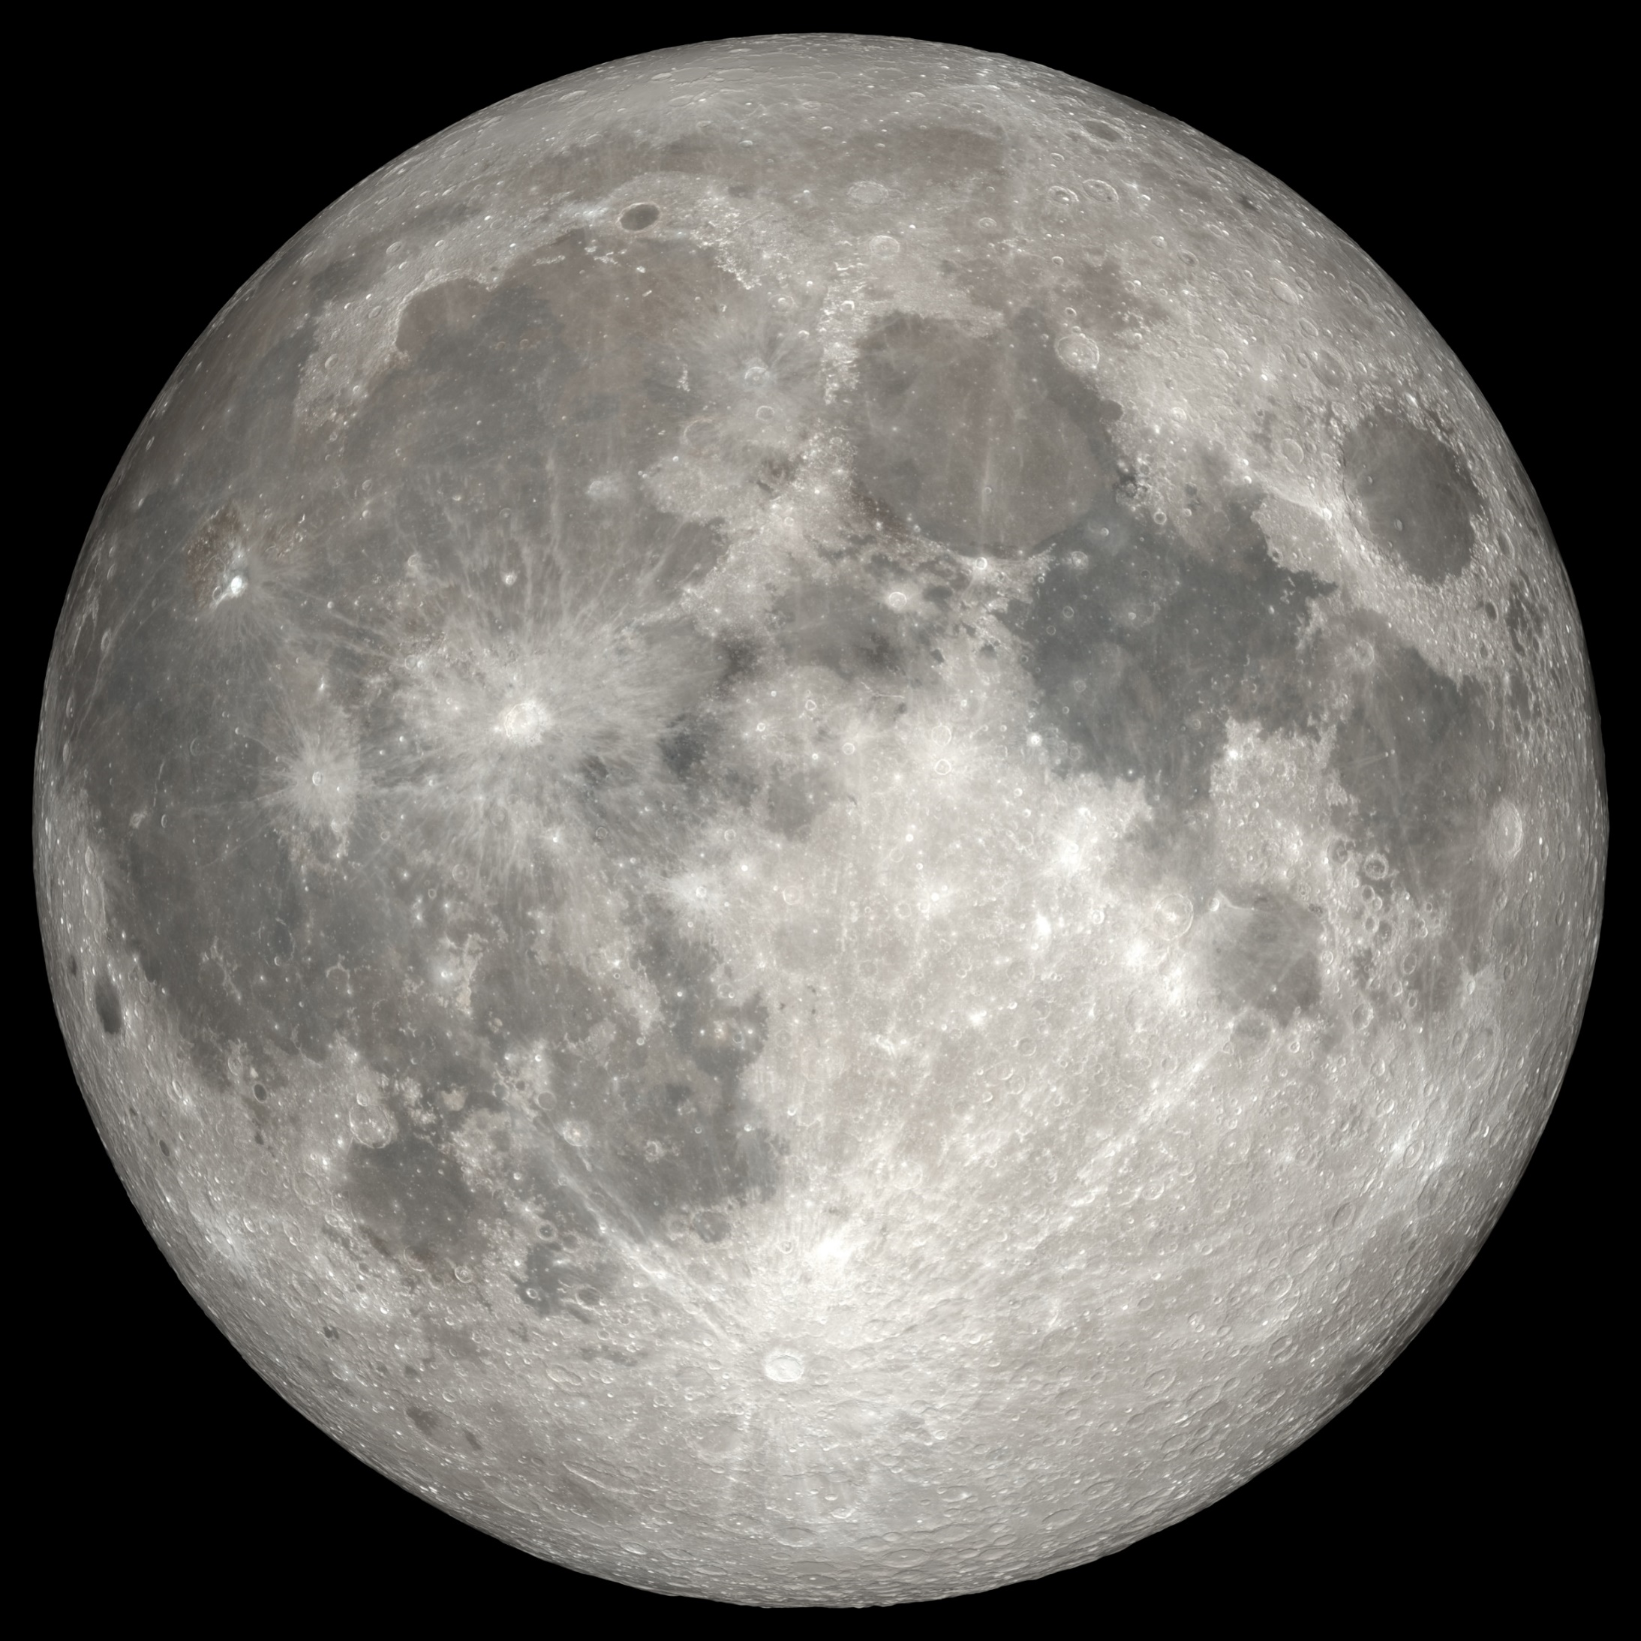
Plant growth on the Moon
Consider lunar characteristics:
Water
Light
Atmosphere
Temperature
Lunar regolith
Additional considerations:
Efficient use of space
Easy to grow, doesn’t take too long
Can eat most (or all) of the plant
Can eat without cooking or minimal preparation
High nutrient content
Notes:
Plant growth on the Moon
Growing plants on the Moon may be challenging as the environment and atmosphere is very different from Earth. The Moon’s soil does not have the necessary nutrients for plants to survive and grow, so plants would need to be in a controlled, closed environment.
Main challenges with growing plants on the Moon:
Water: Liquid water is not available.
Water would need to be provided
Light: Duration of day and night varies on the Moon. Moon days are 28 times longer than on Earth, and there are cycles of 14 days of light and 14 days of darkness.
Use of artificial light systems
Atmosphere: The Moon has no protection from radiation. Moon has very tenuous atmosphere.
Protection from radiation needed
Temperature: Can reach 127 °C in the Sun and -173 °C at night at the equator. At the poles, it can reach up to -250 °C, and some regions inside the craters are permanently shadowed and do not receive sunlight and are cold.
Temperature regulation systems needed
Lunar regolith: The Moon’s soil does not have the necessary nutrients for plant growth. Lunar soil (regolith) has the texture of fine dust.
Potential use of hydroponic or aeroponic systems
Additionally, plants grown on the Moon should provide food for the crew with little preparation or processing needed. Ideally, the plants should require no or minimal preparation to eat, and most or all of the plant should be able to be eaten to reduce waste. The food should not take too long to grow (the mission duration is only one year). The food should be easy to eat (i.e., does not need to be cooked).
It is important to maximize the plant growth in the least amount of space available by making efficient use of space. The smaller the food production system, the better! It is important to remember that the larger the system is, the more resources will be required to make it operational for the duration of the year.
When designing a food production system on another planetary body, it is important to create a system which would mimic Earth’s atmosphere, light, temperature, and nutrient profiles for plant growth.

Slide 12
To think about...
Location – Moon
Duration of the mission – 1 year
Crew size – 4
Keep in mind the lunar characteristics we discussed.
For your food production system, think about
- What type of food will be grown?
- How is it controlled and maintained? By astronauts? Robots?
- How are the nutrients being delivered to the plants?
- What does the lighting system look like?
- How will your food be protected from radiation?
- What temperature will the system require?
- Will the waste from the system be recycled? If so, how?
- How can this system be applied on Earth?
Food criteria – needs to be easy to eat and prepare, tasty, and quick to grow or harvest
Notes:
Now it is time to put your thinking caps on and design your food system. There are several challenges and constraints in producing fresh food on the Moon. Some are laid out here. Keep them in mind as you explore, brainstorm, and develop your idea.
Keep this slide up during the brainstorming so the participants can refer to it.

