Slide 1
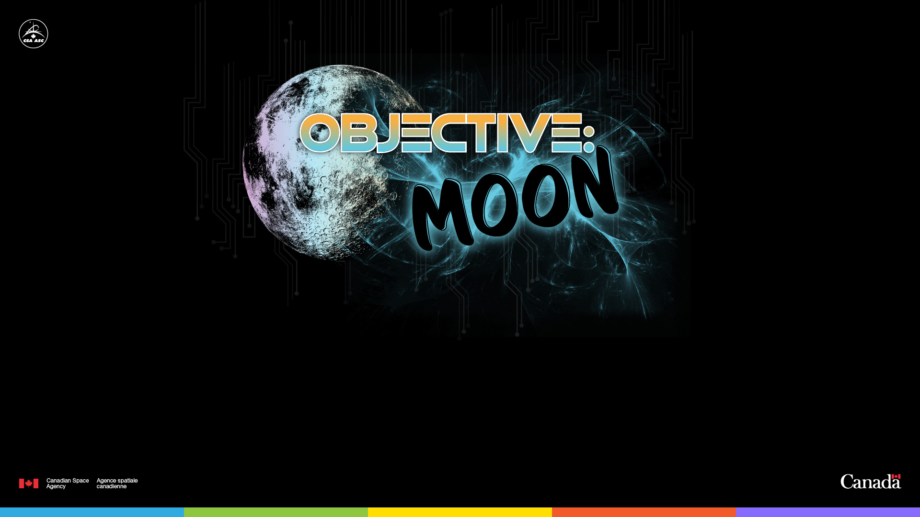
Space Brain Hack
2022–2023
Notes:
Introducing the concept of Space Brain Hack to students
We’re heading back to the Moon… and taking humans farther than we’ve ever been before!
The Canadian Space Agency (CSA) and its partners around the world are facing many new challenges as they aim to send humans farther than we have ever gone in space. During these longer-duration missions, astronauts will have to cope with limited communication and other constraints, so we have to think about new solutions astronauts can use to stay mentally healthy on their journey. We are invited to “hack” the CSA’s brain because we all have experience maintaining our mental health, and imaginations to come up with new ideas and solutions. Are you ready?
Let’s put our thinking caps on!

Slide 2
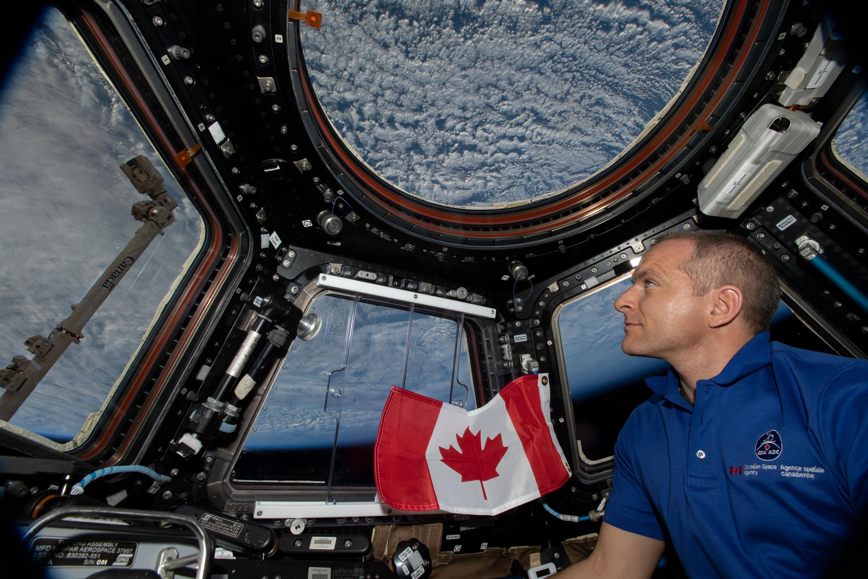
2
Notes:
How it will work
Your challenge is to propose a solution to support astronauts’ mental well-being in space. This might be a way to help them stay connected to home while on a long-distance and/or long-duration mission.
You will learn more about why staying well mentally in space is important and, after that, we'll begin thinking about solutions. Let’s start by talking about Canada’s involvement in lunar missions and space health.
Humans are working towards the exploration of space beyond the International Space Station (ISS). We are taking small steps by first returning to the Moon, with the goal of visiting Mars someday.
Currently, astronauts live and work aboard the ISS, which orbits 400 km above Earth. There have been humans living in space for longer than you all have lived – over 20 years! (See footnote.) When you think about it, 400 km is not very far. It’s about the distance from Montreal to Ottawa and back. (Note: find a local comparison.) This means that the ISS can be resupplied from time to time, there is a rotation of the crews every six months on average, and astronauts can technically get back to Earth if they are really in trouble. It’s not easy at all, but feasible.
Generally, astronauts spend a short time getting to the ISS for a mission of about 6 months long. When we get back to the Moon in the next few years, astronauts will travel much farther and will spend more and more time farther away from Earth during these long-distance missions.
Footnote: The construction of the ISS started in 1998, with the launch of the first module. The first crew started living aboard the orbiting laboratory in November 2000.
Image: Canadian astronaut David Saint-Jacques enjoying the view of Earth from the Cupola on the ISS.

Slide 3


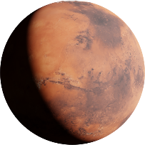
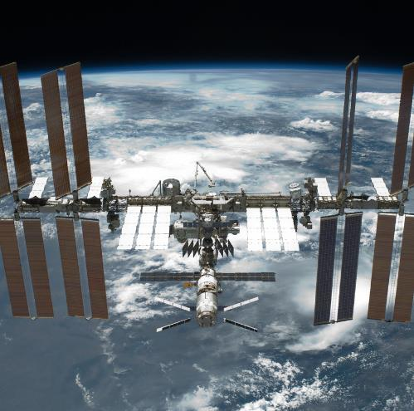

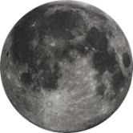
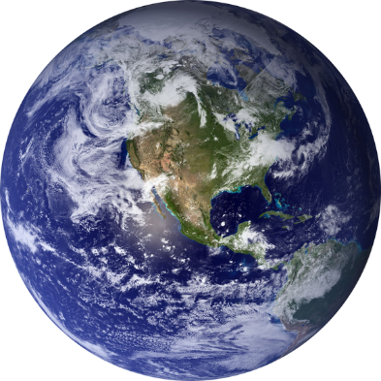
+ 400 km
+ 400 000 km
+ 400 000 000 km
Notes:
The context
Let’s situate ourselves in the solar system. Most crewed missions have been to what we call low Earth orbit – specifically the ISS as we learned in the last slide. Our next set of missions – the Artemis missions – will take people to the Moon. Years from now, when we are ready to send humans to Mars, it will be a significantly more complex voyage.
If you look at the slide, you’ll notice that the Moon is approximately 1000 times farther from Earth than the ISS (384,400 km, rounded to 400,000 km).
And Mars is 1000 times farther away from the Moon (400,000,000 km). Now that is some road trip!
As astronauts travel farther away from Earth, they will experience a communications delay. It takes on average 2.56 seconds for a signal from Earth to reach the Moon and back. While that may sound like a very small delay, it does complicate communications, especially in case of an emergency. Just think about how frustrating and difficult it is when you’re on a video conference call and the image and sound freeze for a few seconds. You miss important information, and sometimes everyone on the call ends up speaking at the same time.
If time permits, pause here to conduct the optional activity described in the “Communication” section of the Educator Guide.

Slide 4
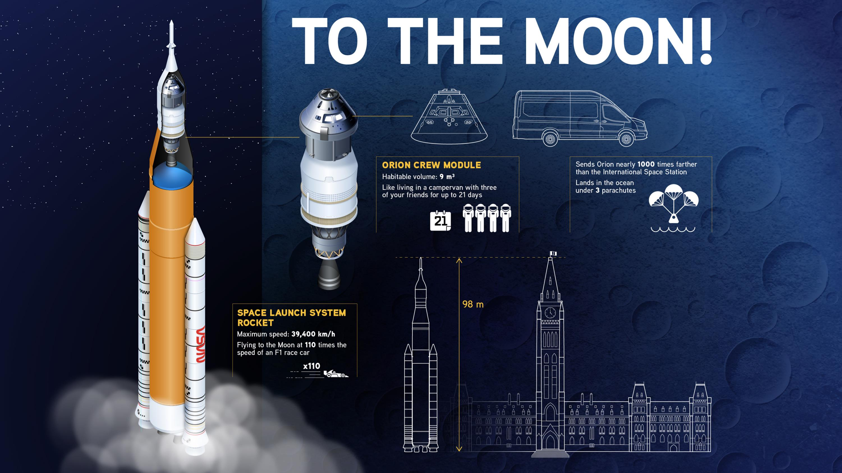
Notes:
The astronauts’ ride
NASA, the CSA, and other international partners are preparing for missions to the Moon, called the Artemis program. They will use new technology to study the Moon in new and better ways. They will also prepare for human missions to Mars. In doing so, the first woman and first person of colour will land on the Moon. Did you know that the last time humans walked on the Moon was in 1972, over 50 years ago? Only 24 people have travelled to the Moon. And only half of them walked on its surface between 1969 and 1972.
The Orion spacecraft, shown here, will be carrying Artemis astronauts to space. It is designed to be launched at the top of NASA's Space Launch System (SLS) rocket. Orion includes the European Service Module and the Crew Module.
The European Service Module will carry air, nitrogen, and water for the crew. The module is also equipped with in-space propulsion and power systems.
The Crew Module is where the crew will live and work during Artemis missions. It can withstand the intense physical forces and heat from re-entry into Earth's atmosphere. It is only about the size of a campervan.
The capsule size brings some very real constraints – think about it. Four adult humans living and working in a van for 3 weeks, and they can’t crack a window or go outside to get some fresh air. In addition to the size, there are physical challenges the astronauts must face, such as exposure to radiation, microgravity, need to stay focused for long periods of time, and stress on the body of launch and re-entry.

Slide 5
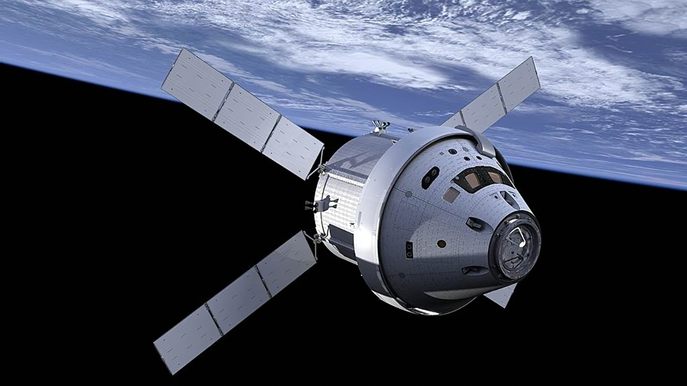
Artemis missions
I
ARTEMIS I
an uncrewed test flight
ARTEMIS II
a crewed test flight
ARTEMIS III
astronauts fly to the Moon
II
III
Notes:
Current mission plans include:
Artemis I, an uncrewed test flight of the Orion spacecraft, which launched on the Space Launch System (SLS) rocket on November 16, 2022 (landing: December 11, 2022).
Artemis II, the first-ever crewed test flight of the Orion spacecraft, targeted to launch on the SLS rocket no later than May 2024. A Canadian astronaut will be part of the crew as mentioned before.
Artemis III, currently targeted for no earlier than 2025, will fly astronauts to the Moon. The mission may land humans on the lunar surface.
Image: NASA

Slide 6
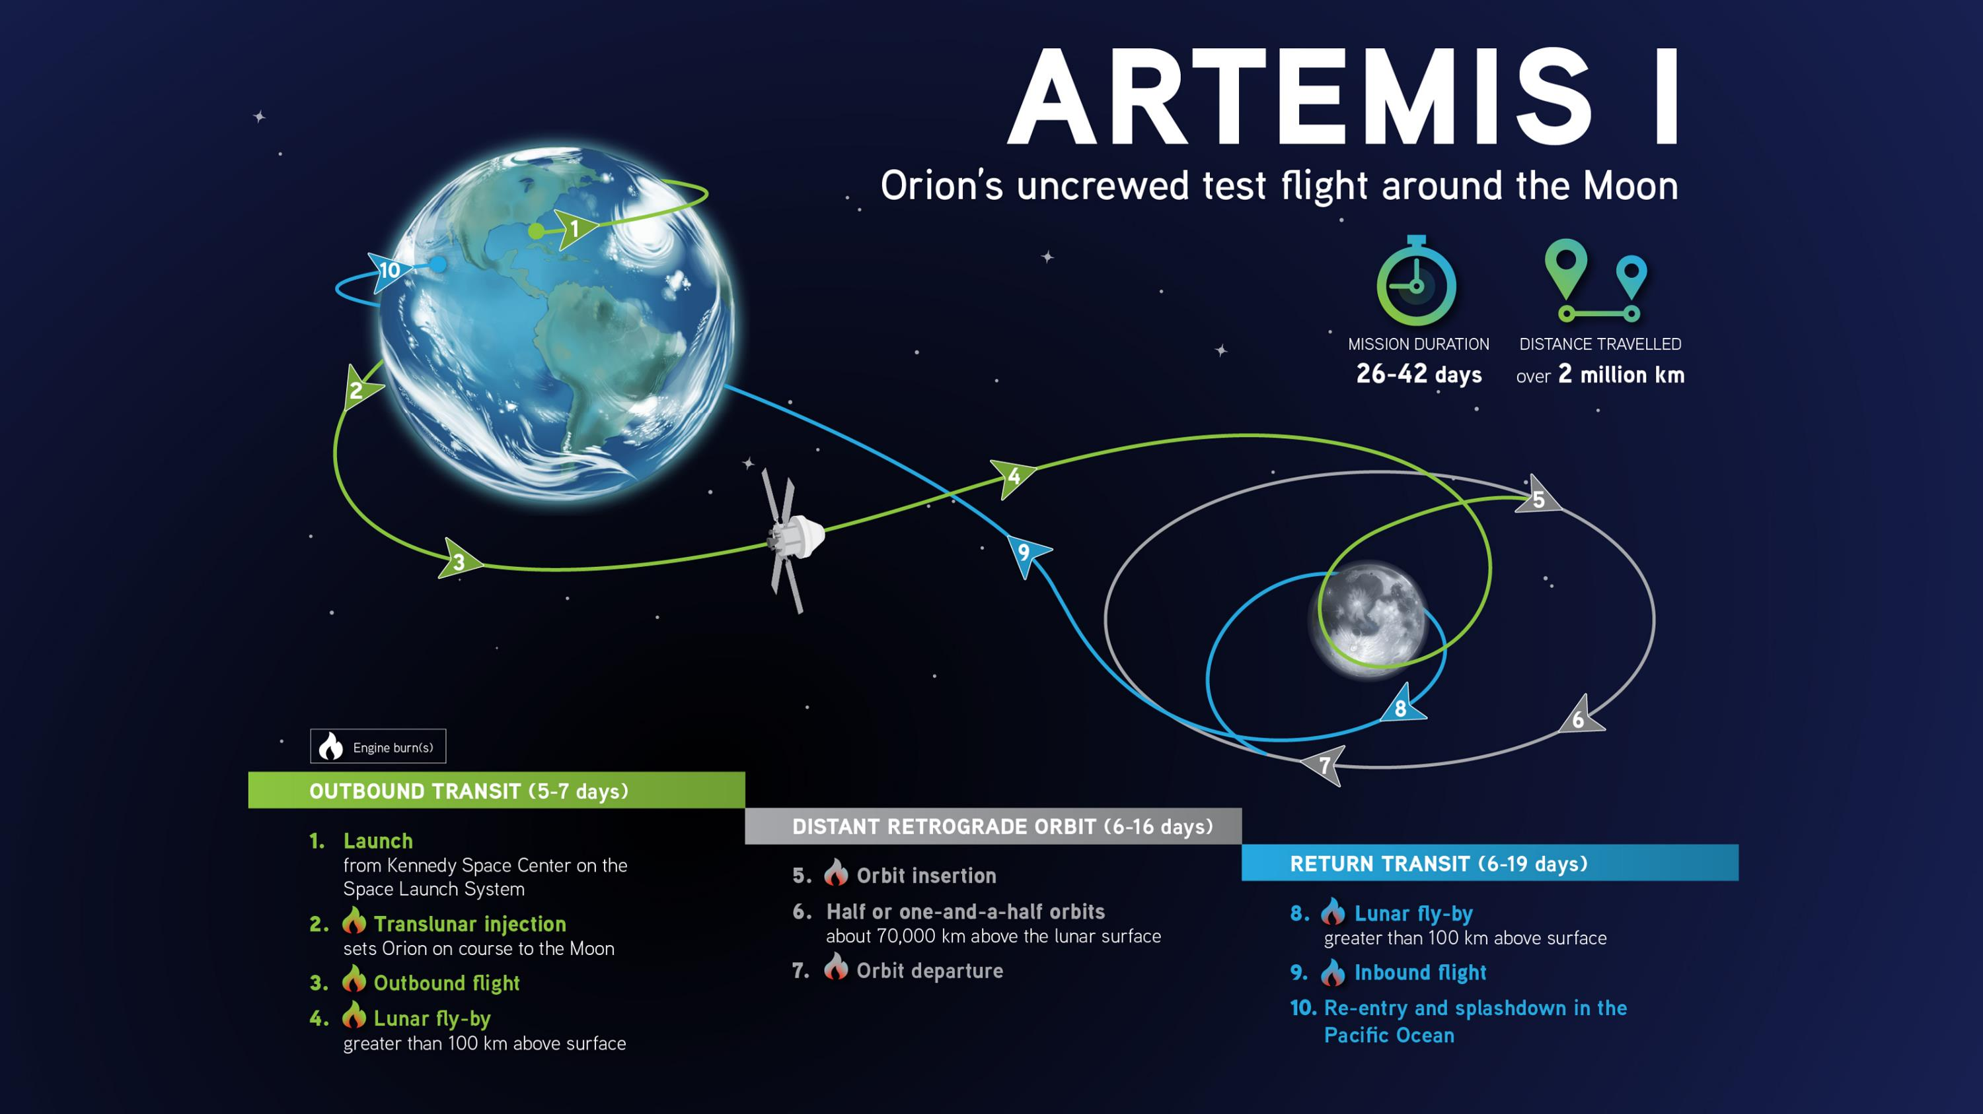
Notes:
This image shows you the path of Orion during the Artemis I mission. The purpose of this trip of almost 26 days is to test the flight path that Artemis II will be taking with astronauts aboard.

Slide 7
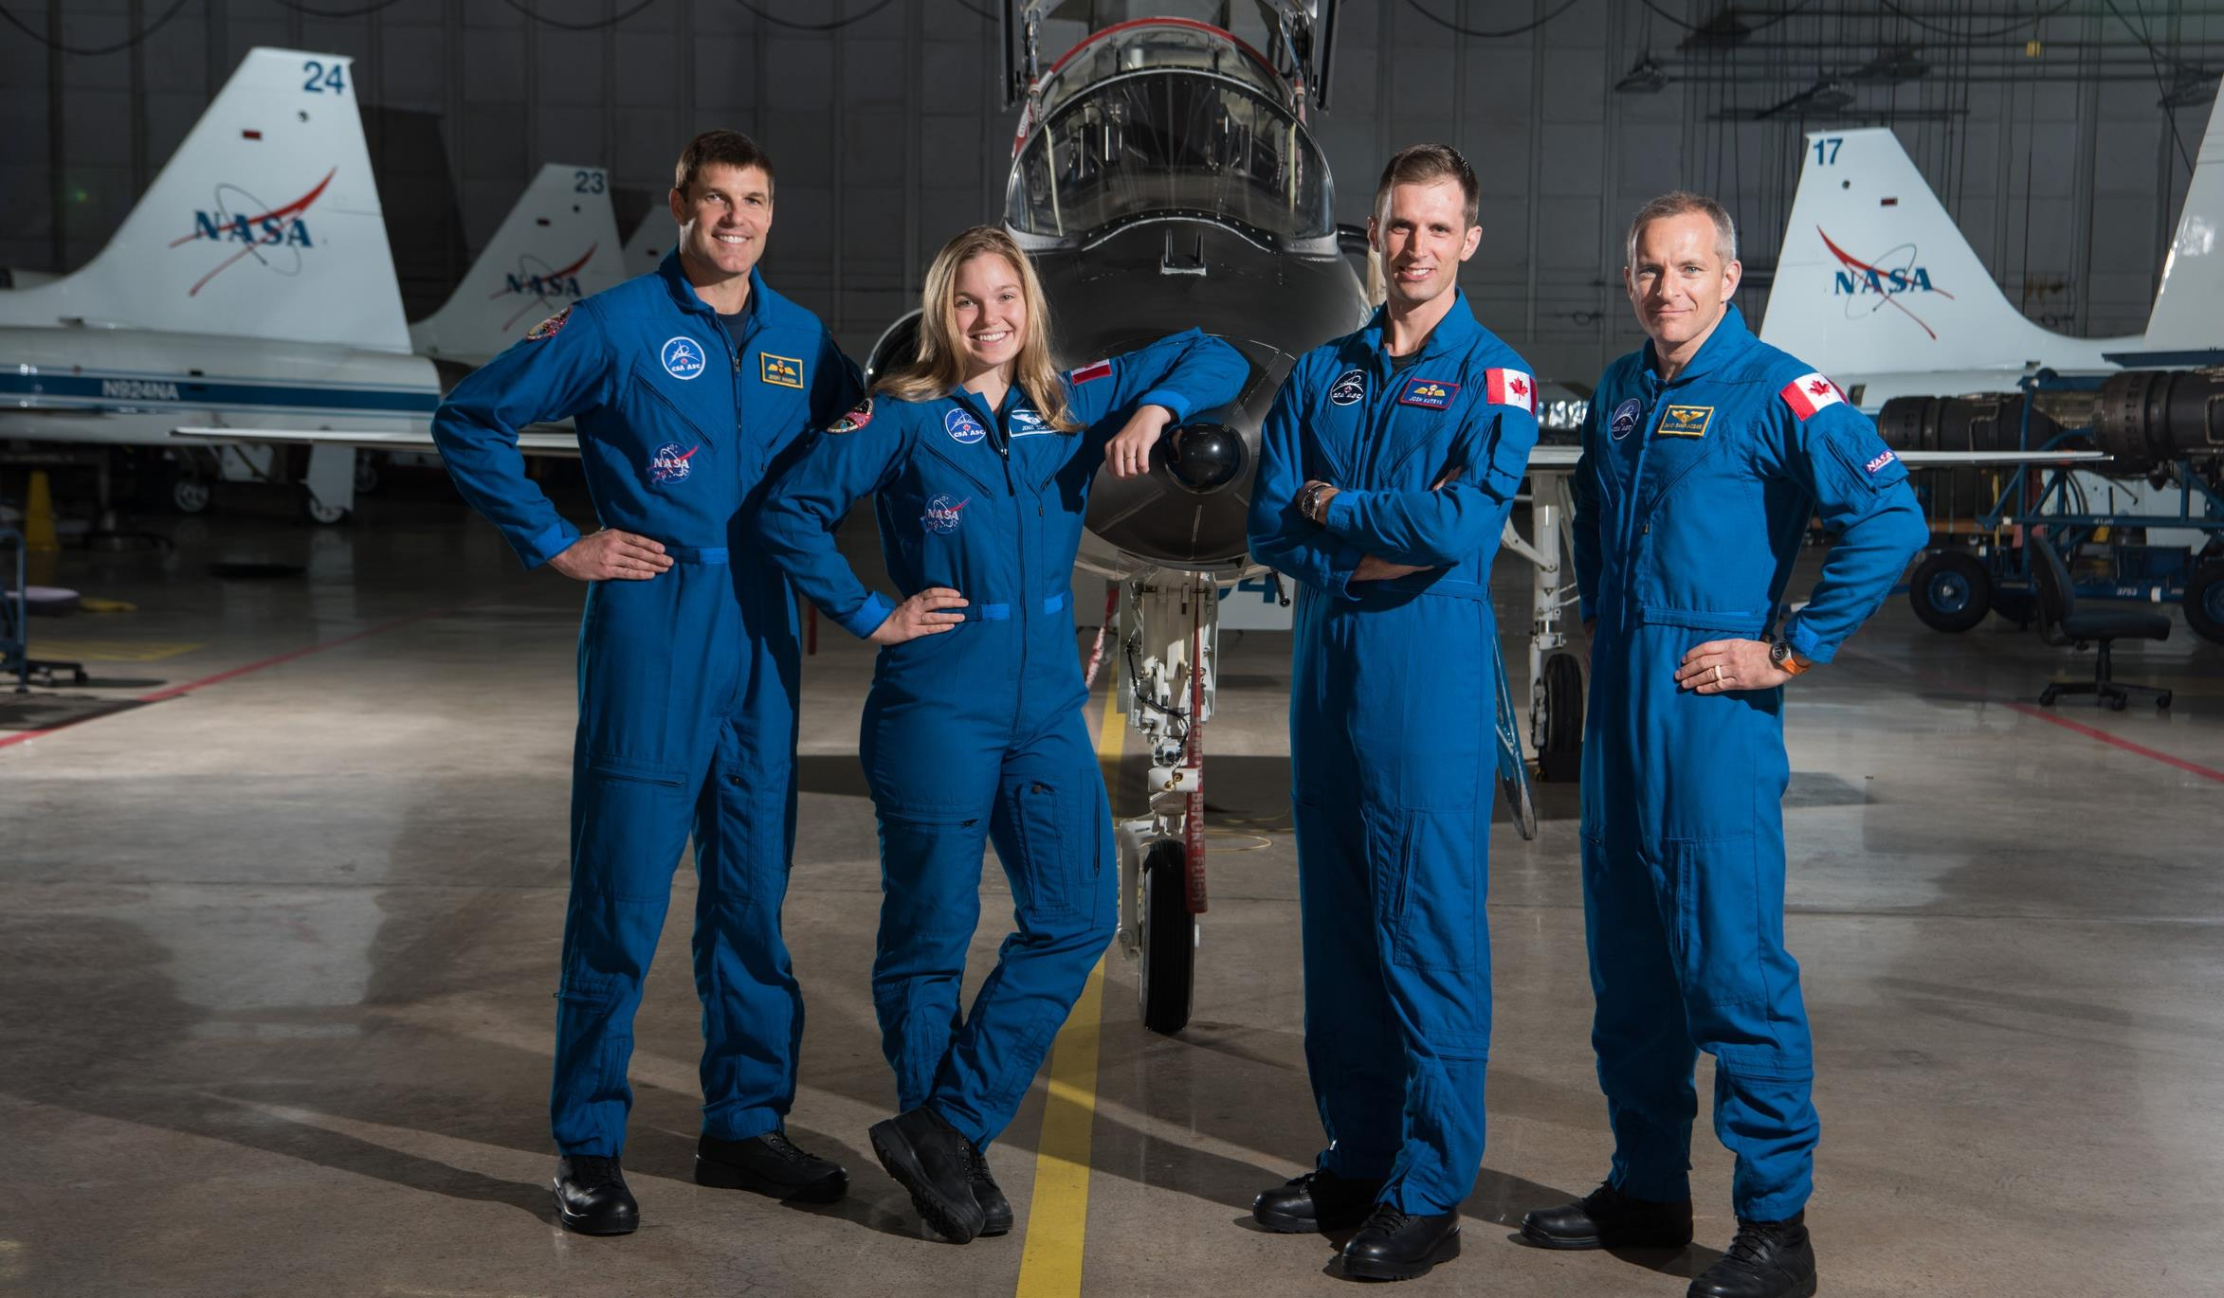
11
Notes:
Canada’s astronauts!
These are Canada’s current astronauts. One of them will be chosen to fly around the Moon on Artemis II!
Each one of them is different, and they work with other astronauts when they are involved in missions. Ideally the solution you propose might work for them, but could work for others in the crews they join and for their fellow earthlings. Part of the CSA’s mandate is to promote the peaceful use of space and ensure that space science and technology has benefits for Canadians, too. Maybe someday you will travel to the Moon or Mars and benefit from it as well!
(From left to right: Jeremy Hansen, Jenni Sidey-Gibbons, Joshua Kutryk, and David Saint-Jacques)

Slide 8
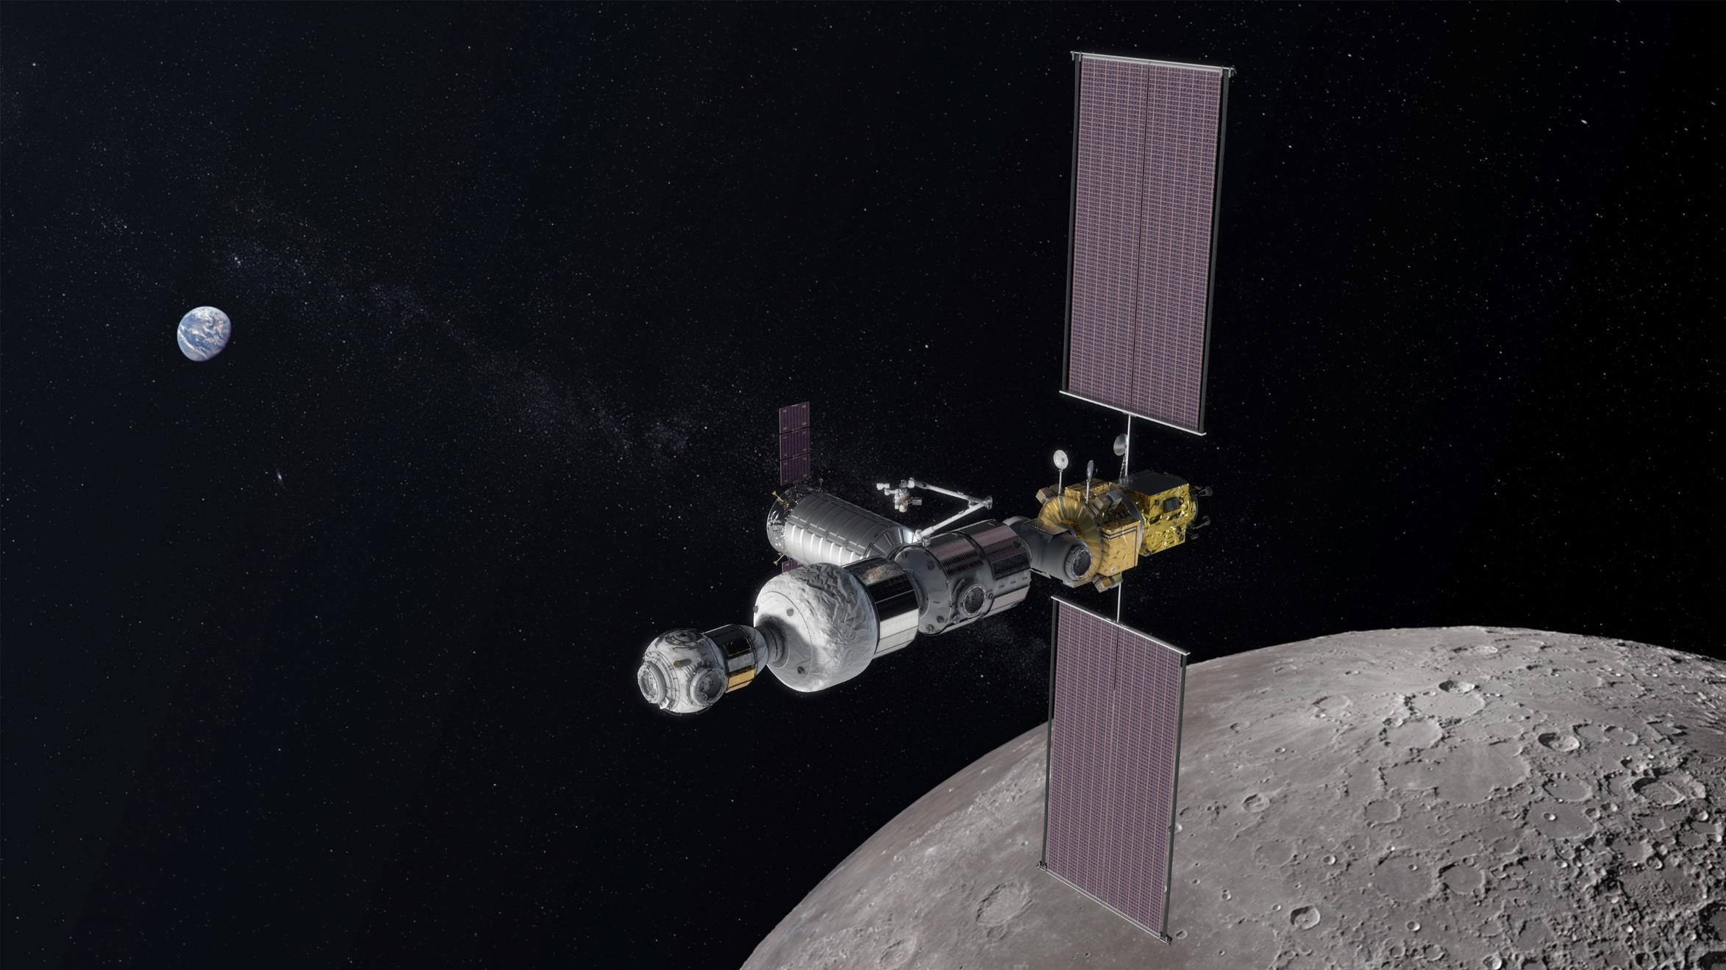
Lunar Gateway
Notes:
The Lunar Gateway
Canada is contributing to the Lunar Gateway, an orbiting space station around the Moon. It will be much smaller than the ISS (about one-sixth), and when astronauts arrive there will be no one there to greet them. Once assembled, the Gateway will include modules for scientific research and living quarters for crews of four. Unlike the ISS, the Gateway will not be crewed continuously, though it will be inhabited at least once a year.
Like the ISS, the Gateway will be a science laboratory and a testbed for new technologies. It will also be our connection to the surface of the Moon, a rendezvous location for exploration of the surface, and a mission control centre for operations on the Moon. One day, the Lunar Gateway will be a stepping stone for voyages to Mars.
Canada is contributing a smart robotic system, Canadarm3, to the Gateway. As an artificial intelligence-based robotic system, Canadarm3 will be able to tend to the Gateway when no humans are on board. It will include:
a large, 8.5-metre-long arm
a smaller, more dexterous arm
a set of detachable tools
This next-generation Canadian robotic system will be designed to:
maintain, repair and inspect the Gateway
capture visiting vehicles
move Gateway modules
help astronauts during spacewalks
enable science both in lunar orbit and on the surface of the Moon
Canadarm3 will be designed to work without an operator. The system will also have the capacity for operation by robotics flight controllers on Earth. Astronauts aboard the Gateway will be able to operate it during spacewalks.
More about the Gateway and Canadarm3:
https://asc-csa.gc.ca/eng/astronomy/moon-exploration/default.asp

Slide 9
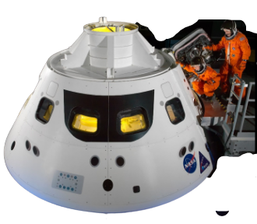
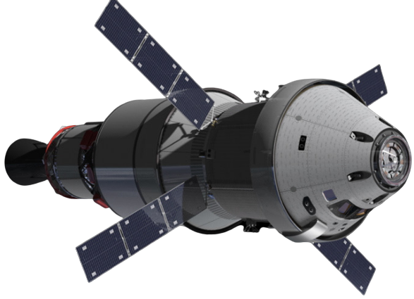

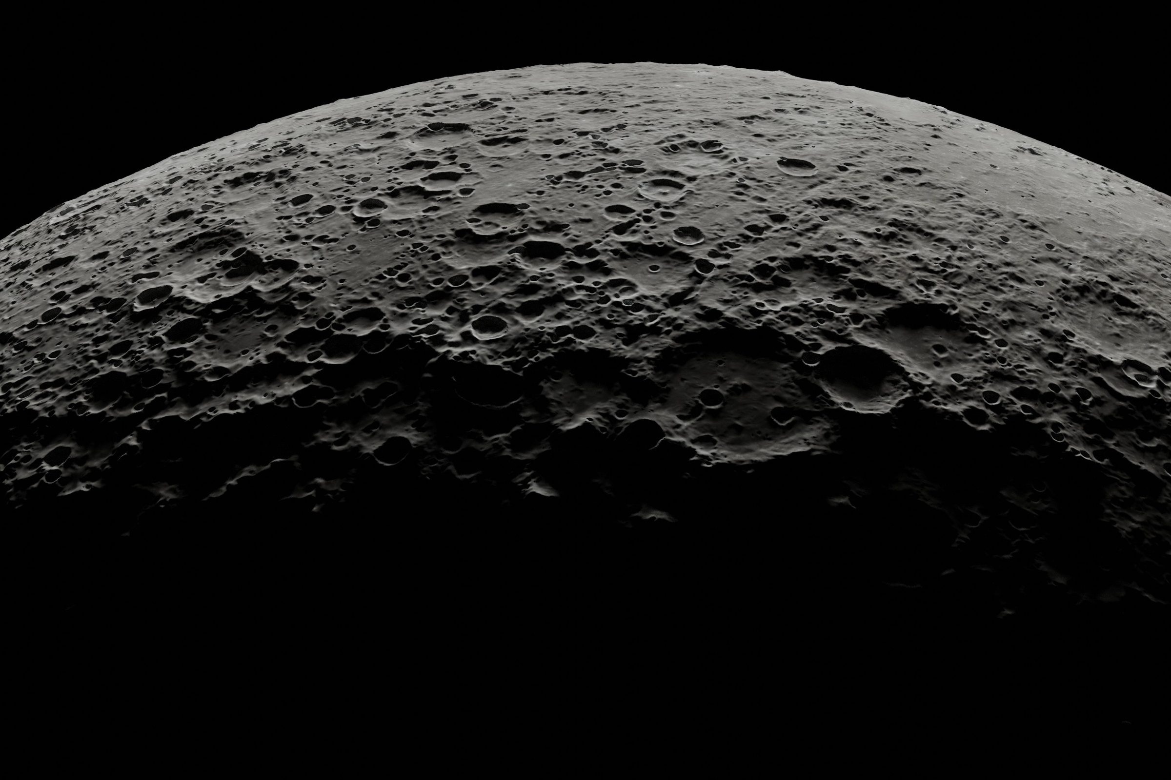
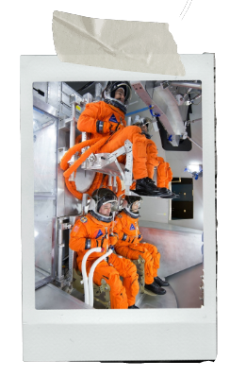
Notes:
Orion and the Gateway in your challenge
Orion will be the mode of transportation for astronauts to travel around the Moon and to the surface, and eventually also to the Lunar Gateway. Your solutions to the challenge are about keeping astronauts mentally healthy aboard, and there are some constraints you will have to keep in mind:
The interior of the Crew Module will be about the size of a small van.
The astronauts will share this space for several days with no privacy.
The astronauts will have some work to do, but not as intensive a schedule as on the ISS or the Gateway, so they will have more downtime.
This is very different from the ISS, which has the interior size of a 747 plane. The ISS has tiny personal quarters the size of a small closet or telephone booth (a one-person bedroom). There are several attached modules, and enough room to move around and get some personal time.

Slide 10

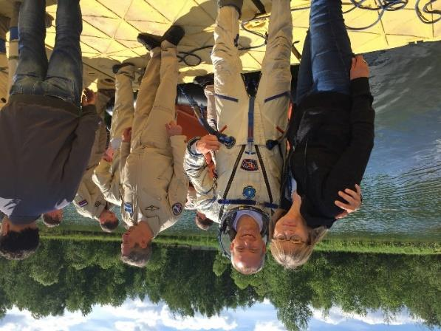
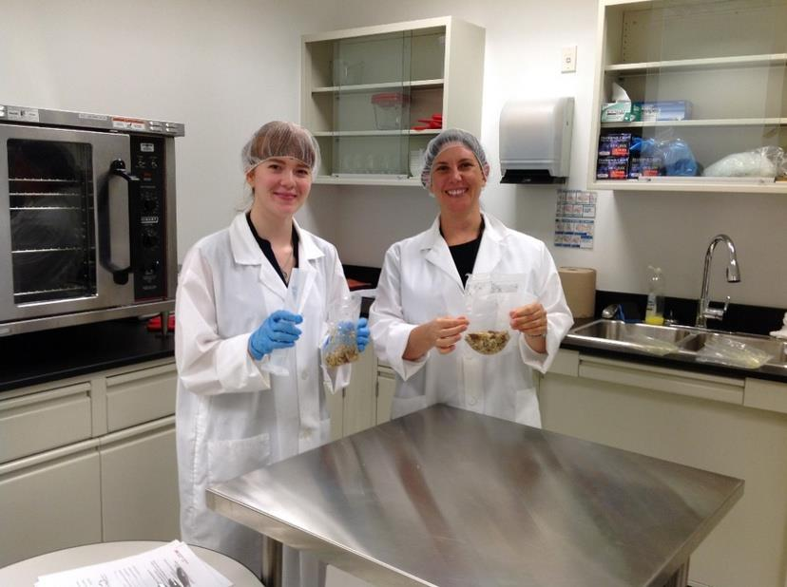
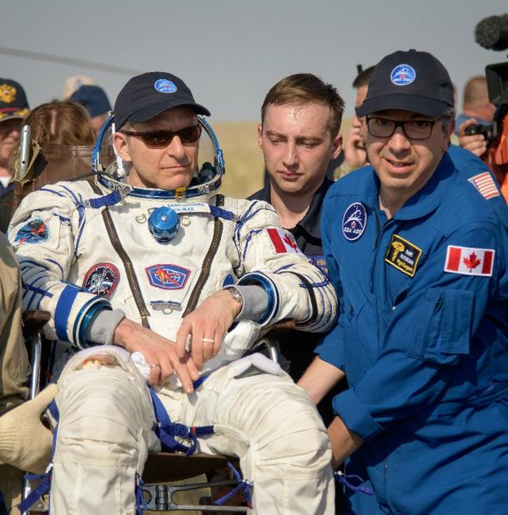
Keeping astronauts healthy
Notes:
Astronauts are the tip of the iceberg of space travel. There is a large team of people supporting astronauts before, during and after their missions. Here are a few experts working with astronauts to keep them physically and mentally healthy. Did you know that there was such a thing as astronaut doctors?
Left: Leena Tomi provides psychological and other support to the astronauts and their families during missions. She is part of the CSA’s Operational Space Medicine team. This team ensures the health and well-being of Canadian astronauts before, during and after spaceflight. Her areas of responsibility are human behaviour and performance, and radiation health and safety.
Middle: Hope Kurylo (left) is a Food Science Specialist. She has a background in nutrition and food sciences. Hope helped provide astronaut David Saint-Jacques with Canadian food during his 2018/2019 mission to the ISS. Dr. Natalie Hirsch (right) builds the fitness and nutrition programs for Canadian astronauts. Astronauts have different programs for before, during, and after their missions. She works closely with the NASA Food Lab to offer Canadian foods to fuel Canadian astronauts and other crewmembers on the ISS. She also supports the recovery of astronauts after they land back on Earth.
Right (in blue): Dr. Raffi Kuyumjian is a Flight Surgeon (a.k.a. an astronaut doctor!). He looks after the health of astronauts before, during and after their mission. He is also involved in a variety of technology development projects to keep astronauts healthy during future deep-space exploration missions.

Slide 11

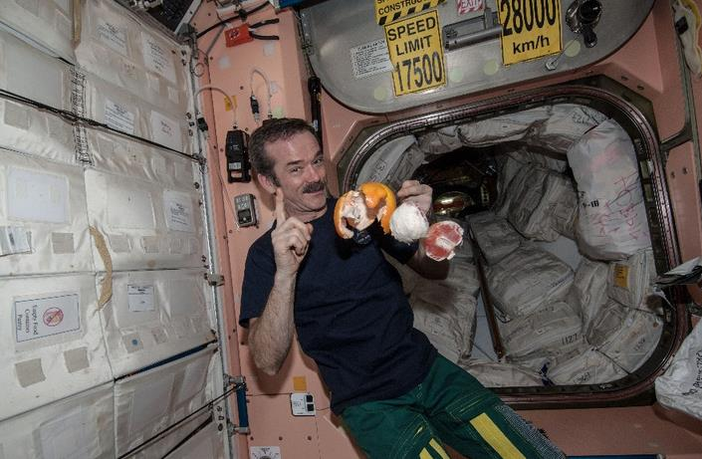
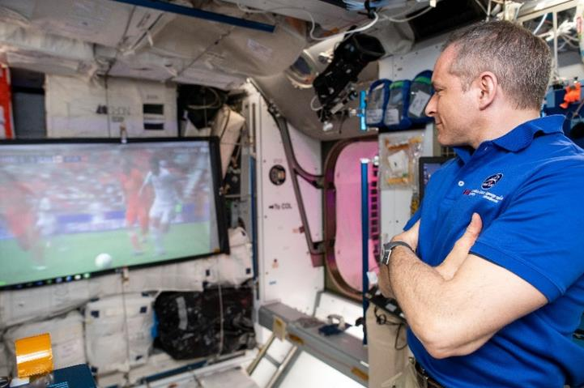
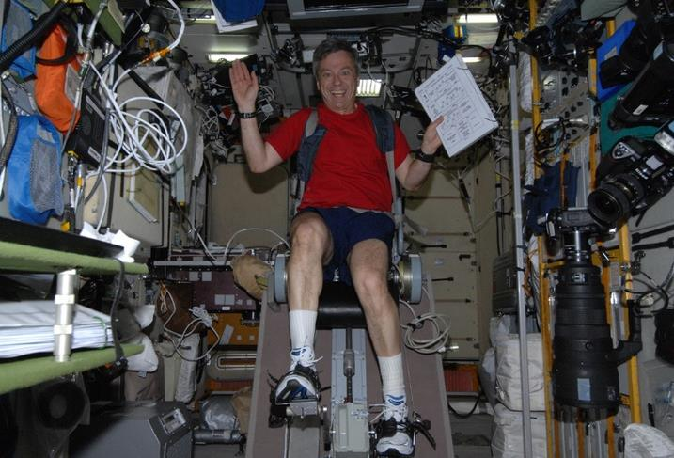
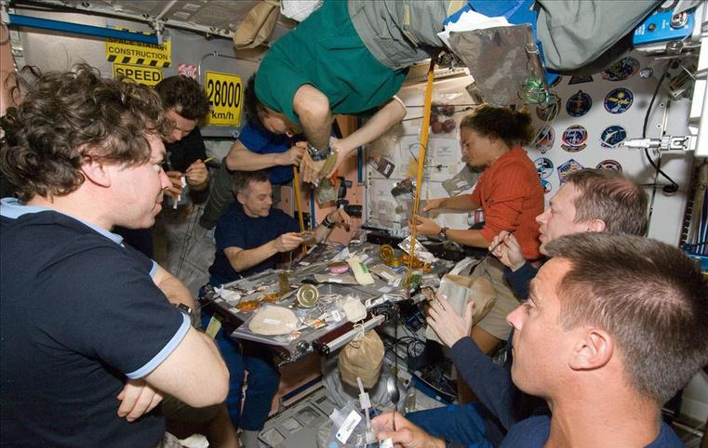
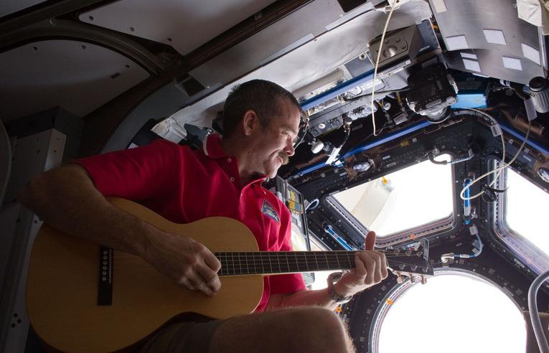
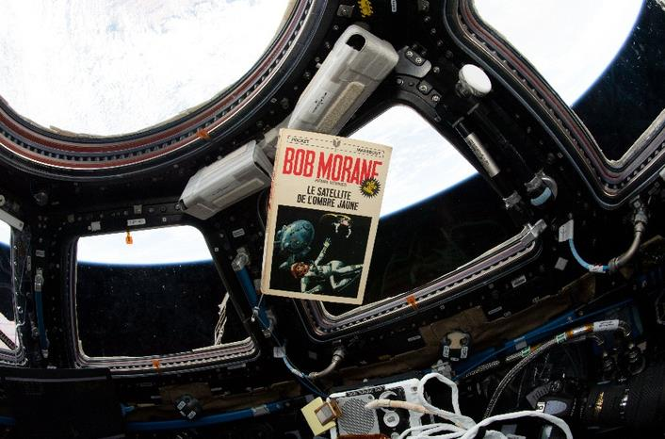
Mental health in space
Notes:
What about mental health in space?
Thinking about your own ways of staying mentally healthy, how do you think astronauts living in space for a long time take care of their mental well-being?
Use the images on the slide to present a few examples.
Astronauts in space are isolated from family and friends. They live in a cramped uncomfortable environment for a long time. Just like you, they like to gather with friends to do activities, share a meal, play a game or watch a movie. They also need some alone time. Some astronauts play music, read books, or watch Earth go by from the ISS’s big bay window called the Cupola. Sleeping well, eating healthy foods and exercising in space are essential to maintain both physical and mental health.
The human body is adapted to life on Earth. When astronauts live in the microgravity environment of space, it affects their bodies. These changes are more noticeable the longer an astronaut stays in space.
Their muscles get weak, their bones lose mass, their blood vessels get stiff, and they are exposed to radiation. Being in space is definitely not a walk in the park! To stay healthy and help their recovery when they get back on Earth, astronauts exercise for about two hours every day. Exercise also helps their mental health.
But why do you think it’s important for astronauts to take care of their mental health?
A few possible answers: If they are not well, they can't continue their work and can’t come home; not being mentally sharp can put them and their crewmembers in dangerous situations, especially in case of an emergency; they live and work in stressful conditions – not taking care of their mental health can add to their stress; given the environment they are in, they need to be able to take care of themselves and each other.
Astronauts can encounter many situations in a long-duration or long-distance mission that test their mental health. Whether it’s cooperating with a team under stressful conditions, maintaining focus while the body adapts to microgravity, or the loneliness they feel being away from friends and family (and not being there to support their family if something happens on the ground), their mental health is always being challenged. Astronauts are human after all!

Slide 12
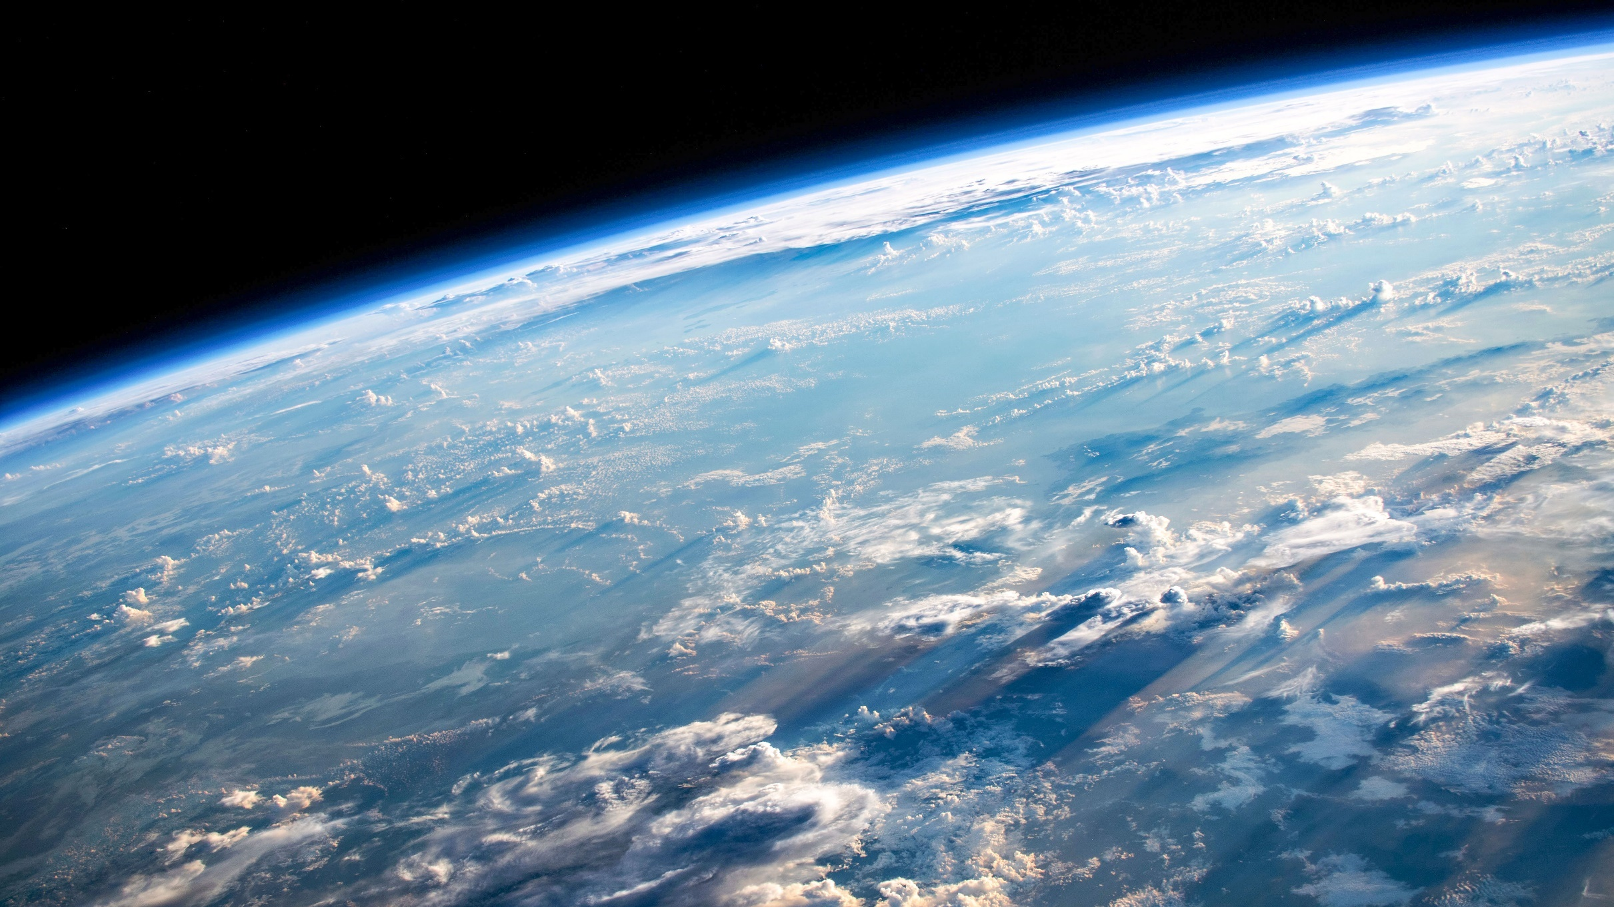
The Overview Effect
Notes:
From above
The experience of seeing Earth floating in the void of space and realizing its fragility has a profound effect on astronauts. This is the “Overview Effect,” a term coined by space philosopher and author Frank White in 1987.
Seeing our home planet from above, against the darkness of the universe, is a life-altering experience for many astronauts. Seeing the thin layer of atmosphere which protects Earth from the vacuum of space (the thin blue haze in this picture) gives astronauts a new perspective. Many speak of finally realizing how delicate our planet is, and how connected everything is on its surface. As humans travel farther into space, how might the feelings of looking back at Earth change? How might it affect the mental health of astronauts on deep-space missions?

Slide 13



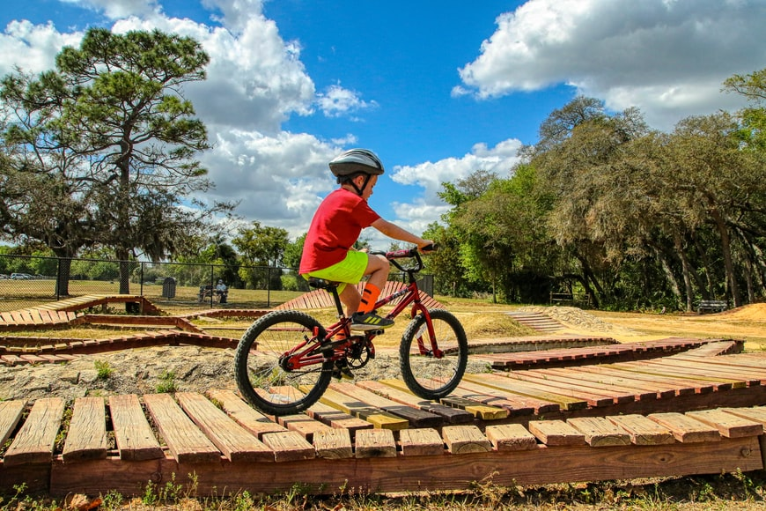



What contributes to your mental well-being?
Notes:
What affects our mental well-being
Ask the students what they know about mental health.
According to the Public Health Agency of Canada, “Mental health is the state of your psychological and emotional well-being. It is a necessary resource for living a healthy life and a main factor in overall health. Good mental health allows you to feel, think and act in ways that help you enjoy life and cope with its challenges.”
In First Nations traditions, mental health is one part of the wellness wheel. The wellness wheel represents our whole health, and includes physical, mental, emotional, and spiritual health. These areas of health are closely tied to personal purpose, meaning, belonging, and hope.
Based on these definitions, what are some of the things that can impact your mental well-being? What are some ways to keep mentally healthy?
Use the images on the slide to present a few examples:
Eating healthy foods, faith and spirituality, listening to music, playing music, reading a good book, being active, having hobbies, spending time with family and friends, our relationships with others, our life, work or school environment, the type of community we live in, playing with a pet, etc.
Invite the students to share a few things that help them maintain their mental health.
Remember, what works for some may be less effective for others depending on their personality and their environment. In a space environment, do you think this is similar or different? Let’s explore!

Slide 14

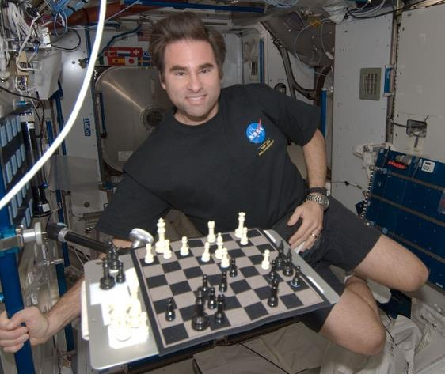
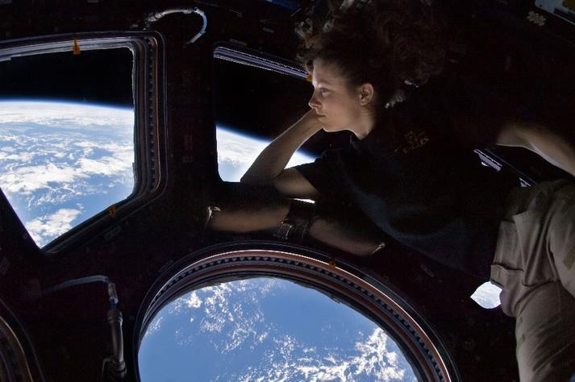
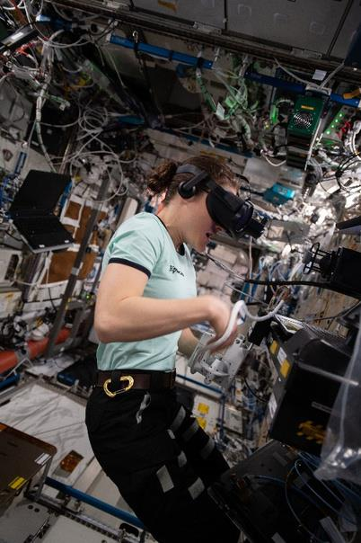
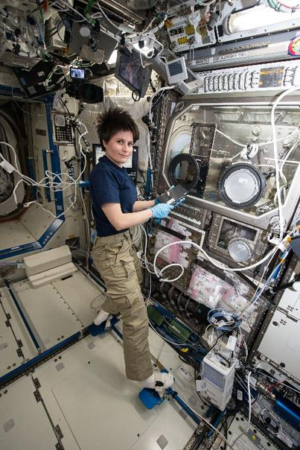
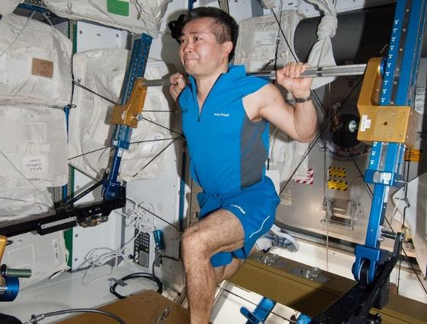
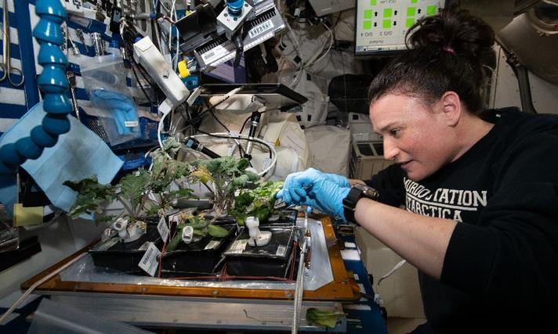
To get you started…
Notes:
What we have
We don’t know yet all the equipment and material that will be in the Orion spacecraft and the Lunar Gateway. To get you started, we can safely assume that some of the items available on the ISS to help astronauts maintain their physical and mental health will also be available aboard Orion and/or Gateway, although the space will be more limited.
The ISS currently has exercise equipment, a 3D printer (far right), virtual reality headsets (far left), iPads and computers with movies and playlists, musical instruments (keyboard and guitar; some astronauts bring their own instruments as well), games (e.g. magnetic chess and Scrabble), and much more!
What an astronaut does in their free time is very much based on their preference. Something everyone loves is watching our planet roll by and taking lots of photos of it from the Cupola!
As mentioned before, crewmembers sometimes gather to watch a movie and spend time together as friends after their workday.
Astronauts can get daily digital care packages uploaded to them from the ground. They can include the day’s news, movies, videos of their loved ones, etc. They also have opportunities to talk to their family and friends.
They also receive physical care packages through resupply missions. These packages include special treats (like meals from the various countries of the crewmembers; Canada likes to send chocolate and maple cookies!), little gifts for special occasions such as birthdays and Christmas, and fresh fruits and vegetables.
Astronauts have opportunities to spend holidays with family and friends via videoconferencing and even have a big feast with other crewmembers aboard the Station.
They also grow a few vegetables and flowers on the ISS. One should not underestimate the impact of growing plants in space! The sight of them, their smell and their taste can be real morale boosters!

Slide 15

To think about…
  Three options to choose from to design your solution:
  1. An astronaut aboard an Artemis mission
        Mission duration: 8 to 10 days (maybe up to three weeks).
        No resupply missions.
        The interior of the Orion capsule is similar to that of a campervan.
      2. An astronaut aboard the Lunar Gateway
        Mission duration: up to three months at a time, occasionally travelling to the lunar surface to conduct science and test new technologies. Eventually, these missions could last longer.
        Very few resupply missions.
        The Lunar Gateway’s habitable volume will be smaller than the interior of a school bus (about 55 vs. 71 cubic metres).
    3. Both kinds of missions
  Other considerations:
    Bandwidth may be limited to upload and download files.
    Communications delay between the ground and the Moon: 2.4 to 2.7 seconds (average 2.56 seconds).
Notes:
Astronauts will face several challenges and constraints. Some are laid out here. Keep them in mind as you explore, brainstorm, and develop your idea.
Keep this slide up during the brainstorming so the participants can refer to it.

