Slide 1



SPACE BRAIN HACK
Notes:
Welcome to Challenge #3
The Canadian Space Agency and the Department of Environment and Climate Change Canada are teaming up to challenge you to a very important HACK. You have the chance to contribute ideas that could revolutionize activities in space and make a positive impact on our climate change resilience.
Here’s the Challenge: We are being invited to HACK the life cycle of a satellite mission to make sure these important instruments have the lowest environmental impact they possibly can.
We are going to learn about Canada’s satellites and what they do. We will explore each phase in a mission and pick one to focus on for solutions for lowering the environmental footprint of activities.
We’ll generate ideas, check them against some real constraints, and propose them to the Canadian Space Agency for evaluation.
You never know what a concept or thought can inspire or where a great idea will come from. Let’s go!

Slide 2
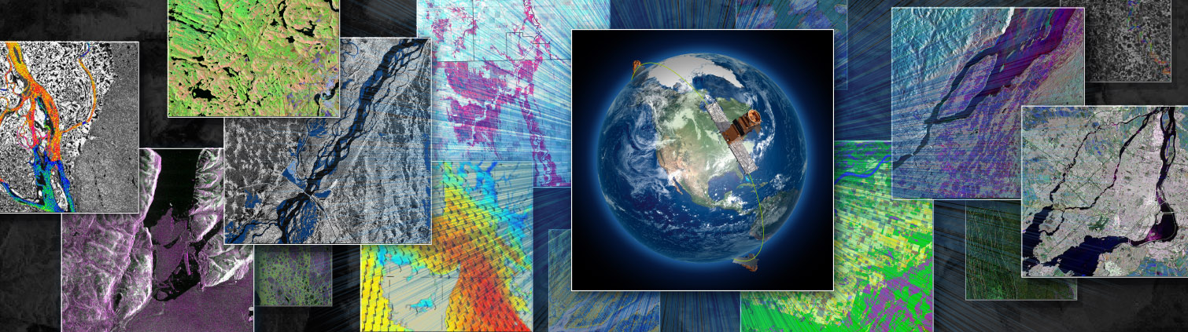
Earth Observation advantage for climate change
Notes:
Canada has been harnessing the power of space and Earth Observation using satellites to help improve our daily life in many ways. Watch this short video: Observing Earth to better protect it - Canadian Space Agency (asc-csa.gc.ca)
We rely on them for weather forecasts, emergency services, telemedicine, electronic payments, getting from place to place using GPS, optimizing crop growth, monitoring icebergs.
We also rely on them for essential data about the state of lands, ecosystems, waterways and the atmosphere. Data and images are needed to monitor change and inform decision making about how to keep communities safe, resilient and actively reducing the environmental impact of human activity on the planet.
There is an impact in getting satellites into space. It requires materials that need energy to gather and process, the burning of fuels to launch and more electricity to operate during their mission.
BUT the impact of not having this essential information is GREATER than the impacts from emissions or resource costs of building and launching a satellite.
Understanding how the climate is changing and the impacts it is having on the seasonal patterns on the ground is key to climate resilience and adaptation for all communities.
Images and data captured by satellites at regular intervals help us understand what’s happening and whether our strategies are working.
It takes more than one satellite to get the kind of information you need – different types of instruments and sensors allow scientists to gather images and measurements to understand what particles are in the atmosphere, how much snow there is and where, or understand the state of forests and track wildfires. A single satellite can't do all these jobs, and sometimes we need a constellation of satellites to get the quality of data we need. So it’s worth thinking through how we can lessen the environmental costs for satellites so we can keep using them.
Let's look closer at what satellites do.

Slide 3
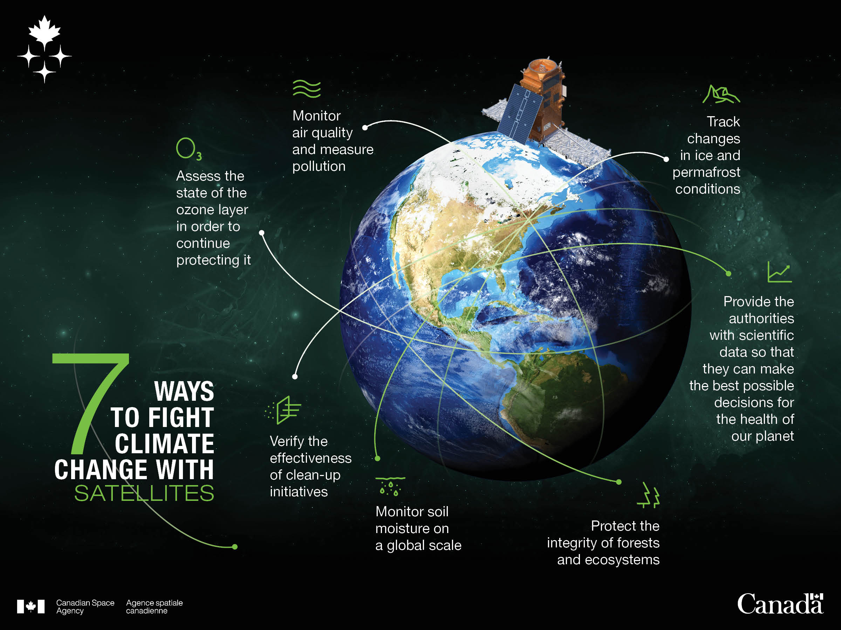
Notes:
Looking at all these contributions to our climate change response, it's clear that satellites are important and WE need them.
Using sensors and instruments and sometimes optical lenses, satellites capture and transmit data back to receiving stations on Earth as they make their orbits.
Missions are designed taking into consideration the properties of light wavelengths and how they are reflected and absorbed by different materials and surfaces.
Here are some satellite missions involving Canada.
RADARSAT and the RADARSAT Constellation Mission (RCM) What is the RCM? | Canadian Space Agency (asc-csa.gc.ca)
SWOT – Surface Water and Ocean Topography is an active mission led by NASA and France’s space agency. Canada contributed a key component that amplifies the power needed by this satellite to generate the microwave pulses that are used to measure water surface elevation. Being a contributing partner enables Canadian scientists to access software tools required to understand SWOT data.
SCISAT – is Canada’s mission to detect chemical processes in the atmosphere and the depletion of the ozone layer. The mission launched in 2003 and was originally planned for 2 years. Over 20 years later it is still operational and its mission has been extended to 2024. It traces more gases than any other space-based instrument in the world.
ADDITIONAL NOTES:
Canada’s upcoming missions:
WildFireSat – This satellite will be equipped with infrared sensors to measure the “radiative heat power” of wildfires. The mission will enhance Canada’s ability to manage wildfires by monitoring active fires daily. By increasing our capabilities to better anticipate which wildfires have the potential to burn out of control, they can be prioritized for suppression. It will also provide precise information on smoke and air quality conditions for communities.
HAWC – Stands for High-altitude Aerosols, Water vapour and Clouds. Canada will place some cutting-edge technologies on NASA’s four-satellite constellation - the Atmosphere Observing System. These will help observe mid-to high-altitude aerosol particles, measure water vapour and observe ice cloud properties. The data these instruments provide will help with predicting near-term weather events, long-term climatic conditions and air quality.
GHGSat – created by a private Canadian company with CSA support, this satellite monitors methane and CO₂ emissions from industry. Greenhouse Gas Emissions Monitoring Service - GHGSat
Potential missions under study:
AOM – Canada is leading the study for a potential Arctic Observing Mission that would provide a better understanding of climate change effects in the North. Environment and Climate Change Canada and the Canadian Space Agency would be bringing international collaborators together to give scientists a new view on weather and climate patterns.

Slide 4
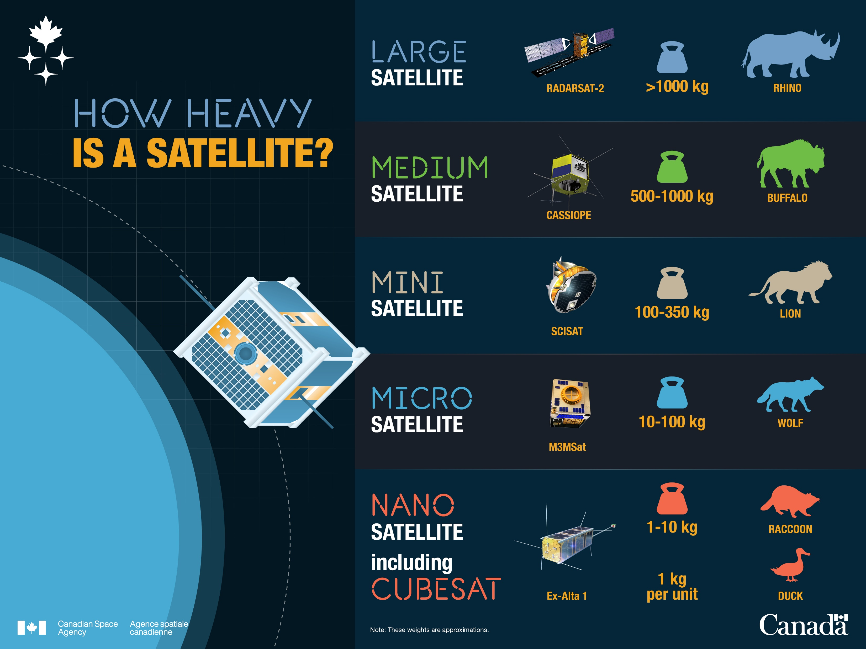
Satellites
Notes:
Not all satellites are the same! We can design them for different purposes, different life spans and different orbits.
Bigger missions are very valuable but take more time, energy and resources.
Smaller satellites are quicker to launch get us data and use less resources but often involve more than one (a constellation).
They all use similar materials to manufacture but in the case of the really small CubeSats, they are less expensive to make. Space agencies are more willing to accept some risks because of this lower cost, so some components maybe less rigorously tested for the space environment. This reduces the overall costs of multiple prototypes for testing purposes.
Some satellites may be designed for a mission of a few years, but may continue to operate past their expected end date, like SCISAT.
The toolkit has links and information about CubeSats – these tiny satellites have been a game changer and may be an avenue to explore.

Slide 5
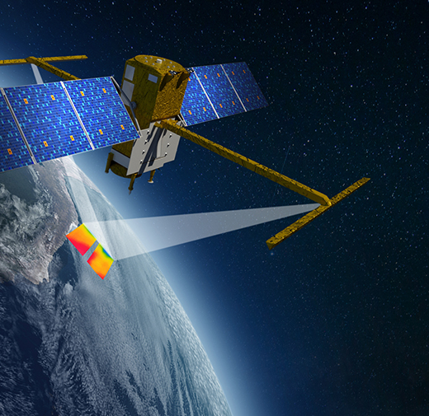
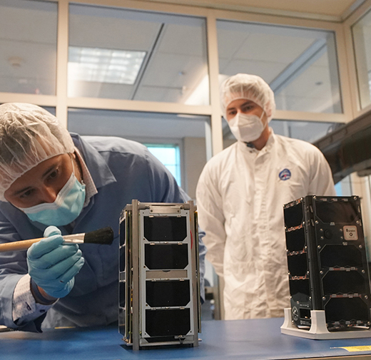
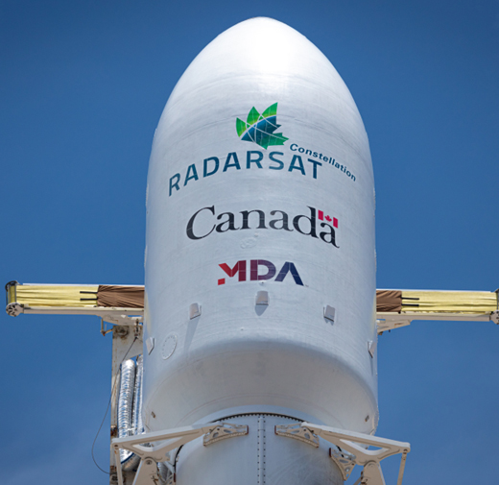
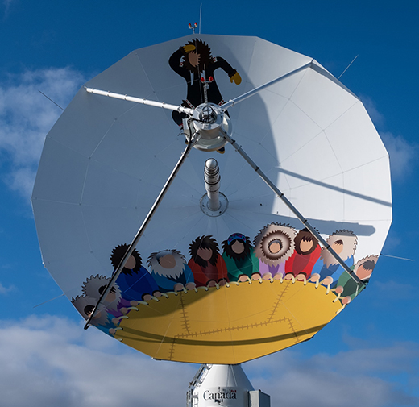
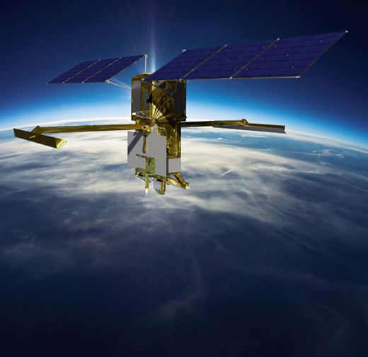
Life cycle of a mission
Design
  Purpose
  Size
  Materials
  Costing
  Duration
Build
  Sourcing materials
  Prototyping
  Manufacturing
Launch
  Fuel types
  Location
Operate
  Ground stations
  Data storage
  Life span
Decommission
  Deorbiting
  Debris
Notes:
A satellite mission starts well before a launch, which means there are many opportunities to propose solutions for reducing greenhouse gas emissions along the way.
Each step has inputs and impacts and trade-offs to consider.
There are constraints when creating an instrument that has to function in a space environment. For example, the materials used on the satellite construction are optimized for functionality and durability as well as weight and cost. But how they are gathered and transported and processed might be done in new ways.
Typical ways of lowering the environmental impact of a product or a process are looking at:
Water use
Energy use and how it's generated (from start to finish), including the lights of the buildings where the mission team works!
GHG emissions from transportation
Pollution (noise, air, water, soil, light, heat)
Waste
FUN FACT – The Blanket Toss or nalukataq depicted on the satellite dish in Inuvik is a kind of “remote sensing” – it was used to see farther and look for game while hunting.
The next slides detail each step of the life cycle. As we explore, think about the step your team would like to “hack.”

Slide 6
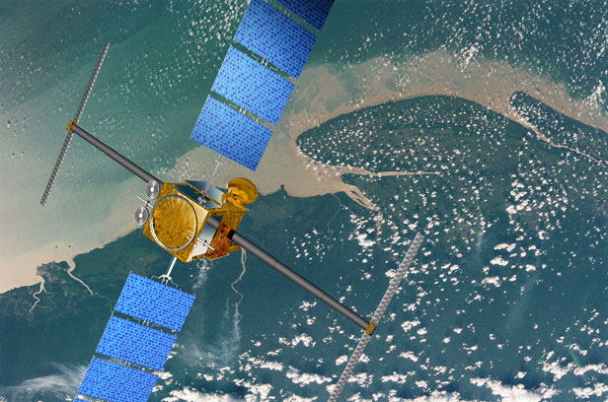
Design phase
The design phase of a satellite mission considers what technology already exists and what new instruments need to be developed to get the information scientists need.
It can involve a lot of international collaboration, research and modelling.
Notes:
Think about energy needs and use of people working on this project.
they are researching, meeting with others, using computers, collaborating with other specialists in the world.
Here we can explore energy reduction approaches for the buildings and equipment, the movement of people, and consideration of materials that can be used in creating models or prototypes.
We also work with the international community to ensure that missions have the maximum possible utilization of the data collected right from the start.
The prototyping activities enable the team to test concepts and instruments before confirming the final design.
Stratospheric balloons are used to test instruments destined for future satellite missions. They are much quicker and less costly to do than a rocket launch. Instruments need to withstand vibration, thermal changes and function in a vacuum. A number of tests take place to get to the “qualification” or “flight model.”
There is usually a model:
in the laboratory for the instrument
a demonstration model – to be flown on an airplane or stratospheric balloon
a structural and thermal model to withstand stresses and temperature changes in flight
an engineering model to test functionality and performance!
Missions can take a few months to design in the case of a CubeSat and or a few years to design in the case of a government mission.

Slide 7
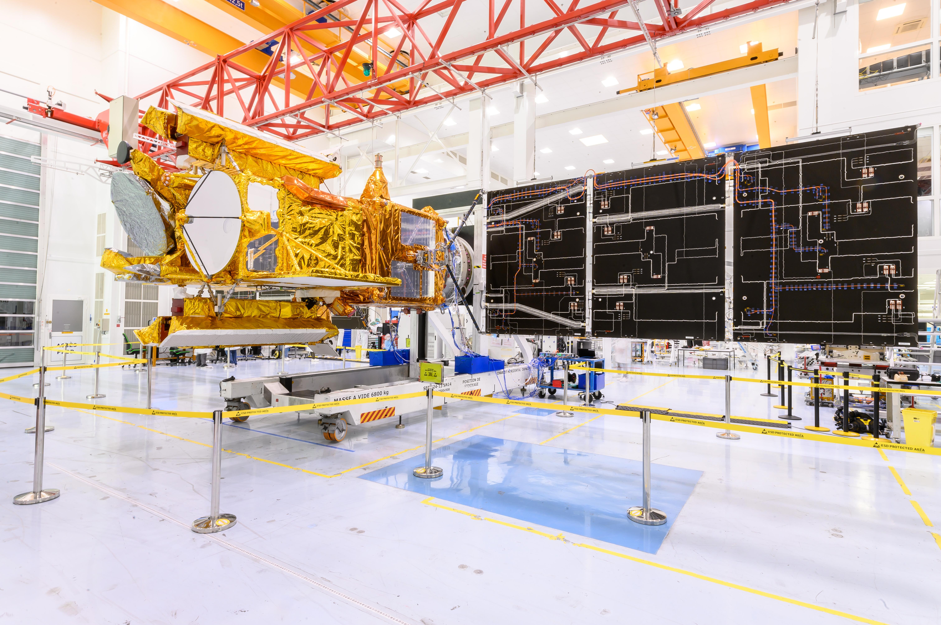
Build phase
Materials: where and how matters
Common elements in satellites | What does it do | Where does it come from | Environmental cost
Gold
Titanium
Aluminum
Lithium
Invar
Solar array test deployment
Notes:
When we calculate the environmental impact of a material, we think about where it comes from and what we need to do to be able to use it.
Materials for space-bound technology are carefully selected to perform well over their mission in the extreme conditions of space. Their weight, reaction to radiation from the Sun, and functionality in a vacuum all factor into the design.
Before the final satellite is built, several models are created to enable as much testing pre-launch as possible. Components include:
Satellite bus: Structural body that contains the command and control centre – the brain of the satellite
Satellite payload: Instruments receiving and managing all raw data collected
Thermal blankets: Thin insulation materials protecting the satellite from extreme temperature and ultraviolet radiation
Solar panels: Capturing solar energy, they provide power to the satellite
Synthetic aperture radar panels: Main instrument that emits a radar signal to Earth’s surface and receives back its echo to generate data
Automatic identification system antenna: Receives information signals emitted by vessels at sea
SOME SATELLITES HAVE PROPULSION SYSTEMS! This helps them modify their orbits as needed or to move off orbit when their mission is complete.
We can explore where the materials to make these components come from and is there a way to reduce the transportation-related emissions, where and how it is processed, the opportunity to reduce or reuse, etc. There may even be an alternative material to explore.

Slide 8
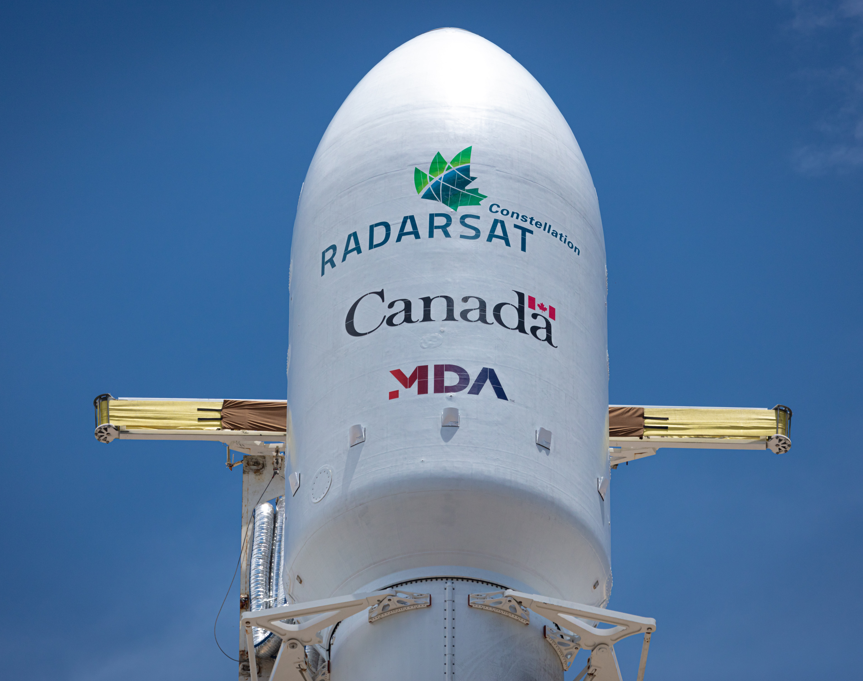
Launch phase
Getting our satellite up into space seems like moment where we could make the biggest reductions in emissions.
Many fuels are selected for the efficiency of conversion of fuel into thrust, and how stable
they are.
Location also matters for “orbital inclination” and safety – launching over the ocean in case of failure.
Notes:
Launches are the most visible/obvious moment of “emissions” to get a satellite into its orbit. There are different approaches to a rocket launch to get the thrust needed.
We can also explore all the activities around the launch such as transporting the rocket to the launch pad, running the control room, post-launch activities.
Is there an opportunity here to find cleaner fuel sources? Ways to mitigate any pollution from the stages that separate as the rocket advances on its path?
Much progress has been made:
Recycling of launch systems – think SpaceX and Blue Origin
Rideshare – carrying CubeSats along on other rocket missions to launch from orbit
Alternative energy or non-fuel methods of getting to orbit – The European Space Agency is using hydrogen for launch.

Slide 9
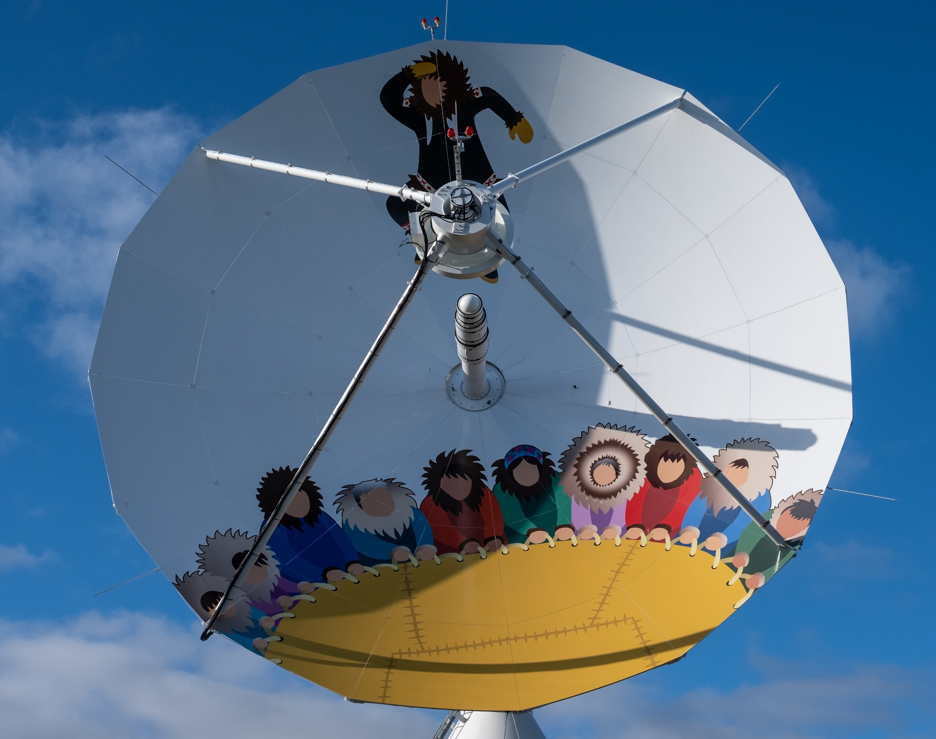
Operations phase
Once the satellite is on orbit, it sends signals and data back down to Earth to a receiving station.
The satellite itself can be drawing energy through its solar panels to harness the power from the Sun for all its work.
The computing power required to capture, process and analyze all the images and data is more than a basic computer can handle.
Notes:
In space, a satellite has batteries and solar panels to get the energy it requires to function throughout its lifespan. On Earth, there is also a “ground segment,” a physical location with receiving systems like this dish from Inuvik, Northwest Territories.
The station where this dish is operated gets some of its power from a solar array to offset greenhouse gases.
Inuvik Satellite Station Facility (canada.ca)
The solar array installed in 2021 by local industry provides clean power to offset greenhouse gases and reduce electrical utility costs.
Here we could explore more about energy consumption in computing, because once the data is collected, it needs to be stored, processed, analyzed and shared.

Slide 10
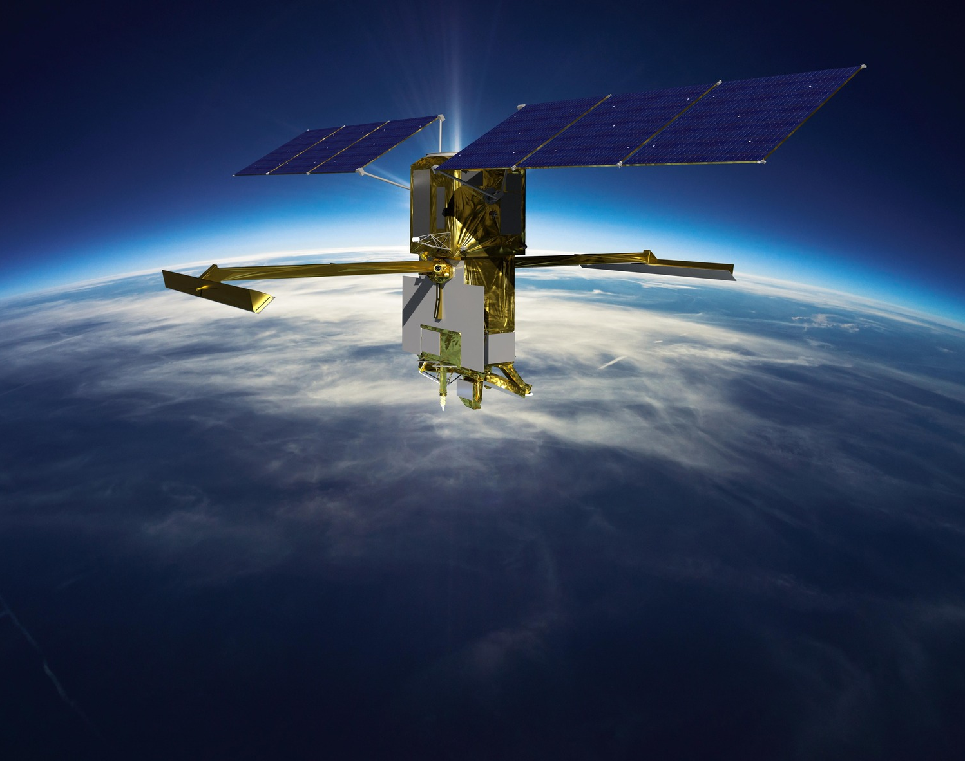
Decommissioning
Once a satellite has completed its mission, it may remain in orbit or use its last bit of fuel to pull it closer to Earth, where it will burn up in the atmosphere.
Some satellites at higher orbits are shifted further out and remain in space.
We don’t currently have a way to recapture the satellite and bring it back to recycle the materials.
Notes:
As satellites are pulled into the atmosphere by Earth’s gravity, friction caused by their speed burns them up, creating tiny particles in the upper atmosphere. More research is needed to understand the effects of these particles.
So far this is the best solution for removing the satellite from space so that it does not become an obstacle or a hazard to other mission equipment.
Here is where we might be most creative, proposing how this material could be captured and repurposed.

Slide 11
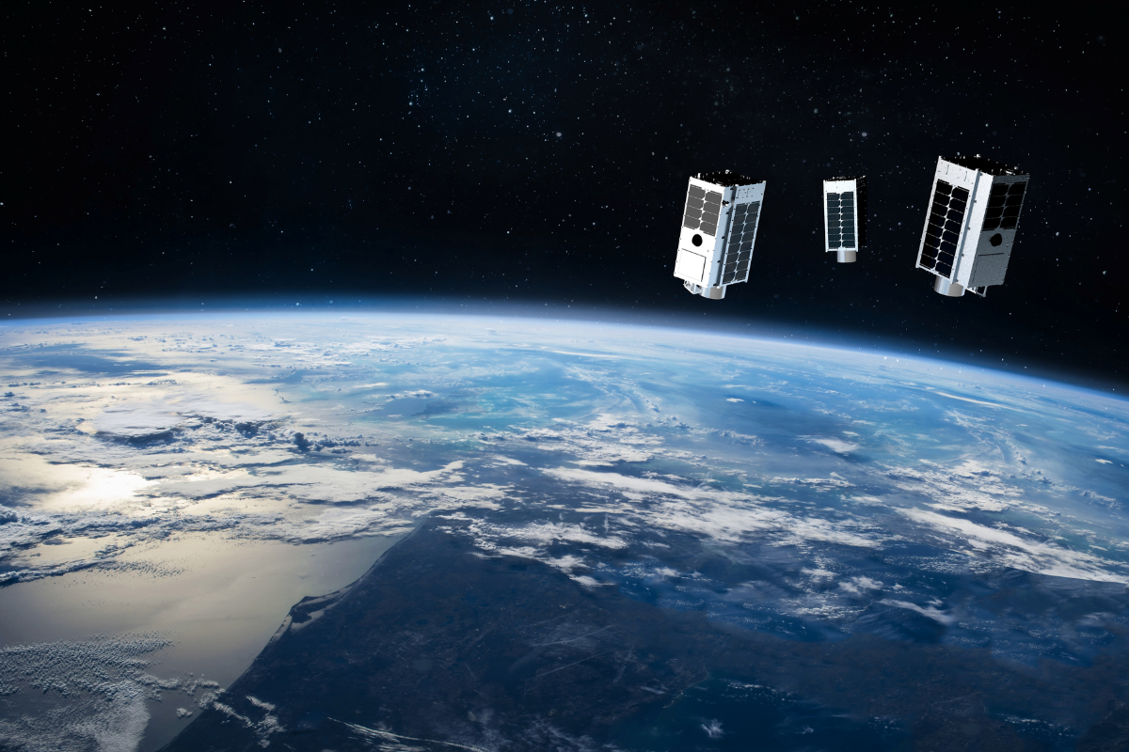
Prepare to HACK
Choose a mission phase of focus – what do you want to know more about? For example:
  Different ways of getting a satellite to orbit
  Optimizing materials for new satellites
Pick a “problem” and investigate: (water, energy, GHG emissions, etc.)
  How might you find a way to achieve the same outcome with a new approach?
Design a solution.
Test your concept with space in mind and refine. Share it with others for feedback.
Think about how your solution could also solve issues on Earth; what adaptations are needed?
Complete the form and submit. Good luck!
2022-10-07 – Artistic rendering of the three satellites (Luca, Penny and Diako) from the GHGSat fleet orbiting Earth. (Credit: GHGSat)
Notes:
As with most space endeavours, you need to break challenges down into smaller components in order to start.
For this Hack, pick a single phase.
You can start imagining ideas right away, but you will want to do a bit of research to learn more about what innovations are already happening in that area. Also think about whether your solution or idea could help in other contexts.
Good luck!

